Slide 1

Which design elements drive consumer appeal?
Consumer Product Packaging Study Appeal Report | October 2026
Prepared by: J Brown Fitterman | jbrown@mindgenomicsassociates.com
Mind Genomics Associates, Inc
Consumer Product Packaging Study

Slide 2
Inputs

Slide 3
The study in this report
Scores in the pages that follow come from this file.
Consumer Product Packaging Study
6 silos · 47 elements
150 respondents
n=150 respondents. Top-2 Box model (ratings 4–5): element lifts show movement above or below the model baseline.
3

Slide 4
How the method works
Every respondent sees their own mix of design variations, and we learn what individually moves the appeal score.
01
We slice the design into unique elements
Each element is one design choice — A_Background, B_Cookie, C_Claim, D_Logo, E_Flavour, and F_Gluten-free.
02
Each element has 4–12 possible variations
Like the small choices a designer would make between the options in a silo.
03
Each respondent sees a set of pack designs
Each pack is a unique combination of variations — never quite the same as anyone else’s.
04
They rate each one
The same rating scale is used on every task. The variation does the work.
05
We learn what drives the rating
The model separates the baseline from the movement each element creates, on its own.
n=150 respondents. Top-2 Box model (ratings 4–5): element lifts show movement above or below the model baseline.
4

Slide 5
Design elements
6 design silos, 47 element variations in total.
A
A_Background
12
B
B_Cookie
8
C
C_Claim
6
D
D_Logo
4
A01 D1 Blue Wrapper, +11
B01 Cookie Chocolate Filling Right Upper D2D3, +7
C01 Claim Full Block Fibrecollagen 33 Protein 20gno Sugar Bottom Centre D2D3, +5
D01 Logo Small Top Left D2, +3
E
E_Flavour
12
F
F_Gluten-free
5
E01 Tripple Chocolate Chip Top Centre Dark Text D2D3 Panel, +11
F01 Gluten Free Badge Dark Bottom Right D2D3, +4
Each card shows the silo letter, the element count, and a sample of the options.
n=150 respondents. Top-2 Box model (ratings 4–5): element lifts show movement above or below the model baseline.
5

Slide 6
WHAT YOU GET BACK
What design elements drive pack appeal?
01
02
Per-element scores
Base appeal
How much each variation moves the appeal rating, on its own, above or below the baseline.
The Top-2 Box intercept. The pack’s starting appeal before a single element is added.
03
04
Build-up scenarios
Full lift summary
The strongest option in each group, shown together, against a weaker combination of the same groups.
Every element, in every group, with the same score used in the charts.
n=150 respondents. Top-2 Box model (ratings 4–5): element lifts show movement above or below the model baseline.
6

Slide 7
Reading The Scores – What The Coefficients Mean
1
Element Lift Scores
Element lifts show the estimated movement each design choice creates above or below the model baseline.
2
Explore Combinations
3
Reading The Scale
These scores can be combined to explore multiple design scenarios.
Coefficient Interpretation
Coefficient Scale | Interpretation
+10 or higher | Strong lift
+5 to +9.9 | Moderate lift
+2 to +4.9 | Small lift
Below +2 | Minimal / weak lift
n=150 respondents. Top-2 Box model (ratings 4–5): element lifts show movement above or below the model baseline.
7

Slide 8
Key Findings

Slide 9
KEY FINDINGS
Where appeal moves
The strongest movement comes from the silos and elements below. Detail charts for every silo follow.
01
The model has a clear starting point
This Top-2 Box model was fit without an intercept. Each element score is the lift on its own.
02
B01 Cookie Chocolate Filling Right Upper D2D3 is the strongest single cue
In B_Cookie, B01 Cookie Chocolate Filling Right Upper D2D3 moves appeal by +26. 47 of 47 elements sit above the baseline.
03
B_Cookie is the lead design area
B01 Cookie Chocolate Filling Right Upper D2D3 tops this silo at +26. E_Flavour has the widest spread, +15 points from E04 Orange Chocolate Top Centre Dark Text D2D3 Panel to E08 Banana Chocolate Top Left Dark Text Panel.
04
D01 Logo Small Top Left D2 is the largest drag
In D_Logo, D01 Logo Small Top Left D2 sits at +3. Negative lifts pull the appeal score below the model baseline.
n=150 respondents. Top-2 Box model (ratings 4–5): element lifts show movement above or below the model baseline.
9

Slide 10
MODEL OVERVIEW: BASE APPEAL
Base appeal before element lift
Base appeal is this model’s starting Top-2 Box score (ratings 4–5) before individual design elements add or subtract lift.
BASE APPEAL
HOW TO USE IT
Consumer Product Packaging Study
Each element chart is movement around this number, not a new total by itself.
No intercept
A build-up adds the baseline and one lift from each silo. That sum is a model scenario. It is not capped at 0 or 100.
Element scores are the lift on their own
Base size 150
n=150 respondents. Top-2 Box model (ratings 4–5): element lifts show movement above or below the model baseline.
10

Slide 11
KEY FINDINGS
Appeal moves most clearly
in four design areas
These are the silos where one element, or the gap inside the silo, moves appeal the most.
ROADMAP FOR THE READ
01
02
03
04
B_Cookie
E_Flavour
C_Claim
A_Background
B01 Cookie Chocolate Filling Right Upper D2D3 leads at +26.
Low end is B06 Cookie Orange Filling Right Lower D1.
E08 Banana Chocolate Top Left Dark Text Panel leads at +23.
Low end is E04 Orange Chocolate Top Centre Dark Text D2D3 Panel.
C04 Claim Full Block Fibrecollagen 33 Protein 20gno Sugar Mid Left D1 leads at +23.
Low end is C03 Claim 33 Protein Only Bottom Centre D2D3.
A06 D2 Orange Wrapper leads at +18.
Low end is A03 D1 Yellow Wrapper.
The clearest appeal movement is concentrated in B_Cookie, E_Flavour, C_Claim, and A_Background.
n=150 respondents. Top-2 Box model (ratings 4–5): element lifts show movement above or below the model baseline.
11

Slide 12
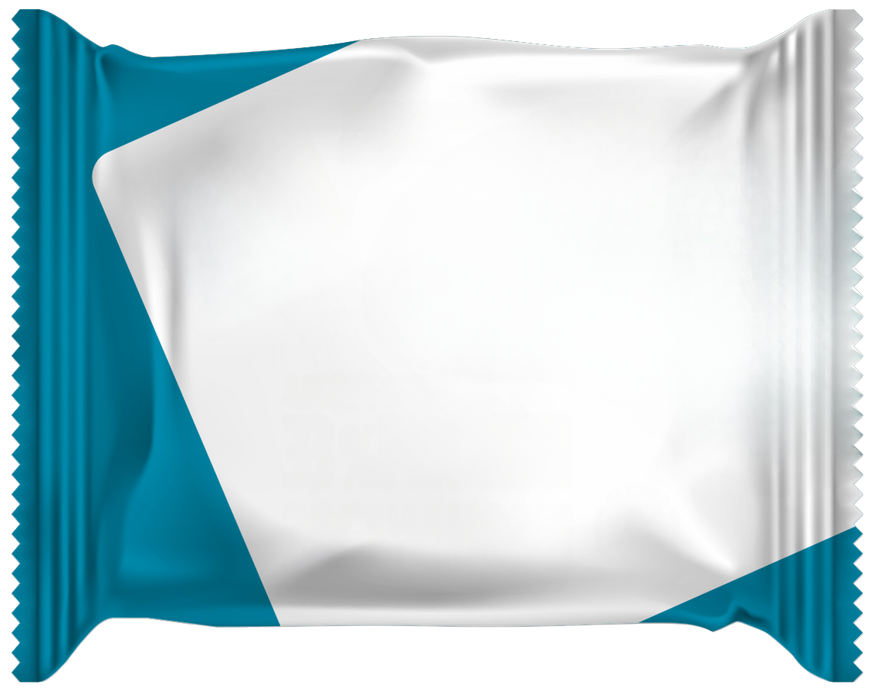
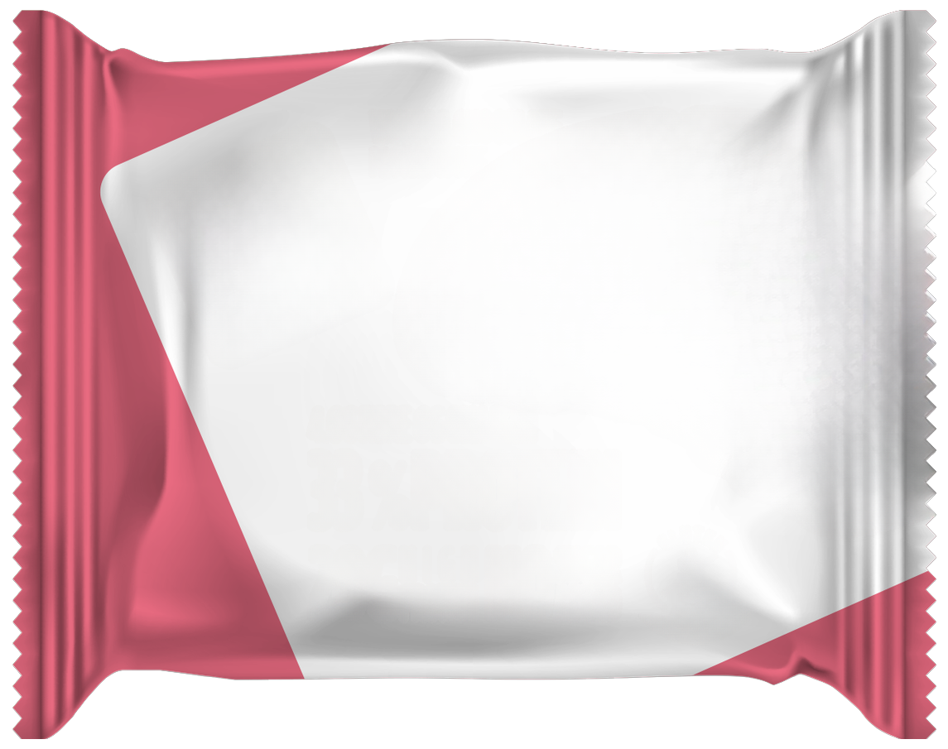
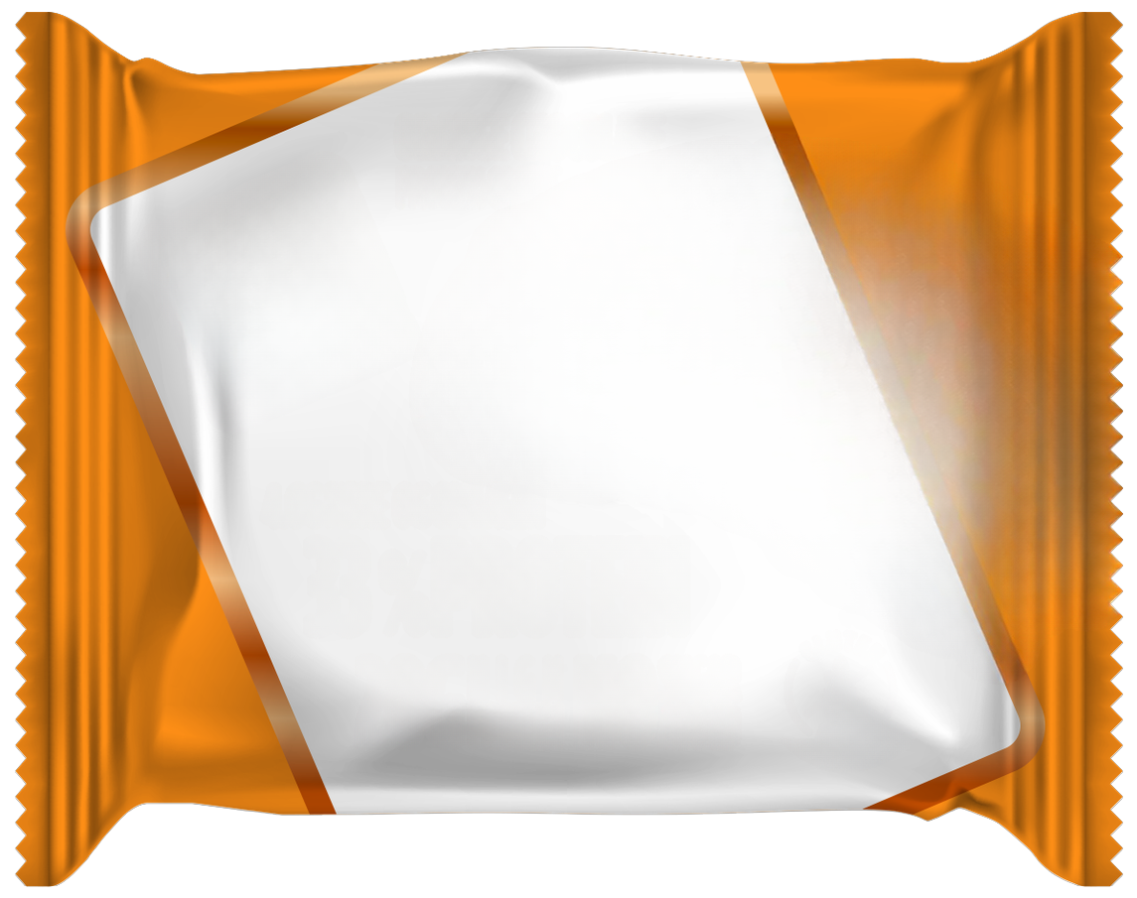
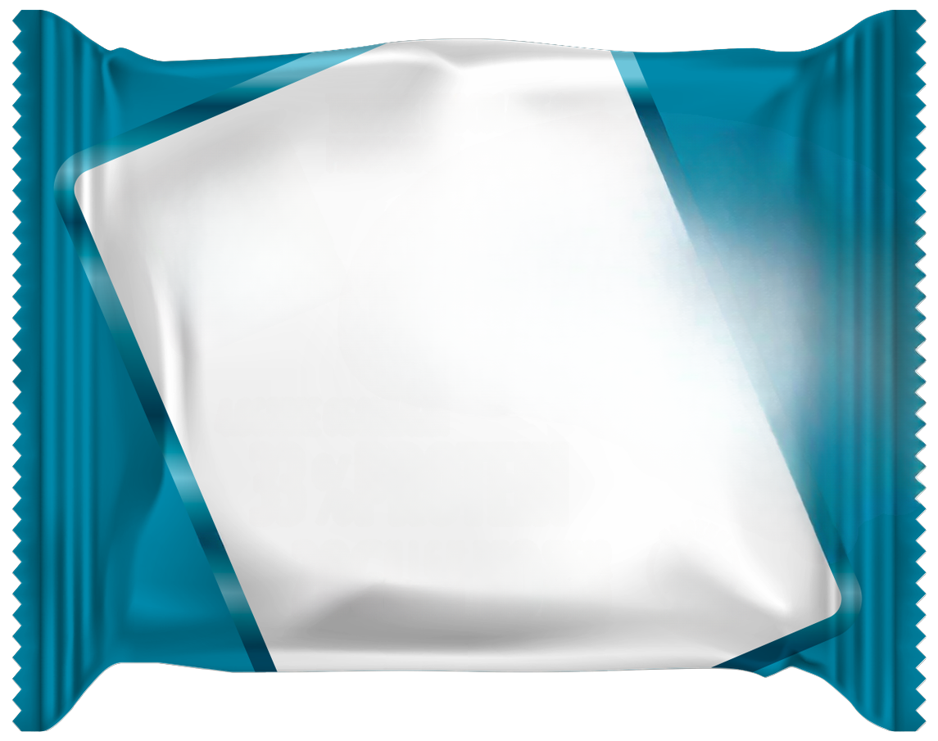
KEY FINDINGS: A_BACKGROUND · Can you read english? · 1 of 3
A_Background splits across the groups
No favors A09 D3 Blue Wrapper; Yes favor A06 D2 Orange Wrapper.
A_BACKGROUND
A09 D3 Blue
Wrapper
+23
+17
A09 D3 Blue Wrapper
D3 Pink Wrapper
+20*
+18*
D3 Pink Wrapper
+19
+16
A06 D2 Orange
Wrapper
+18
+18
A05 D2 Blue
Wrapper
+3
+17
A06 D2 Orange
Wrapper
A05 D2 Blue Wrapper
0
10
20
30
+18*
+10*
No (basesize = 1)
Yes (basesize = 149)
No favors A09 D3 Blue Wrapper; Yes favor A06 D2 Orange Wrapper. The widest segment gap is A01 D1 Blue Wrapper: -6 no / +13 yes.
No basesize = 1; Yes basesize = 149. Top-2 scores rounded to whole points. *Average of the groups in the legend.
12

Slide 13

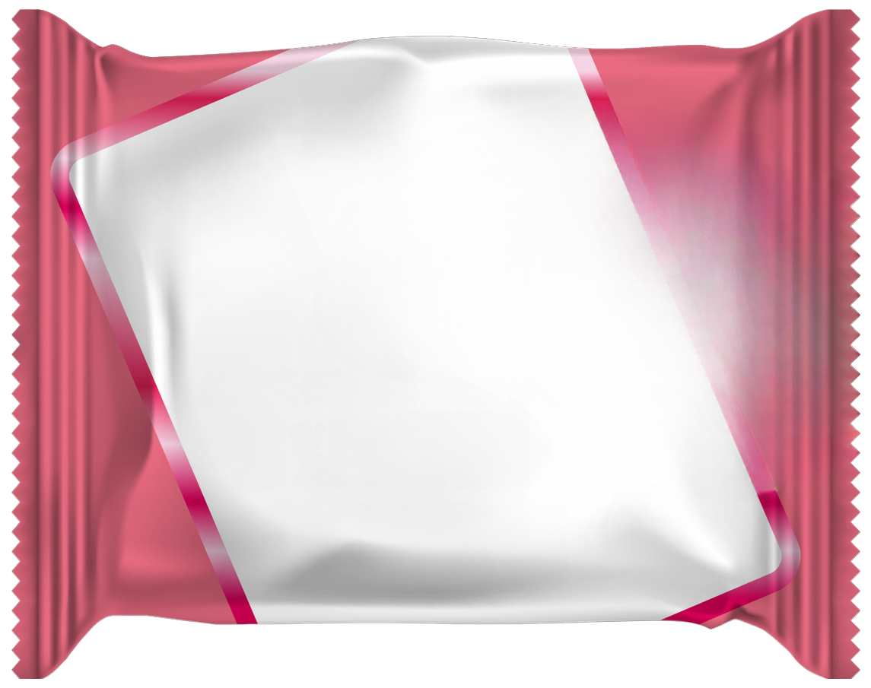
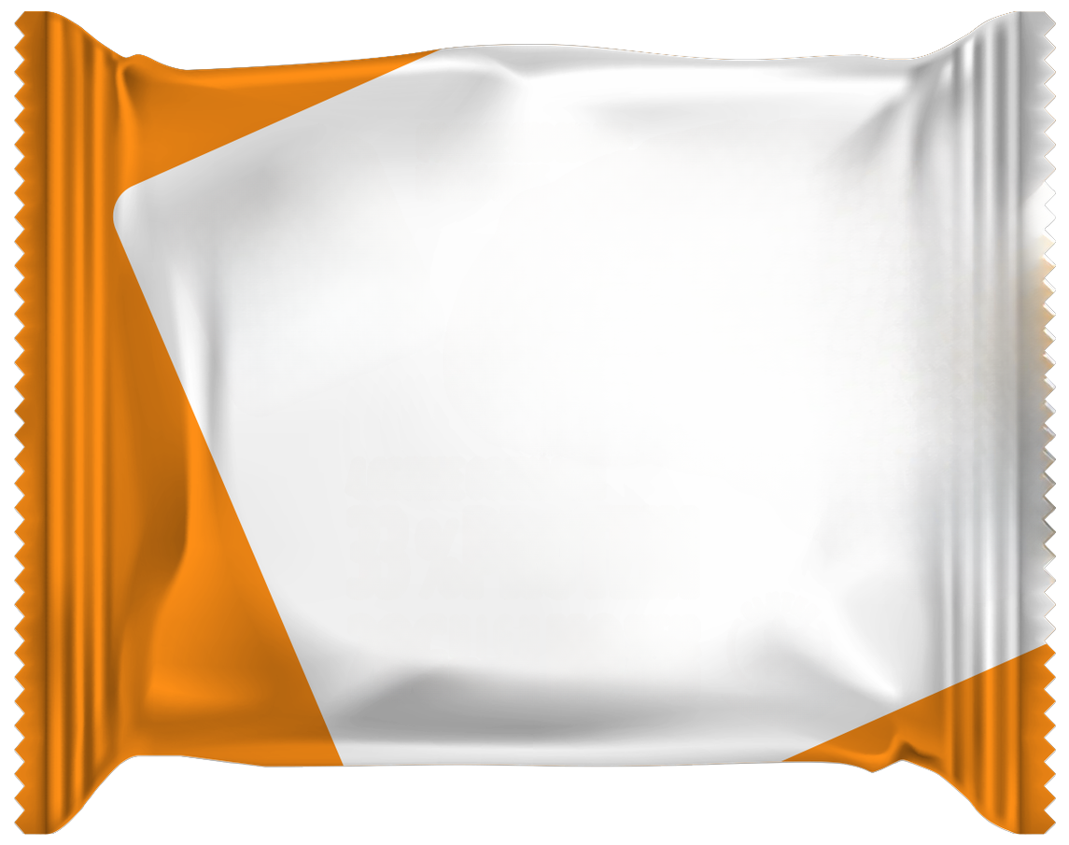
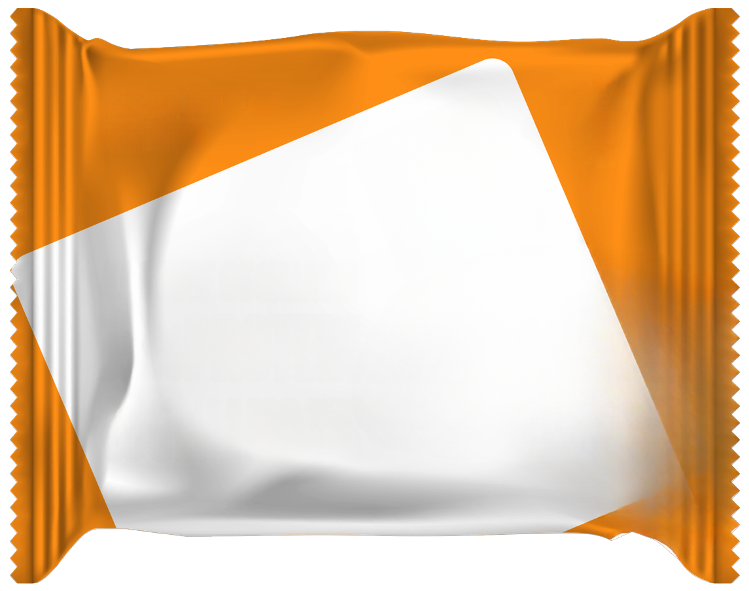
KEY FINDINGS: A_BACKGROUND · Can you read english? · 2 of 3
A_Background splits across the groups
No favors A09 D3 Blue Wrapper; Yes favor A06 D2 Orange Wrapper.
A_BACKGROUND
A07 D2 Yellow
Wrapper
-1
+17
A07 D2 Yellow
Wrapper
A08 D2 Pink Wrapper
+8*
+14*
A08 D2 Pink
Wrapper
+10
+17
D3 Orange
Wrapper
+7
+16
A02 D1 Orange
Wrapper
+13
+14
D3 Orange Wrapper
A02 D1 Orange
Wrapper
-10
0
10
20
+12*
+14*
No (basesize = 1)
Yes (basesize = 149)
No favors A09 D3 Blue Wrapper; Yes favor A06 D2 Orange Wrapper. The widest segment gap is A01 D1 Blue Wrapper: -6 no / +13 yes.
No basesize = 1; Yes basesize = 149. Top-2 scores rounded to whole points. *Average of the groups in the legend.
13

Slide 14
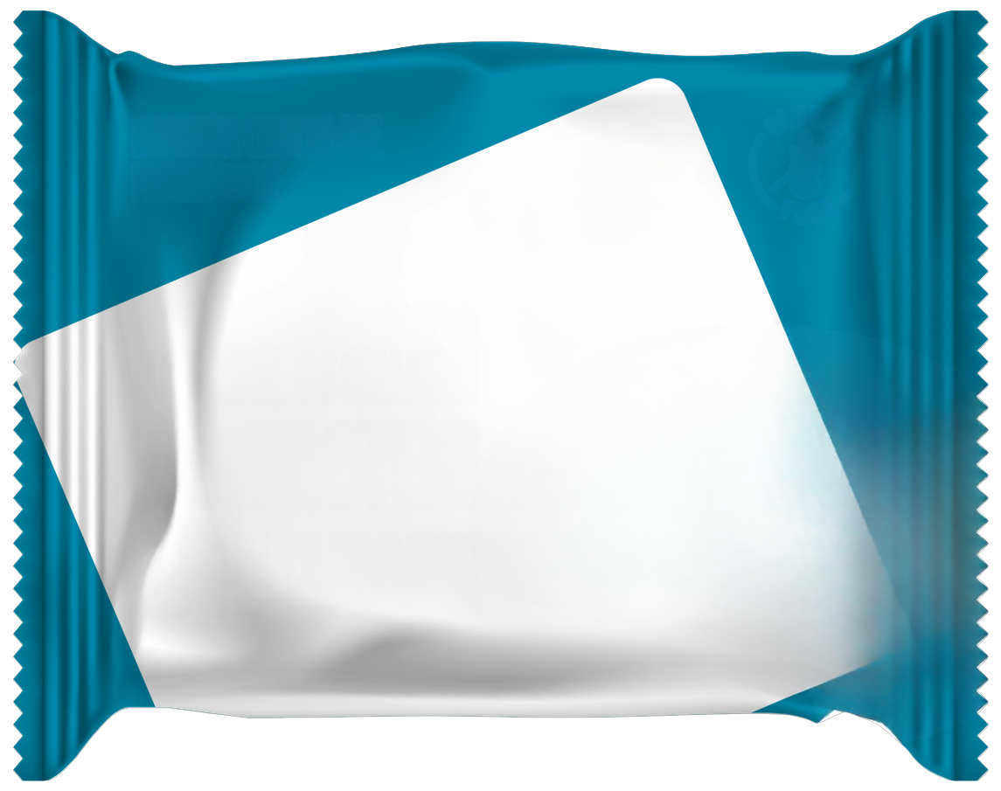
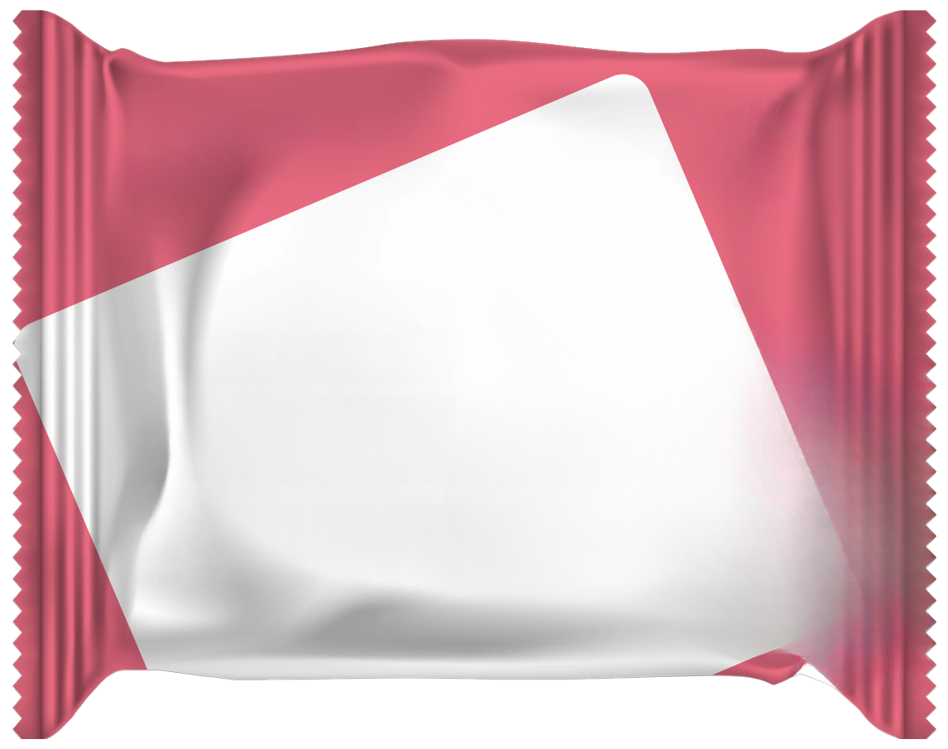
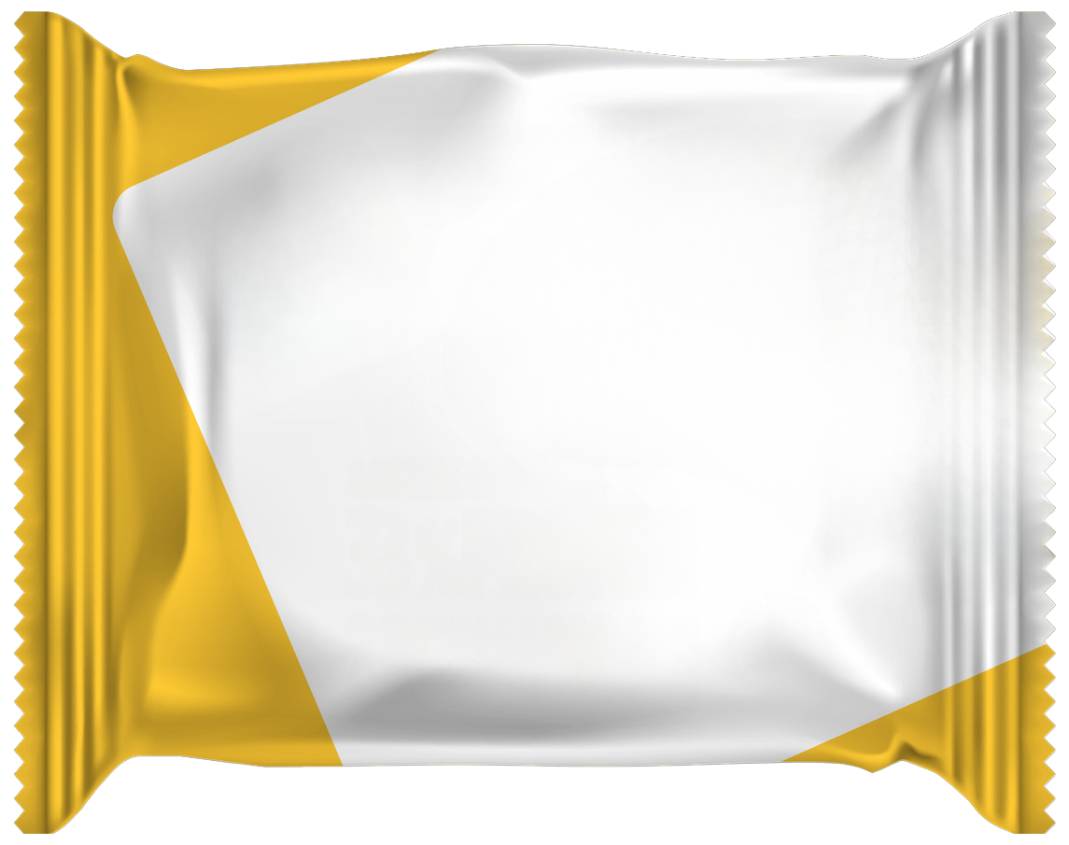

KEY FINDINGS: A_BACKGROUND · Can you read english? · 3 of 3
A_Background splits across the groups
No favors A09 D3 Blue Wrapper; Yes favor A06 D2 Orange Wrapper.
A_BACKGROUND
A01 D1 Blue
Wrapper
-6
+13
A01 D1 Blue Wrapper
A04 D1 Pink Wrapper
+4*
+9*
A04 D1 Pink
Wrapper
+5
+13
D3 Yellow
Wrapper
+11
+13
A03 D1 Yellow
Wrapper
+5
+10
D3 Yellow Wrapper
A03 D1 Yellow
Wrapper
-10
0
10
20
+12*
+8*
No (basesize = 1)
Yes (basesize = 149)
No favors A09 D3 Blue Wrapper; Yes favor A06 D2 Orange Wrapper. The widest segment gap is A01 D1 Blue Wrapper: -6 no / +13 yes.
No basesize = 1; Yes basesize = 149. Top-2 scores rounded to whole points. *Average of the groups in the legend.
14

Slide 15
KEY FINDINGS: A_BACKGROUND · Which of these countries do you live in? · 1 of 3
A_Background splits across the groups
Bulgaria favors A06 D2 Orange Wrapper; Greece favors A06 D2 Orange Wrapper; Saudi Arabia favors A01 D1 Blue Wrapper.
A_BACKGROUND
A06 D2 Orange
Wrapper
+23
+17
A06 D2 Orange
Wrapper
A07 D2 Yellow
Wrapper
+15
+18*
+16*
A07 D2 Yellow
Wrapper
+21
+12
+16
A05 D2 Blue
Wrapper
+20
+12
+17
A08 D2 Pink
Wrapper
+20
+14
A05 D2 Blue Wrapper
A08 D2 Pink Wrapper
+15
0
10
20
30
+16*
+16*
Bulgaria (basesize = 50)
Greece (basesize = 49)
Saudi Arabia (basesize = 51)
Bulgaria favors A06 D2 Orange Wrapper; Greece favors A06 D2 Orange Wrapper; Saudi Arabia favors A01 D1 Blue Wrapper. The widest segment gap is A01 D1 Blue Wrapper: +13 bulgaria / +8 greece / +17 saudi arabia.
Bulgaria basesize = 50; Greece basesize = 49; Saudi Arabia basesize = 51. Top-2 scores rounded to whole points. *Average of the groups in the legend.
15

Slide 16
KEY FINDINGS: A_BACKGROUND · Which of these countries do you live in? · 2 of 3
A_Background splits across the groups
Bulgaria favors A06 D2 Orange Wrapper; Greece favors A06 D2 Orange Wrapper; Saudi Arabia favors A01 D1 Blue Wrapper.
A_BACKGROUND
D3 Pink Wrapper
+20
+12
D3 Pink Wrapper
A09 D3 Blue Wrapper
+15
+16*
+17*
A09 D3 Blue
Wrapper
+18
+17
+17
A01 D1 Blue
Wrapper
+13
+8
+17
A02 D1 Orange
Wrapper
+11
+12
A01 D1 Blue Wrapper
A02 D1 Orange
Wrapper
+17
0
5
10
15
20
+13*
+13*
Bulgaria (basesize = 50)
Greece (basesize = 49)
Saudi Arabia (basesize = 51)
Bulgaria favors A06 D2 Orange Wrapper; Greece favors A06 D2 Orange Wrapper; Saudi Arabia favors A01 D1 Blue Wrapper. The widest segment gap is A01 D1 Blue Wrapper: +13 bulgaria / +8 greece / +17 saudi arabia.
Bulgaria basesize = 50; Greece basesize = 49; Saudi Arabia basesize = 51. Top-2 scores rounded to whole points. *Average of the groups in the legend.
16

Slide 17
KEY FINDINGS: A_BACKGROUND · Which of these countries do you live in? · 3 of 3
A_Background splits across the groups
Bulgaria favors A06 D2 Orange Wrapper; Greece favors A06 D2 Orange Wrapper; Saudi Arabia favors A01 D1 Blue Wrapper.
A_BACKGROUND
D3 Orange
Wrapper
+14
+17
D3 Orange Wrapper
D3 Yellow Wrapper
+16
+16*
+14*
D3 Yellow
Wrapper
+17
+14
+10
A04 D1 Pink
Wrapper
+14
+14
+12
A03 D1 Yellow
Wrapper
+11
+9
A04 D1 Pink Wrapper
A03 D1 Yellow
Wrapper
+11
0
5
10
15
20
+13*
+10*
Bulgaria (basesize = 50)
Greece (basesize = 49)
Saudi Arabia (basesize = 51)
Bulgaria favors A06 D2 Orange Wrapper; Greece favors A06 D2 Orange Wrapper; Saudi Arabia favors A01 D1 Blue Wrapper. The widest segment gap is A01 D1 Blue Wrapper: +13 bulgaria / +8 greece / +17 saudi arabia.
Bulgaria basesize = 50; Greece basesize = 49; Saudi Arabia basesize = 51. Top-2 scores rounded to whole points. *Average of the groups in the legend.
17

Slide 18
KEY FINDINGS: A_BACKGROUND · Do you currently consume protein-enriched food products · 1 of 3
A_Background splits across the groups
No, and I am not interested favors D3 Pink Wrapper; No, but I am interested in trying them favors A07 D2 Yellow Wrapper; Yes, occasionally favors A06 D2 Orange Wrapper; Yes, regularly favors A09 D3 Blue Wrapper.
A_BACKGROUND
A09 D3 Blue
Wrapper
0
+6
+11
A09 D3 Blue Wrapper
A06 D2 Orange
Wrapper
+26
A06 D2 Orange
Wrapper
+8
+11*
+15*
+14
+14
+23
A08 D2 Pink
Wrapper
+4
+10
+11
+23
A05 D2 Blue
Wrapper
-10
+9
+13
+22
-20
0
20
40
A08 D2 Pink Wrapper
A05 D2 Blue Wrapper
No, and I am not interested (basesize = 5)
+12*
+8*
No, but I am interested in trying them (basesize = 15)
Yes, occasionally (basesize = 56)
Yes, regularly (basesize = 74)
No, and I am not interested favors D3 Pink Wrapper; No, but I am interested in trying them favors A07 D2 Yellow Wrapper; Yes, occasionally favors A06 D2 Orange Wrapper; Yes, regularly favors A09 D3 Blue Wrapper. The widest segment gap is A05 D2 Blue Wrapper: -10 no, and i am not interested / +9 no, but i am interested in trying them / +13 yes, occasionally / +22 yes, regularly.
Top-2 scores rounded to whole points. *Average of the groups in the legend.
18

Slide 19
KEY FINDINGS: A_BACKGROUND · Do you currently consume protein-enriched food products · 2 of 3
A_Background splits across the groups
No, and I am not interested favors D3 Pink Wrapper; No, but I am interested in trying them favors A07 D2 Yellow Wrapper; Yes, occasionally favors A06 D2 Orange Wrapper; Yes, regularly favors A09 D3 Blue Wrapper.
A_BACKGROUND
A07 D2 Yellow
Wrapper
+4
+22
+9
A07 D2 Yellow
Wrapper
D3 Yellow Wrapper
+22
D3 Yellow
Wrapper
+6
+14*
+11*
+6
+11
+20
D3 Pink Wrapper
+9
+17
+11
+20
A04 D1 Pink
Wrapper
0
+9
+8
+19
0
10
20
30
D3 Pink Wrapper
A04 D1 Pink Wrapper
No, and I am not interested (basesize = 5)
+14*
+9*
No, but I am interested in trying them (basesize = 15)
Yes, occasionally (basesize = 56)
Yes, regularly (basesize = 74)
No, and I am not interested favors D3 Pink Wrapper; No, but I am interested in trying them favors A07 D2 Yellow Wrapper; Yes, occasionally favors A06 D2 Orange Wrapper; Yes, regularly favors A09 D3 Blue Wrapper. The widest segment gap is A05 D2 Blue Wrapper: -10 no, and i am not interested / +9 no, but i am interested in trying them / +13 yes, occasionally / +22 yes, regularly.
Top-2 scores rounded to whole points. *Average of the groups in the legend.
19

Slide 20
KEY FINDINGS: A_BACKGROUND · Do you currently consume protein-enriched food products · 3 of 3
A_Background splits across the groups
No, and I am not interested favors D3 Pink Wrapper; No, but I am interested in trying them favors A07 D2 Yellow Wrapper; Yes, occasionally favors A06 D2 Orange Wrapper; Yes, regularly favors A09 D3 Blue Wrapper.
A_BACKGROUND
D3 Orange
Wrapper
-8
+14
+13
D3 Orange Wrapper
A01 D1 Blue Wrapper
+19
A01 D1 Blue
Wrapper
-2
+10*
+8*
+10
+9
+17
A02 D1 Orange
Wrapper
+1
+13
+10
+17
A03 D1 Yellow
Wrapper
+4
+8
+6
+15
-20
-10
0
10
20
A02 D1 Orange
Wrapper
A03 D1 Yellow
Wrapper
No, and I am not interested (basesize = 5)
+10*
+8*
No, but I am interested in trying them (basesize = 15)
Yes, occasionally (basesize = 56)
Yes, regularly (basesize = 74)
No, and I am not interested favors D3 Pink Wrapper; No, but I am interested in trying them favors A07 D2 Yellow Wrapper; Yes, occasionally favors A06 D2 Orange Wrapper; Yes, regularly favors A09 D3 Blue Wrapper. The widest segment gap is A05 D2 Blue Wrapper: -10 no, and i am not interested / +9 no, but i am interested in trying them / +13 yes, occasionally / +22 yes, regularly.
Top-2 scores rounded to whole points. *Average of the groups in the legend.
20

Slide 21
KEY FINDINGS: A_BACKGROUND · What would be your ideal way to consume protein-enriched products? · 1 of 3
A_Background splits across the groups
Other favors A07 D2 Yellow Wrapper; Protein bars favor A06 D2 Orange Wrapper; Protein cookies favor A01 D1 Blue Wrapper; Protein powder favors A07 D2 Yellow Wrapper.
A_BACKGROUND
A06 D2 Orange
Wrapper
+9
+23
+18
A06 D2 Orange
Wrapper
D3 Pink Wrapper
+7
+14*
+14*
D3 Pink Wrapper
+11
+23
+8
+13
A05 D2 Blue
Wrapper
+4
+22
+10
+15
A07 D2 Yellow
Wrapper
+17
+19
+14
+22
A05 D2 Blue Wrapper
A07 D2 Yellow
Wrapper
0
10
20
30
+13*
+18*
Other (basesize = 10)
Protein bars (basesize = 52)
Protein cookies (basesize = 80)
Protein powder (basesize = 8)
Other favors A07 D2 Yellow Wrapper; Protein bars favor A06 D2 Orange Wrapper; Protein cookies favor A01 D1 Blue Wrapper; Protein powder favors A07 D2 Yellow Wrapper. The widest segment gap is A01 D1 Blue Wrapper: +7 other / +8 protein bars / +18 protein cookies / -3 protein powder.
Top-2 scores rounded to whole points. *Average of the groups in the legend.
21

Slide 22
KEY FINDINGS: A_BACKGROUND · What would be your ideal way to consume protein-enriched products? · 2 of 3
A_Background splits across the groups
Other favors A07 D2 Yellow Wrapper; Protein bars favor A06 D2 Orange Wrapper; Protein cookies favor A01 D1 Blue Wrapper; Protein powder favors A07 D2 Yellow Wrapper.
A_BACKGROUND
A08 D2 Pink
Wrapper
+12
+20
+16
A08 D2 Pink Wrapper
A09 D3 Blue Wrapper
+11
+15*
+17*
A09 D3 Blue
Wrapper
+14
+20
+16
+17
A02 D1 Orange
Wrapper
+12
+12
+14
+19
D3 Yellow
Wrapper
+8
+19
+2
+12
A02 D1 Orange
Wrapper
D3 Yellow Wrapper
0
5
10
15
20
+14*
+10*
Other (basesize = 10)
Protein bars (basesize = 52)
Protein cookies (basesize = 80)
Protein powder (basesize = 8)
Other favors A07 D2 Yellow Wrapper; Protein bars favor A06 D2 Orange Wrapper; Protein cookies favor A01 D1 Blue Wrapper; Protein powder favors A07 D2 Yellow Wrapper. The widest segment gap is A01 D1 Blue Wrapper: +7 other / +8 protein bars / +18 protein cookies / -3 protein powder.
Top-2 scores rounded to whole points. *Average of the groups in the legend.
22

Slide 23
KEY FINDINGS: A_BACKGROUND · What would be your ideal way to consume protein-enriched products? · 3 of 3
A_Background splits across the groups
Other favors A07 D2 Yellow Wrapper; Protein bars favor A06 D2 Orange Wrapper; Protein cookies favor A01 D1 Blue Wrapper; Protein powder favors A07 D2 Yellow Wrapper.
A_BACKGROUND
A01 D1 Blue
Wrapper
+7
+8
+18
A01 D1 Blue Wrapper
A04 D1 Pink Wrapper
-3
+8*
+10*
A04 D1 Pink
Wrapper
+3
+17
+8
+13
D3 Orange
Wrapper
+2
+17
+7
+17
A03 D1 Yellow
Wrapper
+8
+8
+12
+10
D3 Orange Wrapper
A03 D1 Yellow
Wrapper
-10
0
10
20
+11*
+10*
Other (basesize = 10)
Protein bars (basesize = 52)
Protein cookies (basesize = 80)
Protein powder (basesize = 8)
Other favors A07 D2 Yellow Wrapper; Protein bars favor A06 D2 Orange Wrapper; Protein cookies favor A01 D1 Blue Wrapper; Protein powder favors A07 D2 Yellow Wrapper. The widest segment gap is A01 D1 Blue Wrapper: +7 other / +8 protein bars / +18 protein cookies / -3 protein powder.
Top-2 scores rounded to whole points. *Average of the groups in the legend.
23

Slide 24
KEY FINDINGS: A_BACKGROUND · How familiar are you with the Fitspo brand? · 1 of 3
A_Background splits across the groups
Heard of it, but know little about it favors A06 D2 Orange Wrapper; Not familiar at all favors A07 D2 Yellow Wrapper; Somewhat familiar favors A06 D2 Orange Wrapper; Very familiar favors A05 D2 Blue Wrapper.
A_BACKGROUND
A05 D2 Blue
Wrapper
+4
+8
+20
A05 D2 Blue Wrapper
A09 D3 Blue Wrapper
+22
+14*
+15*
A09 D3 Blue
Wrapper
+7
+11
+21
+22
A06 D2 Orange
Wrapper
+12
+13
+21
+21
A08 D2 Pink
Wrapper
+7
+12
+19
+21
A06 D2 Orange
Wrapper
A08 D2 Pink Wrapper
0
10
20
30
+17*
+15*
Heard of it, but know little about it (basesize = 22)
Not familiar at all (basesize = 25)
Somewhat familiar (basesize = 49)
Very familiar (basesize = 54)
Heard of it, but know little about it favors A06 D2 Orange Wrapper; Not familiar at all favors A07 D2 Yellow Wrapper; Somewhat familiar favors A06 D2 Orange Wrapper; Very familiar favors A05 D2 Blue Wrapper. The widest segment gap is D3 Yellow Wrapper: -4 heard of it, but know little about it / +8 not familiar at all / +17 somewhat familiar / +20 very familiar.
Top-2 scores rounded to whole points. *Average of the groups in the legend.
24

Slide 25
KEY FINDINGS: A_BACKGROUND · How familiar are you with the Fitspo brand? · 2 of 3
A_Background splits across the groups
Heard of it, but know little about it favors A06 D2 Orange Wrapper; Not familiar at all favors A07 D2 Yellow Wrapper; Somewhat familiar favors A06 D2 Orange Wrapper; Very familiar favors A05 D2 Blue Wrapper.
A_BACKGROUND
D3 Pink Wrapper
+5
+11
+21
D3 Pink Wrapper
A02 D1 Orange
Wrapper
+19
+14*
+12*
A02 D1 Orange
Wrapper
+7
+7
+20
+13
A07 D2 Yellow
Wrapper
+11
+14
+17
+20
D3 Orange
Wrapper
+8
+13
+16
+20
A07 D2 Yellow
Wrapper
D3 Orange Wrapper
0
10
20
30
+16*
+14*
Heard of it, but know little about it (basesize = 22)
Not familiar at all (basesize = 25)
Somewhat familiar (basesize = 49)
Very familiar (basesize = 54)
Heard of it, but know little about it favors A06 D2 Orange Wrapper; Not familiar at all favors A07 D2 Yellow Wrapper; Somewhat familiar favors A06 D2 Orange Wrapper; Very familiar favors A05 D2 Blue Wrapper. The widest segment gap is D3 Yellow Wrapper: -4 heard of it, but know little about it / +8 not familiar at all / +17 somewhat familiar / +20 very familiar.
Top-2 scores rounded to whole points. *Average of the groups in the legend.
25

Slide 26
KEY FINDINGS: A_BACKGROUND · How familiar are you with the Fitspo brand? · 3 of 3
A_Background splits across the groups
Heard of it, but know little about it favors A06 D2 Orange Wrapper; Not familiar at all favors A07 D2 Yellow Wrapper; Somewhat familiar favors A06 D2 Orange Wrapper; Very familiar favors A05 D2 Blue Wrapper.
A_BACKGROUND
D3 Yellow
Wrapper
-4
+8
+17
D3 Yellow Wrapper
A04 D1 Pink Wrapper
+20
+10*
+11*
A04 D1 Pink
Wrapper
+3
+7
+14
+19
A01 D1 Blue
Wrapper
+7
+9
+14
+16
A03 D1 Yellow
Wrapper
+1
+4
+11
+16
A01 D1 Blue Wrapper
A03 D1 Yellow
Wrapper
-10
0
10
20
+12*
+8*
Heard of it, but know little about it (basesize = 22)
Not familiar at all (basesize = 25)
Somewhat familiar (basesize = 49)
Very familiar (basesize = 54)
Heard of it, but know little about it favors A06 D2 Orange Wrapper; Not familiar at all favors A07 D2 Yellow Wrapper; Somewhat familiar favors A06 D2 Orange Wrapper; Very familiar favors A05 D2 Blue Wrapper. The widest segment gap is D3 Yellow Wrapper: -4 heard of it, but know little about it / +8 not familiar at all / +17 somewhat familiar / +20 very familiar.
Top-2 scores rounded to whole points. *Average of the groups in the legend.
26

Slide 27
KEY FINDINGS: A_BACKGROUND · How often do you purchase Fitspo products? · 1 of 3
A_Background splits across the groups
Have never purchased Fitspo products favor A06 D2 Orange Wrapper; Have purchased in the past, but not currently favors A07 D2 Yellow Wrapper; Occasionally favors A05 D2 Blue Wrapper; Regularly favors A06 D2 Orange Wrapper.
A_BACKGROUND
A07 D2 Yellow
Wrapper
+13
+27
+13
A07 D2 Yellow
Wrapper
D3 Pink Wrapper
+21
D3 Pink Wrapper
+10
+18*
+18*
+13
+26
+21
A06 D2 Orange
Wrapper
+17
+21
+15
+23
A01 D1 Blue
Wrapper
+8
+21
+14
+13
0
10
20
30
40
A06 D2 Orange
Wrapper
A01 D1 Blue Wrapper
Have never purchased Fitspo products (basesize = 37)
+19*
+14*
Have purchased in the past, but not currently (basesize = 12)
Occasionally (basesize = 56)
Regularly (basesize = 45)
Have never purchased Fitspo products favor A06 D2 Orange Wrapper; Have purchased in the past, but not currently favors A07 D2 Yellow Wrapper; Occasionally favors A05 D2 Blue Wrapper; Regularly favors A06 D2 Orange Wrapper. The widest segment gap is A03 D1 Yellow Wrapper: +2 have never purchased fitspo products / +7 have purchased in the past, but not currently / +11 occasionally / +18 regularly.
Top-2 scores rounded to whole points. *Average of the groups in the legend.
27

Slide 28
KEY FINDINGS: A_BACKGROUND · How often do you purchase Fitspo products? · 2 of 3
A_Background splits across the groups
Have never purchased Fitspo products favor A06 D2 Orange Wrapper; Have purchased in the past, but not currently favors A07 D2 Yellow Wrapper; Occasionally favors A05 D2 Blue Wrapper; Regularly favors A06 D2 Orange Wrapper.
A_BACKGROUND
A04 D1 Pink
Wrapper
+8
+8
+11
A04 D1 Pink Wrapper
A05 D2 Blue Wrapper
+21
A05 D2 Blue
Wrapper
+8
+12*
+14*
+9
+21
+20
A08 D2 Pink
Wrapper
+11
+21
+16
+20
A09 D3 Blue
Wrapper
+13
+13
+18
+21
0
10
20
30
A08 D2 Pink Wrapper
A09 D3 Blue Wrapper
Have never purchased Fitspo products (basesize = 37)
+17*
+16*
Have purchased in the past, but not currently (basesize = 12)
Occasionally (basesize = 56)
Regularly (basesize = 45)
Have never purchased Fitspo products favor A06 D2 Orange Wrapper; Have purchased in the past, but not currently favors A07 D2 Yellow Wrapper; Occasionally favors A05 D2 Blue Wrapper; Regularly favors A06 D2 Orange Wrapper. The widest segment gap is A03 D1 Yellow Wrapper: +2 have never purchased fitspo products / +7 have purchased in the past, but not currently / +11 occasionally / +18 regularly.
Top-2 scores rounded to whole points. *Average of the groups in the legend.
28

Slide 29
KEY FINDINGS: A_BACKGROUND · How often do you purchase Fitspo products? · 3 of 3
A_Background splits across the groups
Have never purchased Fitspo products favor A06 D2 Orange Wrapper; Have purchased in the past, but not currently favors A07 D2 Yellow Wrapper; Occasionally favors A05 D2 Blue Wrapper; Regularly favors A06 D2 Orange Wrapper.
A_BACKGROUND
D3 Yellow
Wrapper
+7
+9
+13
D3 Yellow Wrapper
D3 Orange Wrapper
+21
D3 Orange
Wrapper
+15
+12*
+16*
+15
+20
+15
A02 D1 Orange
Wrapper
+8
+17
+13
+19
A03 D1 Yellow
Wrapper
+2
+7
+11
+18
0
10
20
30
A02 D1 Orange
Wrapper
A03 D1 Yellow
Wrapper
Have never purchased Fitspo products (basesize = 37)
+14*
+10*
Have purchased in the past, but not currently (basesize = 12)
Occasionally (basesize = 56)
Regularly (basesize = 45)
Have never purchased Fitspo products favor A06 D2 Orange Wrapper; Have purchased in the past, but not currently favors A07 D2 Yellow Wrapper; Occasionally favors A05 D2 Blue Wrapper; Regularly favors A06 D2 Orange Wrapper. The widest segment gap is A03 D1 Yellow Wrapper: +2 have never purchased fitspo products / +7 have purchased in the past, but not currently / +11 occasionally / +18 regularly.
Top-2 scores rounded to whole points. *Average of the groups in the legend.
29

Slide 30
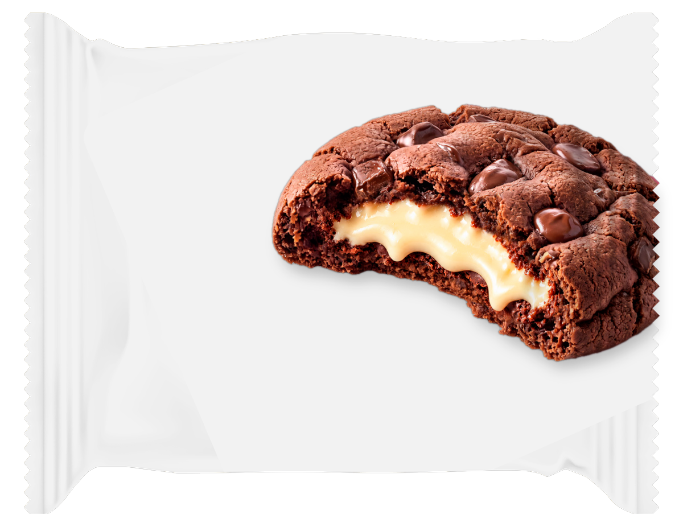
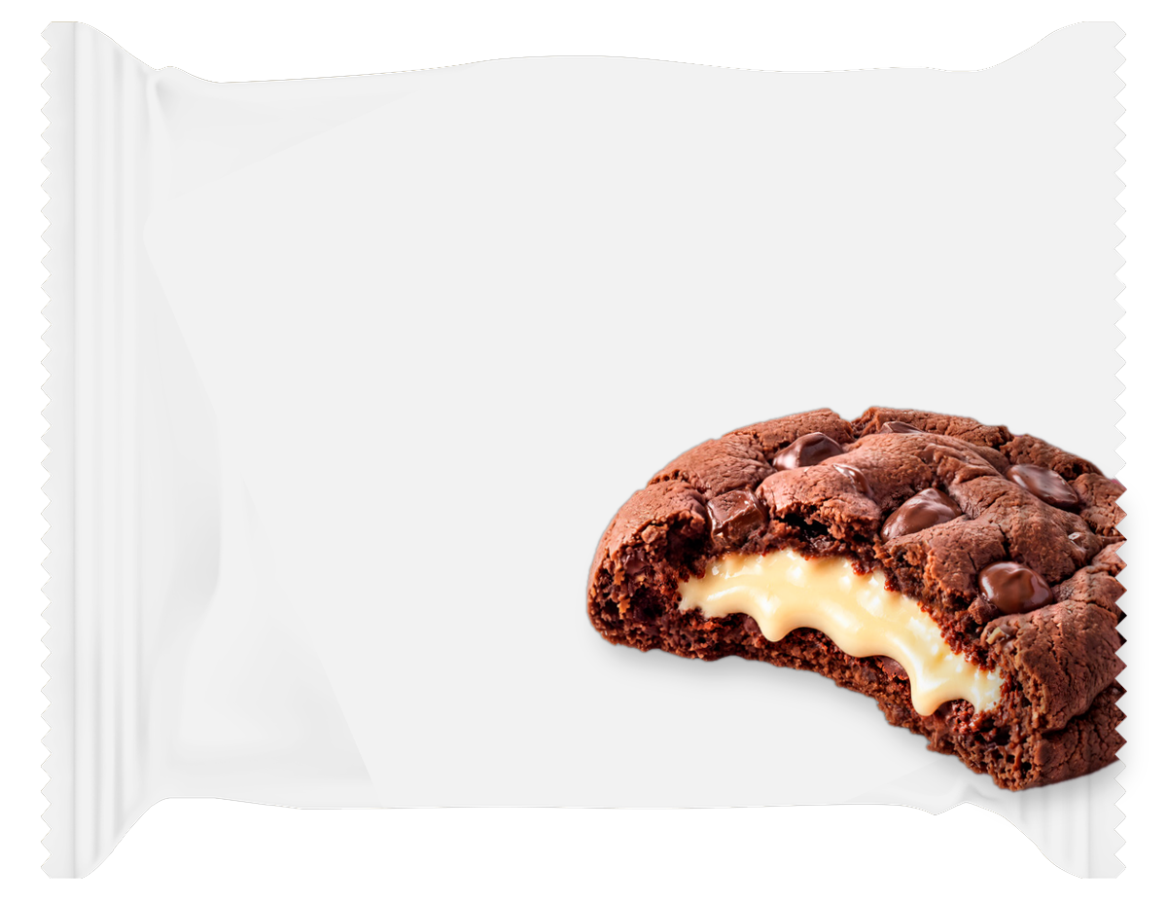
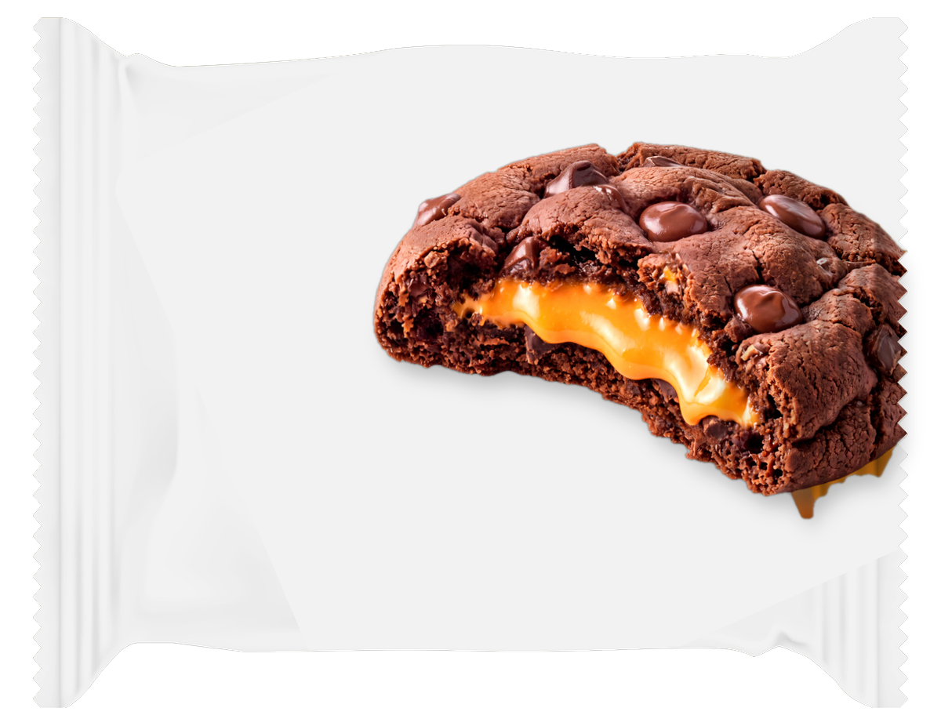
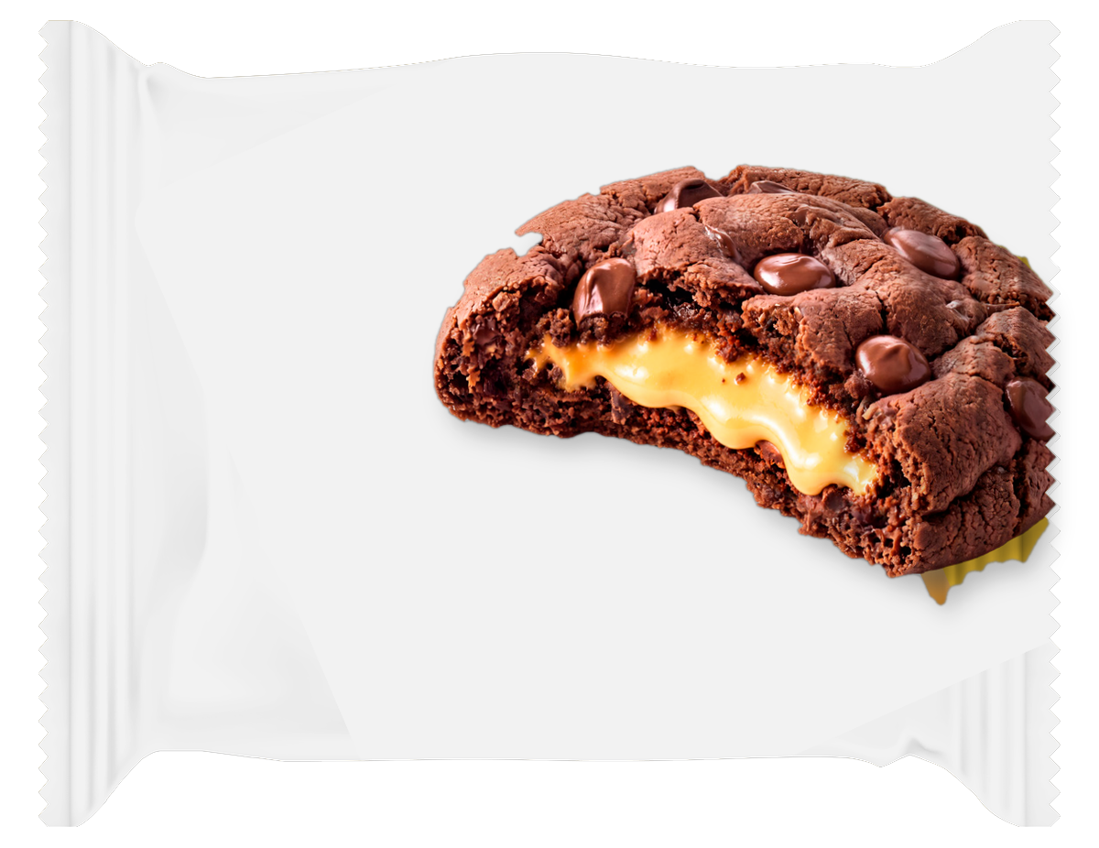
KEY FINDINGS: B_COOKIE · Can you read english? · 1 of 2
B_Cookie splits across the groups
No favors B04 Cookie Vanilla Filling Right Upper D2D3; Yes favor B01 Cookie Chocolate Filling Right Upper D2D3.
B_COOKIE
B04 Cookie Vanilla
Filling Right Upper…
+109
B04 Cookie Vanilla
Filling Right Upper…
B08 Cookie Vanilla
Filling Right Lower…
+22
+66*
+62*
B08 Cookie Vanilla
Filling Right Lower…
+106
+19
B02 Cookie Orange
Filling Right Upper…
+105
+22
B03 Cookie Banana
Filling Right Upper…
+102
+21
B02 Cookie Orange
Filling Right Upper…
B03 Cookie Banana
Filling Right Upper…
0
50
100
150
+64*
+62*
No (basesize = 1)
Yes (basesize = 149)
No favors B04 Cookie Vanilla Filling Right Upper D2D3; Yes favor B01 Cookie Chocolate Filling Right Upper D2D3. The widest segment gap is B04 Cookie Vanilla Filling Right Upper D2D3: +109 no / +22 yes.
No basesize = 1; Yes basesize = 149. Top-2 scores rounded to whole points. *Average of the groups in the legend.
30

Slide 31
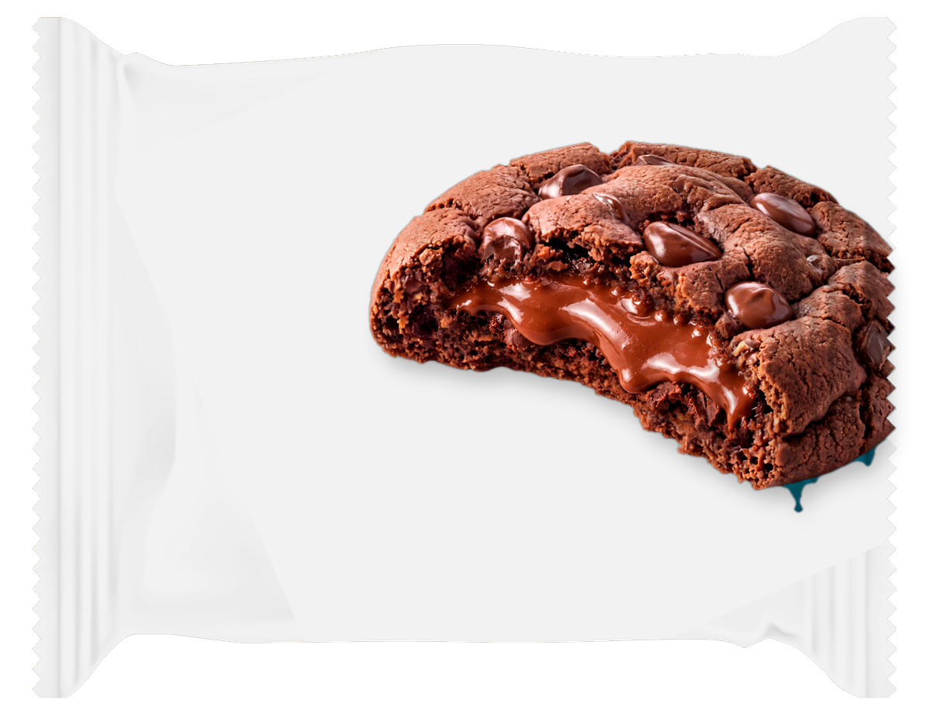
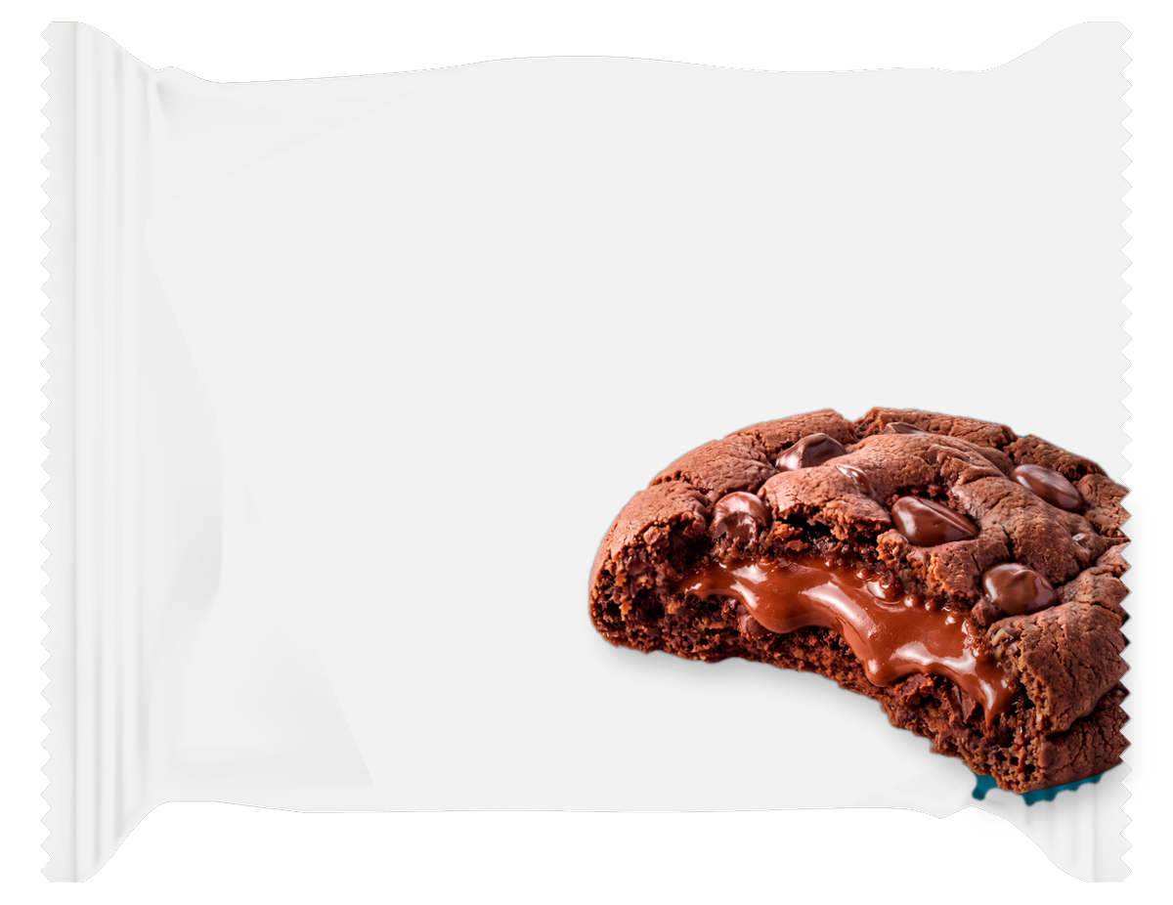
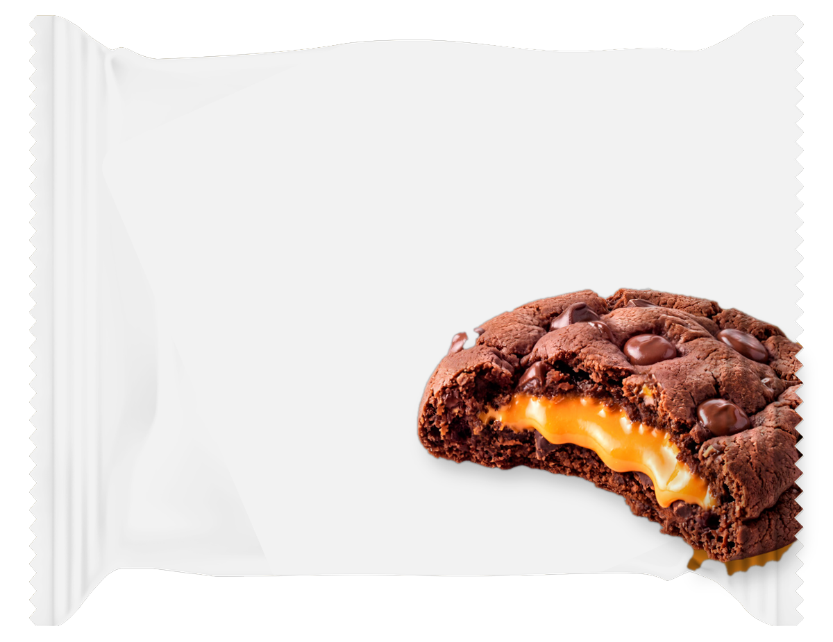

KEY FINDINGS: B_COOKIE · Can you read english? · 2 of 2
B_Cookie splits across the groups
No favors B04 Cookie Vanilla Filling Right Upper D2D3; Yes favor B01 Cookie Chocolate Filling Right Upper D2D3.
B_COOKIE
B01 Cookie Chocolate
Filling Right Upper…
+95
B01 Cookie
Chocolate Filling…
B05 Cookie
Chocolate Filling…
+25
+60*
+49*
B05 Cookie Chocolate
Filling Right Lower…
+75
+23
B06 Cookie Orange
Filling Right Lower…
+68
+16
B07 Cookie Banana
Filling Right Lower…
+61
+16
B06 Cookie Orange
Filling Right Lower…
B07 Cookie Banana
Filling Right Lower…
0
50
100
+42*
+38*
No (basesize = 1)
Yes (basesize = 149)
No favors B04 Cookie Vanilla Filling Right Upper D2D3; Yes favor B01 Cookie Chocolate Filling Right Upper D2D3. The widest segment gap is B04 Cookie Vanilla Filling Right Upper D2D3: +109 no / +22 yes.
No basesize = 1; Yes basesize = 149. Top-2 scores rounded to whole points. *Average of the groups in the legend.
31

Slide 32
KEY FINDINGS: B_COOKIE · Which of these countries do you live in? · 1 of 2
B_Cookie splits across the groups
Bulgaria favors B01 Cookie Chocolate Filling Right Upper D2D3; Greece favors B05 Cookie Chocolate Filling Right Lower D1; Saudi Arabia favors B01 Cookie Chocolate Filling Right Upper D2D3.
B_COOKIE
B01 Cookie Chocolate
Filling Right Upper…
+18
+21
B01 Cookie
Chocolate Filling…
B03 Cookie Banana
Filling Right Upper…
+37
+25*
+21*
B03 Cookie Banana
Filling Right Upper…
+14
+12
+37
B04 Cookie Vanilla
Filling Right Upper…
+17
+13
+36
B02 Cookie Orange
Filling Right Upper…
+15
+18
B04 Cookie Vanilla
Filling Right Upper…
B02 Cookie Orange
Filling Right Upper…
+33
0
10
20
30
40
+22*
+22*
Bulgaria (basesize = 50)
Greece (basesize = 49)
Saudi Arabia (basesize = 51)
Bulgaria favors B01 Cookie Chocolate Filling Right Upper D2D3; Greece favors B05 Cookie Chocolate Filling Right Lower D1; Saudi Arabia favors B01 Cookie Chocolate Filling Right Upper D2D3. The widest segment gap is B03 Cookie Banana Filling Right Upper D2D3: +14 bulgaria / +12 greece / +37 saudi arabia.
Bulgaria basesize = 50; Greece basesize = 49; Saudi Arabia basesize = 51. Top-2 scores rounded to whole points. *Average of the groups in the legend.
32

Slide 33
KEY FINDINGS: B_COOKIE · Which of these countries do you live in? · 2 of 2
B_Cookie splits across the groups
Bulgaria favors B01 Cookie Chocolate Filling Right Upper D2D3; Greece favors B05 Cookie Chocolate Filling Right Lower D1; Saudi Arabia favors B01 Cookie Chocolate Filling Right Upper D2D3.
B_COOKIE
B05 Cookie Chocolate
Filling Right Lower…
+13
+25
B05 Cookie
Chocolate Filling…
B08 Cookie Vanilla
Filling Right Lower…
+32
+23*
+20*
B08 Cookie Vanilla
Filling Right Lower…
+15
+16
+29
B06 Cookie Orange
Filling Right Lower…
+13
+13
+24
B07 Cookie Banana
Filling Right Lower…
+14
+12
B06 Cookie Orange
Filling Right Lower…
B07 Cookie Banana
Filling Right Lower…
+24
0
10
20
30
40
+17*
+17*
Bulgaria (basesize = 50)
Greece (basesize = 49)
Saudi Arabia (basesize = 51)
Bulgaria favors B01 Cookie Chocolate Filling Right Upper D2D3; Greece favors B05 Cookie Chocolate Filling Right Lower D1; Saudi Arabia favors B01 Cookie Chocolate Filling Right Upper D2D3. The widest segment gap is B03 Cookie Banana Filling Right Upper D2D3: +14 bulgaria / +12 greece / +37 saudi arabia.
Bulgaria basesize = 50; Greece basesize = 49; Saudi Arabia basesize = 51. Top-2 scores rounded to whole points. *Average of the groups in the legend.
33

Slide 34
KEY FINDINGS: B_COOKIE · Do you currently consume protein-enriched food products · 1 of 2
B_Cookie splits across the groups
No, and I am not interested favors B02 Cookie Orange Filling Right Upper D2D3; No, but I am interested in trying them favors B01 Cookie Chocolate Filling Right Upper D2D3; Yes, occasionally favors B01 Cookie Chocolate Filling Right Upper D2D3; Yes, regularly favors B05 Cookie Chocolate Filling Right Lower D1.
B_COOKIE
B01 Cookie Chocolate
Filling Right Upper…
+8
+30
+25
B01 Cookie
Chocolate Filling…
B05 Cookie
Chocolate Filling…
+26
+22*
+18*
B05 Cookie Chocolate
Filling Right Lower…
+12
+14
+19
+29
B02 Cookie Orange
Filling Right Upper…
+22
+27
+20
+23
B04 Cookie Vanilla
Filling Right Upper…
+19
+21
+23
+22
0
10
20
30
40
B02 Cookie Orange
Filling Right Upper…
B04 Cookie Vanilla
Filling Right Upper…
No, and I am not interested (basesize = 5)
+23*
+21*
No, but I am interested in trying them (basesize = 15)
Yes, occasionally (basesize = 56)
Yes, regularly (basesize = 74)
No, and I am not interested favors B02 Cookie Orange Filling Right Upper D2D3; No, but I am interested in trying them favors B01 Cookie Chocolate Filling Right Upper D2D3; Yes, occasionally favors B01 Cookie Chocolate Filling Right Upper D2D3; Yes, regularly favors B05 Cookie Chocolate Filling Right Lower D1. The widest segment gap is B01 Cookie Chocolate Filling Right Upper D2D3: +8 no, and i am not interested / +30 no, but i am interested in trying them / +25 yes, occasionally / +26 yes, regularly.
Top-2 scores rounded to whole points. *Average of the groups in the legend.
34

Slide 35
KEY FINDINGS: B_COOKIE · Do you currently consume protein-enriched food products · 2 of 2
B_Cookie splits across the groups
No, and I am not interested favors B02 Cookie Orange Filling Right Upper D2D3; No, but I am interested in trying them favors B01 Cookie Chocolate Filling Right Upper D2D3; Yes, occasionally favors B01 Cookie Chocolate Filling Right Upper D2D3; Yes, regularly favors B05 Cookie Chocolate Filling Right Lower D1.
B_COOKIE
B08 Cookie Vanilla
Filling Right Lower…
+12
+22
+18
B08 Cookie Vanilla
Filling Right Lower…
B03 Cookie Banana
Filling Right Upper…
+23
+19*
+21*
B03 Cookie Banana
Filling Right Upper…
+20
+21
+21
+22
B06 Cookie Orange
Filling Right Lower…
+3
+5
+13
+22
B07 Cookie Banana
Filling Right Lower…
+11
+15
+12
+21
0
10
20
30
B06 Cookie Orange
Filling Right Lower…
B07 Cookie Banana
Filling Right Lower…
No, and I am not interested (basesize = 5)
+11*
+15*
No, but I am interested in trying them (basesize = 15)
Yes, occasionally (basesize = 56)
Yes, regularly (basesize = 74)
No, and I am not interested favors B02 Cookie Orange Filling Right Upper D2D3; No, but I am interested in trying them favors B01 Cookie Chocolate Filling Right Upper D2D3; Yes, occasionally favors B01 Cookie Chocolate Filling Right Upper D2D3; Yes, regularly favors B05 Cookie Chocolate Filling Right Lower D1. The widest segment gap is B01 Cookie Chocolate Filling Right Upper D2D3: +8 no, and i am not interested / +30 no, but i am interested in trying them / +25 yes, occasionally / +26 yes, regularly.
Top-2 scores rounded to whole points. *Average of the groups in the legend.
35

Slide 36
KEY FINDINGS: B_COOKIE · What would be your ideal way to consume protein-enriched products? · 1 of 2
B_Cookie splits across the groups
Other favors B02 Cookie Orange Filling Right Upper D2D3; Protein bars favor B01 Cookie Chocolate Filling Right Upper D2D3; Protein cookies favor B01 Cookie Chocolate Filling Right Upper D2D3; Protein powder favors B03 Cookie Banana Filling Right Upper D2D3.
B_COOKIE
B01 Cookie Chocolate
Filling Right Upper…
+17
+22
+31
B01 Cookie
Chocolate Filling…
B02 Cookie Orange
Filling Right Upper…
+13
+21*
+23*
B02 Cookie Orange
Filling Right Upper…
+17
+28
+21
+25
B03 Cookie Banana
Filling Right Upper…
+18
+23
+23
+27
B04 Cookie Vanilla
Filling Right Upper…
+18
+27
+24
+24
B03 Cookie Banana
Filling Right Upper…
B04 Cookie Vanilla
Filling Right Upper…
0
10
20
30
40
+23*
+23*
Other (basesize = 10)
Protein bars (basesize = 52)
Protein cookies (basesize = 80)
Protein powder (basesize = 8)
Other favors B02 Cookie Orange Filling Right Upper D2D3; Protein bars favor B01 Cookie Chocolate Filling Right Upper D2D3; Protein cookies favor B01 Cookie Chocolate Filling Right Upper D2D3; Protein powder favors B03 Cookie Banana Filling Right Upper D2D3. The widest segment gap is B01 Cookie Chocolate Filling Right Upper D2D3: +17 other / +22 protein bars / +31 protein cookies / +13 protein powder.
Top-2 scores rounded to whole points. *Average of the groups in the legend.
36

Slide 37
KEY FINDINGS: B_COOKIE · What would be your ideal way to consume protein-enriched products? · 2 of 2
B_Cookie splits across the groups
Other favors B02 Cookie Orange Filling Right Upper D2D3; Protein bars favor B01 Cookie Chocolate Filling Right Upper D2D3; Protein cookies favor B01 Cookie Chocolate Filling Right Upper D2D3; Protein powder favors B03 Cookie Banana Filling Right Upper D2D3.
B_COOKIE
B05 Cookie Chocolate
Filling Right Lower…
+20
+21
+26
B05 Cookie
Chocolate Filling…
B08 Cookie Vanilla
Filling Right Lower…
+13
+20*
+21*
B08 Cookie Vanilla
Filling Right Lower…
+16
+25
+20
+22
B06 Cookie Orange
Filling Right Lower…
+9
+15
+10
+19
B07 Cookie Banana
Filling Right Lower…
+14
+15
+19
+9
B06 Cookie Orange
Filling Right Lower…
B07 Cookie Banana
Filling Right Lower…
0
10
20
30
40
+13*
+14*
Other (basesize = 10)
Protein bars (basesize = 52)
Protein cookies (basesize = 80)
Protein powder (basesize = 8)
Other favors B02 Cookie Orange Filling Right Upper D2D3; Protein bars favor B01 Cookie Chocolate Filling Right Upper D2D3; Protein cookies favor B01 Cookie Chocolate Filling Right Upper D2D3; Protein powder favors B03 Cookie Banana Filling Right Upper D2D3. The widest segment gap is B01 Cookie Chocolate Filling Right Upper D2D3: +17 other / +22 protein bars / +31 protein cookies / +13 protein powder.
Top-2 scores rounded to whole points. *Average of the groups in the legend.
37

Slide 38
KEY FINDINGS: B_COOKIE · How familiar are you with the Fitspo brand? · 1 of 2
B01 Cookie Chocolate Filling Right Upper D2D3 leads in every group
B01 Cookie Chocolate Filling Right Upper D2D3 leads every group; B08 Cookie Vanilla Filling Right Lower D1 ranks last.
B_COOKIE
B01 Cookie Chocolate
Filling Right Upper…
+19
+26
+27
B01 Cookie
Chocolate Filling…
B05 Cookie
Chocolate Filling…
+28
+25*
+22*
B05 Cookie Chocolate
Filling Right Lower…
+17
+24
+22
+27
B04 Cookie Vanilla
Filling Right Upper…
+19
+21
+21
+25
B02 Cookie Orange
Filling Right Upper…
+18
+22
+22
+24
B04 Cookie Vanilla
Filling Right Upper…
B02 Cookie Orange
Filling Right Upper…
0
10
20
30
40
+22*
+22*
Heard of it, but know little about it (basesize = 22)
Not familiar at all (basesize = 25)
Somewhat familiar (basesize = 49)
Very familiar (basesize = 54)
Every group ranks B01 Cookie Chocolate Filling Right Upper D2D3 first. The widest segment gap is B06 Cookie Orange Filling Right Lower D1: +15 heard of it, but know little about it / +8 not familiar at all / +15 somewhat familiar / +22 very familiar.
Top-2 scores rounded to whole points. *Average of the groups in the legend.
38

Slide 39
KEY FINDINGS: B_COOKIE · How familiar are you with the Fitspo brand? · 2 of 2
B01 Cookie Chocolate Filling Right Upper D2D3 leads in every group
B01 Cookie Chocolate Filling Right Upper D2D3 leads every group; B08 Cookie Vanilla Filling Right Lower D1 ranks last.
B_COOKIE
B03 Cookie Banana
Filling Right Upper…
+16
+23
+22
B03 Cookie Banana
Filling Right Upper…
B06 Cookie Orange
Filling Right Lower…
+22
+21*
+15*
B06 Cookie Orange
Filling Right Lower…
+8
+15
+15
+22
B07 Cookie Banana
Filling Right Lower…
+9
+14
+17
+22
B08 Cookie Vanilla
Filling Right Lower…
+18
+21
+19
+21
B07 Cookie Banana
Filling Right Lower…
B08 Cookie Vanilla
Filling Right Lower…
0
10
20
30
+16*
+20*
Heard of it, but know little about it (basesize = 22)
Not familiar at all (basesize = 25)
Somewhat familiar (basesize = 49)
Very familiar (basesize = 54)
Every group ranks B01 Cookie Chocolate Filling Right Upper D2D3 first. The widest segment gap is B06 Cookie Orange Filling Right Lower D1: +15 heard of it, but know little about it / +8 not familiar at all / +15 somewhat familiar / +22 very familiar.
Top-2 scores rounded to whole points. *Average of the groups in the legend.
39

Slide 40
KEY FINDINGS: B_COOKIE · How often do you purchase Fitspo products? · 1 of 2
B_Cookie splits across the groups
Have never purchased Fitspo products favor B04 Cookie Vanilla Filling Right Upper D2D3; Have purchased in the past, but not currently favors B01 Cookie Chocolate Filling Right Upper D2D3; Occasionally favors B01 Cookie Chocolate Filling Right Upper D2D3; Regularly favors B05 Cookie Chocolate Filling Right Lower D1.
B_COOKIE
B05 Cookie Chocolate
Filling Right Lower…
+14
+19
+22
B05 Cookie
Chocolate Filling…
B01 Cookie
Chocolate Filling…
+31
+22*
+24*
B01 Cookie Chocolate
Filling Right Upper…
+19
+23
+26
+29
B04 Cookie Vanilla
Filling Right Upper…
+10
+25
+18
+28
B02 Cookie Orange
Filling Right Upper…
+8
+24
+20
+27
0
10
20
30
40
B04 Cookie Vanilla
Filling Right Upper…
B02 Cookie Orange
Filling Right Upper…
Have never purchased Fitspo products (basesize = 37)
+20*
+20*
Have purchased in the past, but not currently (basesize = 12)
Occasionally (basesize = 56)
Regularly (basesize = 45)
Have never purchased Fitspo products favor B04 Cookie Vanilla Filling Right Upper D2D3; Have purchased in the past, but not currently favors B01 Cookie Chocolate Filling Right Upper D2D3; Occasionally favors B01 Cookie Chocolate Filling Right Upper D2D3; Regularly favors B05 Cookie Chocolate Filling Right Lower D1. The widest segment gap is B02 Cookie Orange Filling Right Upper D2D3: +24 have never purchased fitspo products / +8 have purchased in the past, but not currently / +20 occasionally / +27 regularly.
Top-2 scores rounded to whole points. *Average of the groups in the legend.
40

Slide 41
KEY FINDINGS: B_COOKIE · How often do you purchase Fitspo products? · 2 of 2
B_Cookie splits across the groups
Have never purchased Fitspo products favor B04 Cookie Vanilla Filling Right Upper D2D3; Have purchased in the past, but not currently favors B01 Cookie Chocolate Filling Right Upper D2D3; Occasionally favors B01 Cookie Chocolate Filling Right Upper D2D3; Regularly favors B05 Cookie Chocolate Filling Right Lower D1.
B_COOKIE
B03 Cookie Banana
Filling Right Upper…
+15
+24
+16
B03 Cookie Banana
Filling Right Upper…
B06 Cookie Orange
Filling Right Lower…
+27
+20*
+15*
B06 Cookie Orange
Filling Right Lower…
+11
+13
+12
+25
B07 Cookie Banana
Filling Right Lower…
+13
+17
+13
+25
B08 Cookie Vanilla
Filling Right Lower…
+14
+22
+16
+25
0
10
20
30
40
B07 Cookie Banana
Filling Right Lower…
B08 Cookie Vanilla
Filling Right Lower…
Have never purchased Fitspo products (basesize = 37)
+17*
+19*
Have purchased in the past, but not currently (basesize = 12)
Occasionally (basesize = 56)
Regularly (basesize = 45)
Have never purchased Fitspo products favor B04 Cookie Vanilla Filling Right Upper D2D3; Have purchased in the past, but not currently favors B01 Cookie Chocolate Filling Right Upper D2D3; Occasionally favors B01 Cookie Chocolate Filling Right Upper D2D3; Regularly favors B05 Cookie Chocolate Filling Right Lower D1. The widest segment gap is B02 Cookie Orange Filling Right Upper D2D3: +24 have never purchased fitspo products / +8 have purchased in the past, but not currently / +20 occasionally / +27 regularly.
Top-2 scores rounded to whole points. *Average of the groups in the legend.
41

Slide 42
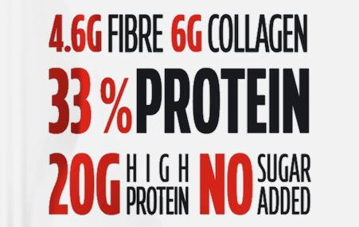

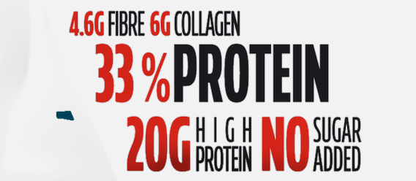

KEY FINDINGS: C_CLAIM · Can you read english? · 1 of 2
C04 Claim Full Block Fibrecollagen 33 Protein 20gno Sugar Mid Left D1 leads in both groups
C04 Claim Full Block Fibrecollagen 33 Protein 20gno Sugar Mid Left D1 leads both groups; C03 Claim 33 Protein Only Bottom Centre D2D3 ranks last.
C_CLAIM
C04 Claim Full Block
Fibrecollagen 33…
+8
C04 Claim Full
Block Fibrecollagen…
C05 Claim 33
Protein 20g High…
+24
+16*
+14*
C05 Claim 33 Protein
20g High Protein No…
+6
+21
C01 Claim Full Block
Fibrecollagen 33…
-8
+17
C02 Claim 33 Protein
20g High Protein No…
-7
C01 Claim Full
Block Fibrecollagen…
C02 Claim 33
Protein 20g High…
+16
+4*
+4*
-20
0
20
40
No (basesize = 1)
Yes (basesize = 149)
Both groups rank C04 Claim Full Block Fibrecollagen 33 Protein 20gno Sugar Mid Left D1 first. The widest segment gap is C01 Claim Full Block Fibrecollagen 33 Protein 20gno Sugar Bottom Centre D2D3: -8 no / +17 yes.
No basesize = 1; Yes basesize = 149. Top-2 scores rounded to whole points. *Average of the groups in the legend.
42

Slide 43


KEY FINDINGS: C_CLAIM · Can you read english? · 2 of 2
C04 Claim Full Block Fibrecollagen 33 Protein 20gno Sugar Mid Left D1 leads in both groups
C04 Claim Full Block Fibrecollagen 33 Protein 20gno Sugar Mid Left D1 leads both groups; C03 Claim 33 Protein Only Bottom Centre D2D3 ranks last.
C_CLAIM
C06 Claim 33 Protein
Only Mid Left D1
+8
+14
C06 Claim 33
Protein Only Mid…
C03 Claim 33
Protein Only Bottom…
+11*
+1*
C03 Claim 33 Protein
Only Bottom Centre…
-10
+12
-10
0
10
20
No (basesize = 1)
Yes (basesize = 149)
Both groups rank C04 Claim Full Block Fibrecollagen 33 Protein 20gno Sugar Mid Left D1 first. The widest segment gap is C01 Claim Full Block Fibrecollagen 33 Protein 20gno Sugar Bottom Centre D2D3: -8 no / +17 yes.
No basesize = 1; Yes basesize = 149. Top-2 scores rounded to whole points. *Average of the groups in the legend.
43

Slide 44
KEY FINDINGS: C_CLAIM · Which of these countries do you live in? · 1 of 2
C04 Claim Full Block Fibrecollagen 33 Protein 20gno Sugar Mid Left D1 leads in every group
C04 Claim Full Block Fibrecollagen 33 Protein 20gno Sugar Mid Left D1 leads every group; C02 Claim 33 Protein 20g High Protein No Sugar Added Bottom Centre D2D3 ranks last.
C_CLAIM
C04 Claim Full Block
Fibrecollagen 33…
+27
C04 Claim Full
Block Fibrecollagen…
C05 Claim 33
Protein 20g High…
+19
+24
+23*
+21*
C05 Claim 33 Protein
20g High Protein No…
+20
+19
+23
C01 Claim Full Block
Fibrecollagen 33…
+16
+14
+20
C02 Claim 33 Protein
20g High Protein No…
+17
C01 Claim Full
Block Fibrecollagen…
C02 Claim 33
Protein 20g High…
+12
+17
+17*
+15*
0
10
20
30
40
Bulgaria (basesize = 50)
Greece (basesize = 49)
Saudi Arabia (basesize = 51)
Every group ranks C04 Claim Full Block Fibrecollagen 33 Protein 20gno Sugar Mid Left D1 first. The widest segment gap is C03 Claim 33 Protein Only Bottom Centre D2D3: +12 bulgaria / +7 greece / +17 saudi arabia.
Bulgaria basesize = 50; Greece basesize = 49; Saudi Arabia basesize = 51. Top-2 scores rounded to whole points. *Average of the groups in the legend.
44

Slide 45
KEY FINDINGS: C_CLAIM · Which of these countries do you live in? · 2 of 2
C04 Claim Full Block Fibrecollagen 33 Protein 20gno Sugar Mid Left D1 leads in every group
C04 Claim Full Block Fibrecollagen 33 Protein 20gno Sugar Mid Left D1 leads every group; C02 Claim 33 Protein 20g High Protein No Sugar Added Bottom Centre D2D3 ranks last.
C_CLAIM
C03 Claim 33 Protein
Only Bottom Centre…
+12
+7
+17
C03 Claim 33
Protein Only Bottom…
C06 Claim 33
Protein Only Mid…
+12*
+14*
C06 Claim 33 Protein
Only Mid Left D1
+16
+10
+17
0
5
10
15
20
Bulgaria (basesize = 50)
Greece (basesize = 49)
Saudi Arabia (basesize = 51)
Every group ranks C04 Claim Full Block Fibrecollagen 33 Protein 20gno Sugar Mid Left D1 first. The widest segment gap is C03 Claim 33 Protein Only Bottom Centre D2D3: +12 bulgaria / +7 greece / +17 saudi arabia.
Bulgaria basesize = 50; Greece basesize = 49; Saudi Arabia basesize = 51. Top-2 scores rounded to whole points. *Average of the groups in the legend.
45

Slide 46
KEY FINDINGS: C_CLAIM · Do you currently consume protein-enriched food products · 1 of 2
C_Claim splits across the groups
No, and I am not interested favors C05 Claim 33 Protein 20g High Protein No Sugar Added Mid Left D1; No, but I am interested in trying them favors C04 Claim Full Block Fibrecollagen 33 Protein 20gno Sugar Mid Left D1; Yes, occasionally favors C04 Claim Full Block Fibrecollagen 33 Protein 20gno Sugar Mid Left D1; Yes, regularly favors C04 Claim Full Block Fibrecollagen 33 Protein 20gno Sugar Mid Left D1.
C_CLAIM
C04 Claim Full Block
Fibrecollagen 33…
0
+22
C04 Claim Full
Block Fibrecollagen…
C05 Claim 33
Protein 20g High…
+22
+26
+18*
+19*
C05 Claim 33 Protein
20g High Protein No…
+16
+17
+19
+23
C02 Claim 33 Protein
20g High Protein No…
-3
+12
+11
+21
C01 Claim Full Block
Fibrecollagen 33…
+1
+9
+17
+20
-20
0
20
40
C02 Claim 33
Protein 20g High…
C01 Claim Full
Block Fibrecollagen…
No, and I am not interested (basesize = 5)
+10*
+12*
No, but I am interested in trying them (basesize = 15)
Yes, occasionally (basesize = 56)
Yes, regularly (basesize = 74)
No, and I am not interested favors C05 Claim 33 Protein 20g High Protein No Sugar Added Mid Left D1; No, but I am interested in trying them favors C04 Claim Full Block Fibrecollagen 33 Protein 20gno Sugar Mid Left D1; Yes, occasionally favors C04 Claim Full Block Fibrecollagen 33 Protein 20gno Sugar Mid Left D1; Yes, regularly favors C04 Claim Full Block Fibrecollagen 33 Protein 20gno Sugar Mid Left D1. The widest segment gap is C04 Claim Full Block Fibrecollagen 33 Protein 20gno Sugar Mid Left D1: 0 no, and i am not interested / +22 no, but i am interested in trying them / +22 yes, occasionally / +26 yes, regularly.
Top-2 scores rounded to whole points. *Average of the groups in the legend.
46

Slide 47
KEY FINDINGS: C_CLAIM · Do you currently consume protein-enriched food products · 2 of 2
C_Claim splits across the groups
No, and I am not interested favors C05 Claim 33 Protein 20g High Protein No Sugar Added Mid Left D1; No, but I am interested in trying them favors C04 Claim Full Block Fibrecollagen 33 Protein 20gno Sugar Mid Left D1; Yes, occasionally favors C04 Claim Full Block Fibrecollagen 33 Protein 20gno Sugar Mid Left D1; Yes, regularly favors C04 Claim Full Block Fibrecollagen 33 Protein 20gno Sugar Mid Left D1.
C_CLAIM
C03 Claim 33 Protein
Only Bottom Centre…
-5
+3
+10
+17
C03 Claim 33
Protein Only Bottom…
C06 Claim 33
Protein Only Mid…
+6*
+13*
C06 Claim 33 Protein
Only Mid Left D1
+12
+10
+12
+17
-10
0
10
20
No, and I am not interested (basesize = 5)
No, but I am interested in trying them (basesize = 15)
Yes, occasionally (basesize = 56)
Yes, regularly (basesize = 74)
No, and I am not interested favors C05 Claim 33 Protein 20g High Protein No Sugar Added Mid Left D1; No, but I am interested in trying them favors C04 Claim Full Block Fibrecollagen 33 Protein 20gno Sugar Mid Left D1; Yes, occasionally favors C04 Claim Full Block Fibrecollagen 33 Protein 20gno Sugar Mid Left D1; Yes, regularly favors C04 Claim Full Block Fibrecollagen 33 Protein 20gno Sugar Mid Left D1. The widest segment gap is C04 Claim Full Block Fibrecollagen 33 Protein 20gno Sugar Mid Left D1: 0 no, and i am not interested / +22 no, but i am interested in trying them / +22 yes, occasionally / +26 yes, regularly.
Top-2 scores rounded to whole points. *Average of the groups in the legend.
47

Slide 48
KEY FINDINGS: C_CLAIM · What would be your ideal way to consume protein-enriched products? · 1 of 2
C_Claim splits across the groups
Other favors C05 Claim 33 Protein 20g High Protein No Sugar Added Mid Left D1; Protein bars favor C04 Claim Full Block Fibrecollagen 33 Protein 20gno Sugar Mid Left D1; Protein cookies favor C04 Claim Full Block Fibrecollagen 33 Protein 20gno Sugar Mid Left D1; Protein powder favors C01 Claim Full Block Fibrecollagen 33 Protein 20gno Sugar Bottom Centre D2D3.
C_CLAIM
C01 Claim Full Block
Fibrecollagen 33…
+8
+14
C01 Claim Full
Block Fibrecollagen…
C04 Claim Full
Block Fibrecollagen…
+19
+27
+17*
+21*
C04 Claim Full Block
Fibrecollagen 33…
+10
+27
+23
+24
C05 Claim 33 Protein
20g High Protein No…
+15
+22
+17
+21
C02 Claim 33 Protein
20g High Protein No…
+3
+18
+11
+16
C05 Claim 33
Protein 20g High…
C02 Claim 33
Protein 20g High…
0
10
20
30
40
+19*
+12*
Other (basesize = 10)
Protein bars (basesize = 52)
Protein cookies (basesize = 80)
Protein powder (basesize = 8)
Other favors C05 Claim 33 Protein 20g High Protein No Sugar Added Mid Left D1; Protein bars favor C04 Claim Full Block Fibrecollagen 33 Protein 20gno Sugar Mid Left D1; Protein cookies favor C04 Claim Full Block Fibrecollagen 33 Protein 20gno Sugar Mid Left D1; Protein powder favors C01 Claim Full Block Fibrecollagen 33 Protein 20gno Sugar Bottom Centre D2D3. The widest segment gap is C01 Claim Full Block Fibrecollagen 33 Protein 20gno Sugar Bottom Centre D2D3: +8 other / +14 protein bars / +19 protein cookies / +27 protein powder.
Top-2 scores rounded to whole points. *Average of the groups in the legend.
48

Slide 49
KEY FINDINGS: C_CLAIM · What would be your ideal way to consume protein-enriched products? · 2 of 2
C_Claim splits across the groups
Other favors C05 Claim 33 Protein 20g High Protein No Sugar Added Mid Left D1; Protein bars favor C04 Claim Full Block Fibrecollagen 33 Protein 20gno Sugar Mid Left D1; Protein cookies favor C04 Claim Full Block Fibrecollagen 33 Protein 20gno Sugar Mid Left D1; Protein powder favors C01 Claim Full Block Fibrecollagen 33 Protein 20gno Sugar Bottom Centre D2D3.
C_CLAIM
C06 Claim 33 Protein
Only Mid Left D1
+9
+14
+16
+8
C06 Claim 33
Protein Only Mid…
C03 Claim 33
Protein Only Bottom…
+12*
+11*
C03 Claim 33 Protein
Only Bottom Centre…
+7
+14
+12
+10
0
5
10
15
20
Other (basesize = 10)
Protein bars (basesize = 52)
Protein cookies (basesize = 80)
Protein powder (basesize = 8)
Other favors C05 Claim 33 Protein 20g High Protein No Sugar Added Mid Left D1; Protein bars favor C04 Claim Full Block Fibrecollagen 33 Protein 20gno Sugar Mid Left D1; Protein cookies favor C04 Claim Full Block Fibrecollagen 33 Protein 20gno Sugar Mid Left D1; Protein powder favors C01 Claim Full Block Fibrecollagen 33 Protein 20gno Sugar Bottom Centre D2D3. The widest segment gap is C01 Claim Full Block Fibrecollagen 33 Protein 20gno Sugar Bottom Centre D2D3: +8 other / +14 protein bars / +19 protein cookies / +27 protein powder.
Top-2 scores rounded to whole points. *Average of the groups in the legend.
49

Slide 50
KEY FINDINGS: C_CLAIM · How familiar are you with the Fitspo brand? · 1 of 2
C_Claim splits across the groups
Heard of it, but know little about it favors C01 Claim Full Block Fibrecollagen 33 Protein 20gno Sugar Bottom Centre D2D3; Not familiar at all favors C04 Claim Full Block Fibrecollagen 33 Protein 20gno Sugar Mid Left D1; Somewhat familiar favors C04 Claim Full Block Fibrecollagen 33 Protein 20gno Sugar Mid Left D1; Very familiar favors C04 Claim Full Block Fibrecollagen 33 Protein 20gno Sugar Mid Left D1.
C_CLAIM
C04 Claim Full Block
Fibrecollagen 33…
+23
+26
C04 Claim Full
Block Fibrecollagen…
C01 Claim Full
Block Fibrecollagen…
+21
+25
+24*
+17*
C01 Claim Full Block
Fibrecollagen 33…
+12
+23
+15
+18
C05 Claim 33 Protein
20g High Protein No…
+15
+22
+21
+23
C02 Claim 33 Protein
20g High Protein No…
+10
+14
+12
+22
C05 Claim 33
Protein 20g High…
C02 Claim 33
Protein 20g High…
0
10
20
30
40
+20*
+14*
Heard of it, but know little about it (basesize = 22)
Not familiar at all (basesize = 25)
Somewhat familiar (basesize = 49)
Very familiar (basesize = 54)
Heard of it, but know little about it favors C01 Claim Full Block Fibrecollagen 33 Protein 20gno Sugar Bottom Centre D2D3; Not familiar at all favors C04 Claim Full Block Fibrecollagen 33 Protein 20gno Sugar Mid Left D1; Somewhat familiar favors C04 Claim Full Block Fibrecollagen 33 Protein 20gno Sugar Mid Left D1; Very familiar favors C04 Claim Full Block Fibrecollagen 33 Protein 20gno Sugar Mid Left D1. The widest segment gap is C03 Claim 33 Protein Only Bottom Centre D2D3: +13 heard of it, but know little about it / +1 not familiar at all / +12 somewhat familiar / +17 very familiar.
Top-2 scores rounded to whole points. *Average of the groups in the legend.
50

Slide 51
KEY FINDINGS: C_CLAIM · How familiar are you with the Fitspo brand? · 2 of 2
C_Claim splits across the groups
Heard of it, but know little about it favors C01 Claim Full Block Fibrecollagen 33 Protein 20gno Sugar Bottom Centre D2D3; Not familiar at all favors C04 Claim Full Block Fibrecollagen 33 Protein 20gno Sugar Mid Left D1; Somewhat familiar favors C04 Claim Full Block Fibrecollagen 33 Protein 20gno Sugar Mid Left D1; Very familiar favors C04 Claim Full Block Fibrecollagen 33 Protein 20gno Sugar Mid Left D1.
C_CLAIM
C06 Claim 33 Protein
Only Mid Left D1
+14
+12
+10
+19
C06 Claim 33
Protein Only Mid…
C03 Claim 33
Protein Only Bottom…
+14*
+11*
C03 Claim 33 Protein
Only Bottom Centre…
+13
+1
+12
+17
0
5
10
15
20
Heard of it, but know little about it (basesize = 22)
Not familiar at all (basesize = 25)
Somewhat familiar (basesize = 49)
Very familiar (basesize = 54)
Heard of it, but know little about it favors C01 Claim Full Block Fibrecollagen 33 Protein 20gno Sugar Bottom Centre D2D3; Not familiar at all favors C04 Claim Full Block Fibrecollagen 33 Protein 20gno Sugar Mid Left D1; Somewhat familiar favors C04 Claim Full Block Fibrecollagen 33 Protein 20gno Sugar Mid Left D1; Very familiar favors C04 Claim Full Block Fibrecollagen 33 Protein 20gno Sugar Mid Left D1. The widest segment gap is C03 Claim 33 Protein Only Bottom Centre D2D3: +13 heard of it, but know little about it / +1 not familiar at all / +12 somewhat familiar / +17 very familiar.
Top-2 scores rounded to whole points. *Average of the groups in the legend.
51

Slide 52
KEY FINDINGS: C_CLAIM · How often do you purchase Fitspo products? · 1 of 2
C04 Claim Full Block Fibrecollagen 33 Protein 20gno Sugar Mid Left D1 leads in every group
C04 Claim Full Block Fibrecollagen 33 Protein 20gno Sugar Mid Left D1 leads every group; C06 Claim 33 Protein Only Mid Left D1 ranks last.
C_CLAIM
C04 Claim Full Block
Fibrecollagen 33…
+23
+29
C04 Claim Full
Block Fibrecollagen…
C01 Claim Full
Block Fibrecollagen…
+22
+24
+24*
+18*
C01 Claim Full Block
Fibrecollagen 33…
+14
+25
+16
+17
C02 Claim 33 Protein
20g High Protein No…
+9
+19
+13
+23
C05 Claim 33 Protein
20g High Protein No…
+19
+23
+21
+21
C02 Claim 33
Protein 20g High…
C05 Claim 33
Protein 20g High…
0
10
20
30
40
Have never purchased Fitspo products (basesize = 37)
+16*
+21*
Have purchased in the past, but not currently (basesize = 12)
Occasionally (basesize = 56)
Regularly (basesize = 45)
Every group ranks C04 Claim Full Block Fibrecollagen 33 Protein 20gno Sugar Mid Left D1 first. The widest segment gap is C02 Claim 33 Protein 20g High Protein No Sugar Added Bottom Centre D2D3: +9 have never purchased fitspo products / +19 have purchased in the past, but not currently / +13 occasionally / +23 regularly.
Top-2 scores rounded to whole points. *Average of the groups in the legend.
52

Slide 53
KEY FINDINGS: C_CLAIM · How often do you purchase Fitspo products? · 2 of 2
C04 Claim Full Block Fibrecollagen 33 Protein 20gno Sugar Mid Left D1 leads in every group
C04 Claim Full Block Fibrecollagen 33 Protein 20gno Sugar Mid Left D1 leads every group; C06 Claim 33 Protein Only Mid Left D1 ranks last.
C_CLAIM
C03 Claim 33 Protein
Only Bottom Centre…
+6
+16
+12
+16
C03 Claim 33
Protein Only Bottom…
C06 Claim 33
Protein Only Mid…
+12*
+14*
C06 Claim 33 Protein
Only Mid Left D1
+14
+14
+15
+14
0
5
10
15
20
Have never purchased Fitspo products (basesize = 37)
Have purchased in the past, but not currently (basesize = 12)
Occasionally (basesize = 56)
Regularly (basesize = 45)
Every group ranks C04 Claim Full Block Fibrecollagen 33 Protein 20gno Sugar Mid Left D1 first. The widest segment gap is C02 Claim 33 Protein 20g High Protein No Sugar Added Bottom Centre D2D3: +9 have never purchased fitspo products / +19 have purchased in the past, but not currently / +13 occasionally / +23 regularly.
Top-2 scores rounded to whole points. *Average of the groups in the legend.
53

Slide 54




KEY FINDINGS: D_LOGO · Can you read english?
D03 Logo Small Upper Centre Right D1 leads in both groups
D03 Logo Small Upper Centre Right D1 leads both groups; D01 Logo Small Top Left D2 ranks last.
D_LOGO
D03 Logo Small
Upper Centre Right…
+22
+5
D03 Logo Small
Upper Centre Right…
D04 Logo Large
Upper Centre Right…
+14*
+12*
D04 Logo Large Upper
Centre Right D1…
+22
+3
D02 Logo Large Top
Left D3
+16
+4
D01 Logo Small Top
Left D2
+12
+3
D02 Logo Large Top
Left D3
D01 Logo Small Top
Left D2
0
10
20
30
+10*
+8*
No (basesize = 1)
Yes (basesize = 149)
Both groups rank D03 Logo Small Upper Centre Right D1 first. The widest segment gap is D04 Logo Large Upper Centre Right D1 Position: +22 no / +3 yes.
No basesize = 1; Yes basesize = 149. Top-2 scores rounded to whole points. *Average of the groups in the legend.
54

Slide 55
KEY FINDINGS: D_LOGO · Which of these countries do you live in?
D_Logo splits across the groups
Bulgaria favors D03 Logo Small Upper Centre Right D1; Greece favors D02 Logo Large Top Left D3; Saudi Arabia favors D03 Logo Small Upper Centre Right D1.
D_LOGO
D03 Logo Small
Upper Centre Right…
+8
+1
D03 Logo Small
Upper Centre Right…
D01 Logo Small Top
Left D2
+6
+5*
+3*
D01 Logo Small Top
Left D2
+7
+2
+1
D04 Logo Large Upper
Centre Right D1…
+4
-2
+6
D02 Logo Large Top
Left D3
+4
+3
D04 Logo Large
Upper Centre Right…
D02 Logo Large Top
Left D3
+5
-5
0
5
10
+3*
+4*
Bulgaria (basesize = 50)
Greece (basesize = 49)
Saudi Arabia (basesize = 51)
Bulgaria favors D03 Logo Small Upper Centre Right D1; Greece favors D02 Logo Large Top Left D3; Saudi Arabia favors D03 Logo Small Upper Centre Right D1. The widest segment gap is D04 Logo Large Upper Centre Right D1 Position: +4 bulgaria / -2 greece / +6 saudi arabia.
Bulgaria basesize = 50; Greece basesize = 49; Saudi Arabia basesize = 51. Top-2 scores rounded to whole points. *Average of the groups in the legend.
55

Slide 56
KEY FINDINGS: D_LOGO · Do you currently consume protein-enriched food products
D_Logo splits across the groups
No, and I am not interested favors D03 Logo Small Upper Centre Right D1; No, but I am interested in trying them favors D01 Logo Small Top Left D2; Yes, occasionally favors D01 Logo Small Top Left D2; Yes, regularly favors D03 Logo Small Upper Centre Right D1.
D_LOGO
D03 Logo Small
Upper Centre Right…
0
+11
+6
D03 Logo Small
Upper Centre Right…
D01 Logo Small Top
Left D2
+5
+6*
+1*
D01 Logo Small Top
Left D2
-5
0
+1
+8
D02 Logo Large Top
Left D3
-6
0
+3
+8
D04 Logo Large Upper
Centre Right D1…
-1
+4
+2
+5
-10
0
10
20
D02 Logo Large Top
Left D3
D04 Logo Large
Upper Centre Right…
No, and I am not interested (basesize = 5)
+1*
+2*
No, but I am interested in trying them (basesize = 15)
Yes, occasionally (basesize = 56)
Yes, regularly (basesize = 74)
No, and I am not interested favors D03 Logo Small Upper Centre Right D1; No, but I am interested in trying them favors D01 Logo Small Top Left D2; Yes, occasionally favors D01 Logo Small Top Left D2; Yes, regularly favors D03 Logo Small Upper Centre Right D1. The widest segment gap is D02 Logo Large Top Left D3: -6 no, and i am not interested / 0 no, but i am interested in trying them / +8 yes, occasionally / +3 yes, regularly.
Top-2 scores rounded to whole points. *Average of the groups in the legend.
56

Slide 57
KEY FINDINGS: D_LOGO · What would be your ideal way to consume protein-enriched products?
D_Logo splits across the groups
Other favors D03 Logo Small Upper Centre Right D1; Protein bars favor D01 Logo Small Top Left D2; Protein cookies favor D02 Logo Large Top Left D3; Protein powder favors D01 Logo Small Top Left D2.
D_LOGO
D03 Logo Small
Upper Centre Right…
+5
+10
+5
D03 Logo Small
Upper Centre Right…
D01 Logo Small Top
Left D2
+4
+6*
+2*
D01 Logo Small Top
Left D2
-6
+5
+3
+7
D02 Logo Large Top
Left D3
-9
+3
+6
+7
D04 Logo Large Upper
Centre Right D1…
+3
+7
+2
+3
D02 Logo Large Top
Left D3
D04 Logo Large
Upper Centre Right…
-10
-5
0
5
10
+2*
+4*
Other (basesize = 10)
Protein bars (basesize = 52)
Protein cookies (basesize = 80)
Protein powder (basesize = 8)
Other favors D03 Logo Small Upper Centre Right D1; Protein bars favor D01 Logo Small Top Left D2; Protein cookies favor D02 Logo Large Top Left D3; Protein powder favors D01 Logo Small Top Left D2. The widest segment gap is D02 Logo Large Top Left D3: -9 other / +3 protein bars / +6 protein cookies / +7 protein powder.
Top-2 scores rounded to whole points. *Average of the groups in the legend.
57

Slide 58
KEY FINDINGS: D_LOGO · How familiar are you with the Fitspo brand?
D_Logo splits across the groups
Heard of it, but know little about it favors D01 Logo Small Top Left D2; Not familiar at all favors D01 Logo Small Top Left D2; Somewhat familiar favors D02 Logo Large Top Left D3; Very familiar favors D03 Logo Small Upper Centre Right D1.
D_LOGO
D01 Logo Small Top
Left D2
+3
+10
+3
D01 Logo Small Top
Left D2
D03 Logo Small
Upper Centre Right…
+2
+4*
+4*
D03 Logo Small
Upper Centre Right…
+1
+5
+4
+8
D02 Logo Large Top
Left D3
+2
+7
+4
+5
D04 Logo Large Upper
Centre Right D1…
0
+6
+1
+4
D02 Logo Large Top
Left D3
D04 Logo Large
Upper Centre Right…
0
5
10
+4*
+3*
Heard of it, but know little about it (basesize = 22)
Not familiar at all (basesize = 25)
Somewhat familiar (basesize = 49)
Very familiar (basesize = 54)
Heard of it, but know little about it favors D01 Logo Small Top Left D2; Not familiar at all favors D01 Logo Small Top Left D2; Somewhat familiar favors D02 Logo Large Top Left D3; Very familiar favors D03 Logo Small Upper Centre Right D1. The widest segment gap is D01 Logo Small Top Left D2: +10 heard of it, but know little about it / +3 not familiar at all / +3 somewhat familiar / +2 very familiar.
Top-2 scores rounded to whole points. *Average of the groups in the legend.
58

Slide 59
KEY FINDINGS: D_LOGO · How often do you purchase Fitspo products?
D_Logo splits across the groups
Have never purchased Fitspo products favor D02 Logo Large Top Left D3; Have purchased in the past, but not currently favors D01 Logo Small Top Left D2; Occasionally favors D01 Logo Small Top Left D2; Regularly favors D03 Logo Small Upper Centre Right D1.
D_LOGO
D01 Logo Small Top
Left D2
+3
+12
+6
D01 Logo Small Top
Left D2
D02 Logo Large Top
Left D3
-1
+5*
+5*
D02 Logo Large Top
Left D3
+4
+8
+4
+4
D03 Logo Small
Upper Centre Right…
0
+3
+6
+7
D04 Logo Large Upper
Centre Right D1…
+2
+4
+3
+3
-10
0
10
20
D03 Logo Small
Upper Centre Right…
D04 Logo Large
Upper Centre Right…
Have never purchased Fitspo products (basesize = 37)
+4*
+3*
Have purchased in the past, but not currently (basesize = 12)
Occasionally (basesize = 56)
Regularly (basesize = 45)
Have never purchased Fitspo products favor D02 Logo Large Top Left D3; Have purchased in the past, but not currently favors D01 Logo Small Top Left D2; Occasionally favors D01 Logo Small Top Left D2; Regularly favors D03 Logo Small Upper Centre Right D1. The widest segment gap is D01 Logo Small Top Left D2: +3 have never purchased fitspo products / +12 have purchased in the past, but not currently / +6 occasionally / -1 regularly.
Top-2 scores rounded to whole points. *Average of the groups in the legend.
59

Slide 60
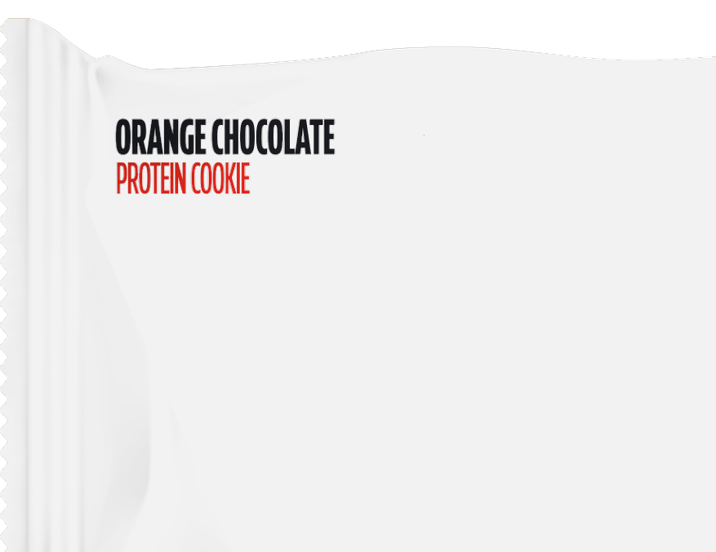
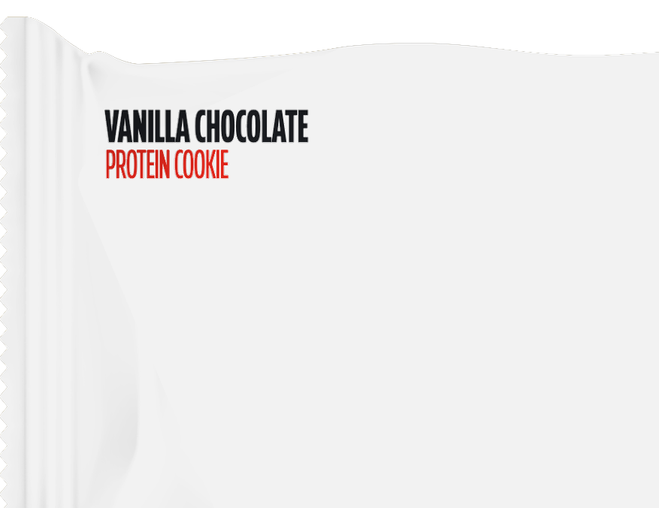
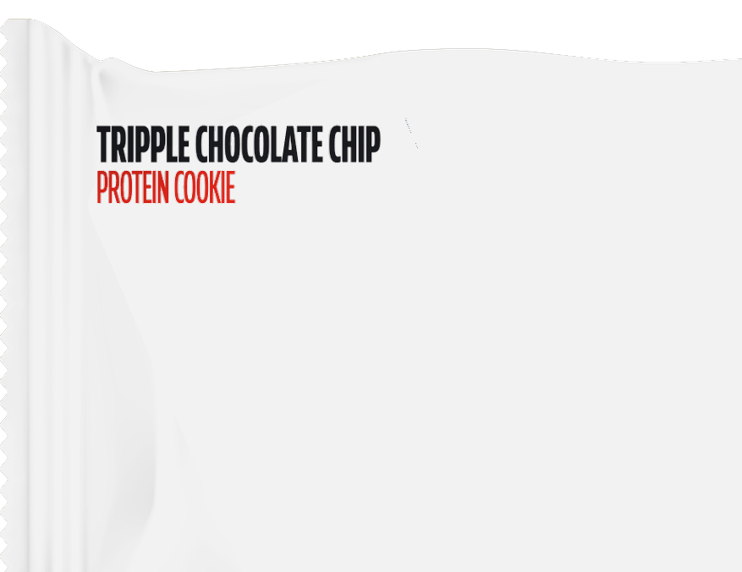
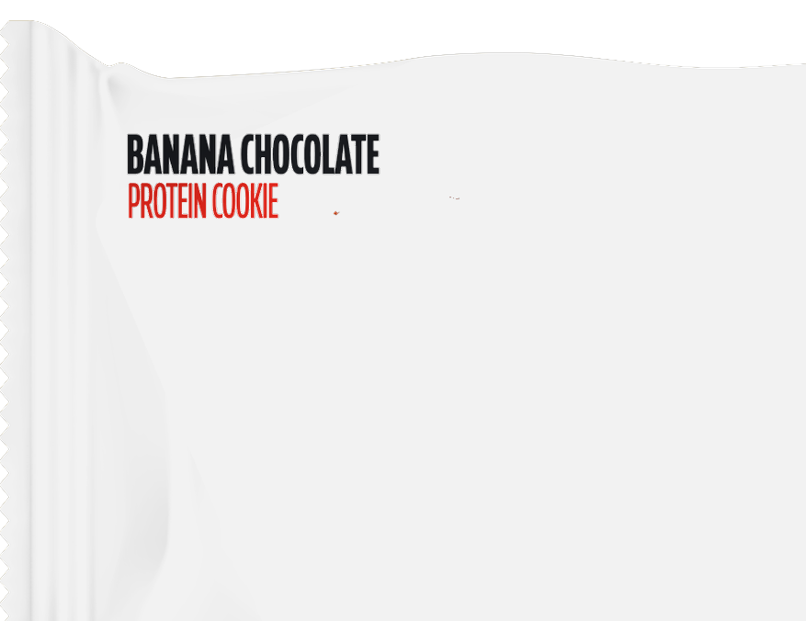
KEY FINDINGS: E_FLAVOUR · Can you read english? · 1 of 3
E_Flavour splits across the groups
No favors E05 Orange Chocolate Top Left Dark Text Panel; Yes favor Vanilla Chocolate Top Left Dark Text Panel.
E_FLAVOUR
E05 Orange Chocolate
Top Left Dark Text…
+24
E05 Orange
Chocolate Top Left…
Vanilla Chocolate
Top Left Dark Text…
+18
+21*
0*
Vanilla Chocolate
Top Left Dark Text…
-25
+24
E02 Tripple
Chocolate Chip Top…
+7
+23
E08 Banana Chocolate
Top Left Dark Text…
-40
+23
E02 Tripple
Chocolate Chip Top…
E08 Banana
Chocolate Top Left…
-50
0
50
+15*
-8*
No (basesize = 1)
Yes (basesize = 149)
No favors E05 Orange Chocolate Top Left Dark Text Panel; Yes favor Vanilla Chocolate Top Left Dark Text Panel. The widest segment gap is E08 Banana Chocolate Top Left Dark Text Panel: -40 no / +23 yes.
No basesize = 1; Yes basesize = 149. Top-2 scores rounded to whole points. *Average of the groups in the legend.
60

Slide 61
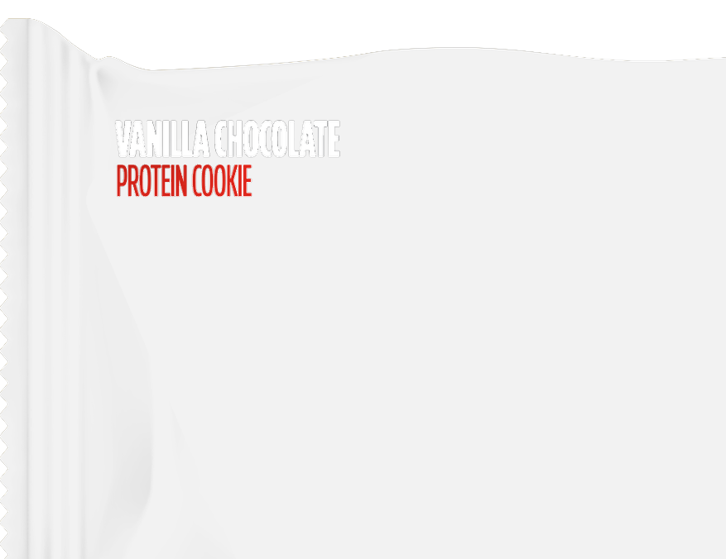
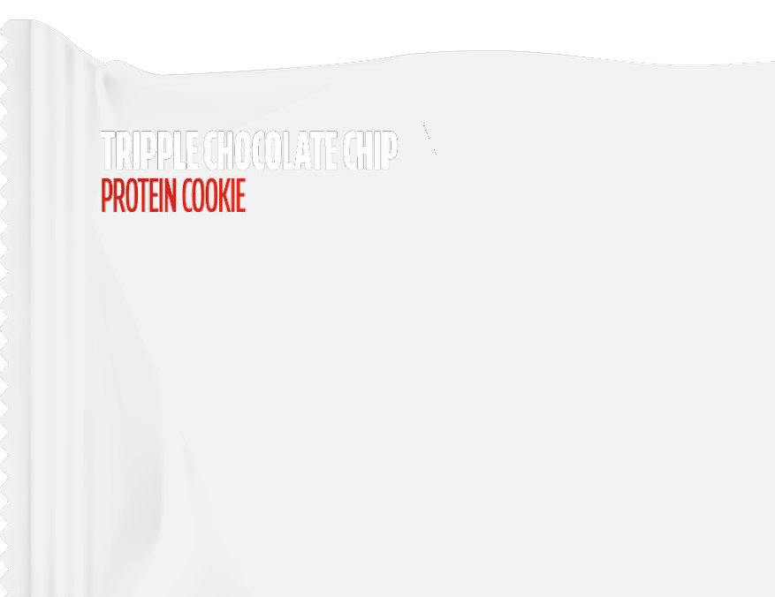
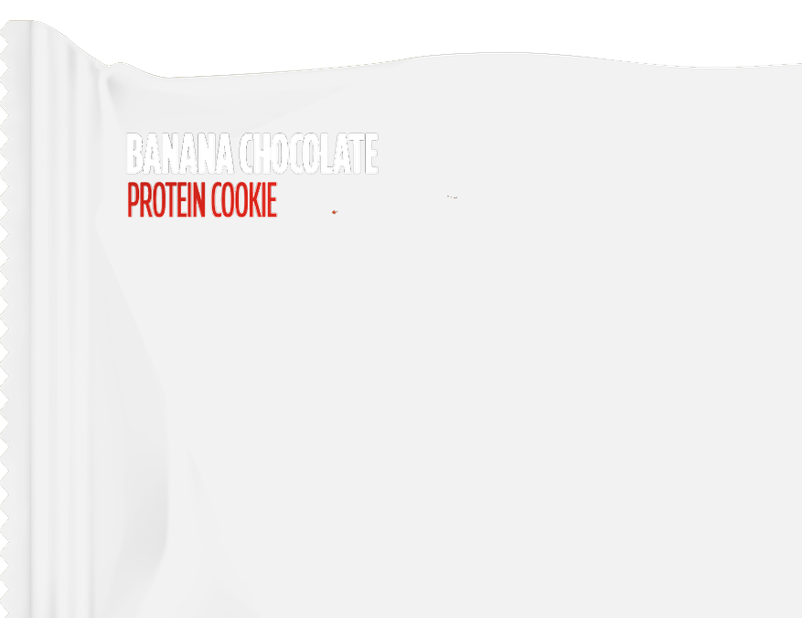
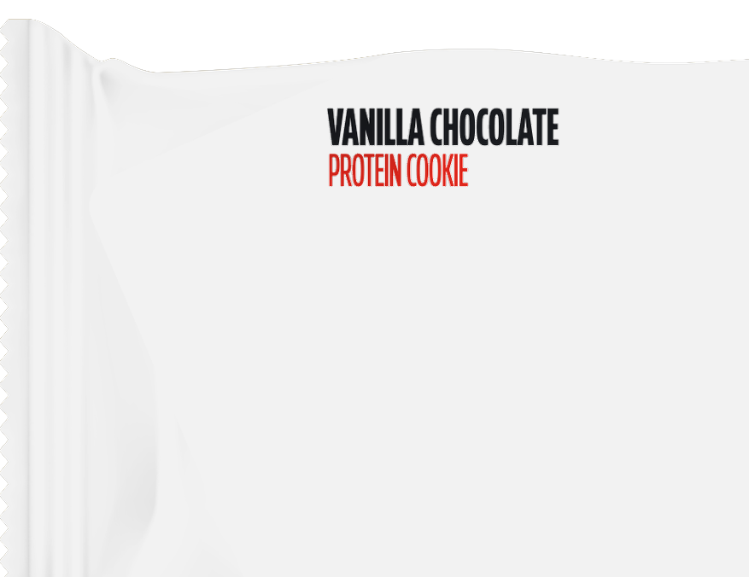
KEY FINDINGS: E_FLAVOUR · Can you read english? · 2 of 3
E_Flavour splits across the groups
No favors E05 Orange Chocolate Top Left Dark Text Panel; Yes favor Vanilla Chocolate Top Left Dark Text Panel.
E_FLAVOUR
Vanilla Chocolate
Top Left White Text…
+14
Vanilla Chocolate
Top Left White Text…
E03 Tripple
Chocolate Chip Top…
+11
+12*
-2*
E03 Tripple
Chocolate Chip Top…
-15
+12
E09 Banana Chocolate
Top Left White Text…
+10
+12
Vanilla Chocolate
Top Centre Dark Text…
-23
+12
E09 Banana
Chocolate Top Left…
Vanilla Chocolate
Top Centre Dark…
-40
-20
0
20
+11*
-6*
No (basesize = 1)
Yes (basesize = 149)
No favors E05 Orange Chocolate Top Left Dark Text Panel; Yes favor Vanilla Chocolate Top Left Dark Text Panel. The widest segment gap is E08 Banana Chocolate Top Left Dark Text Panel: -40 no / +23 yes.
No basesize = 1; Yes basesize = 149. Top-2 scores rounded to whole points. *Average of the groups in the legend.
61

Slide 62
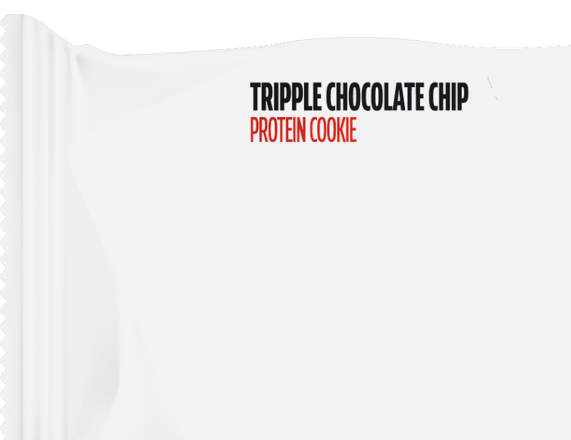


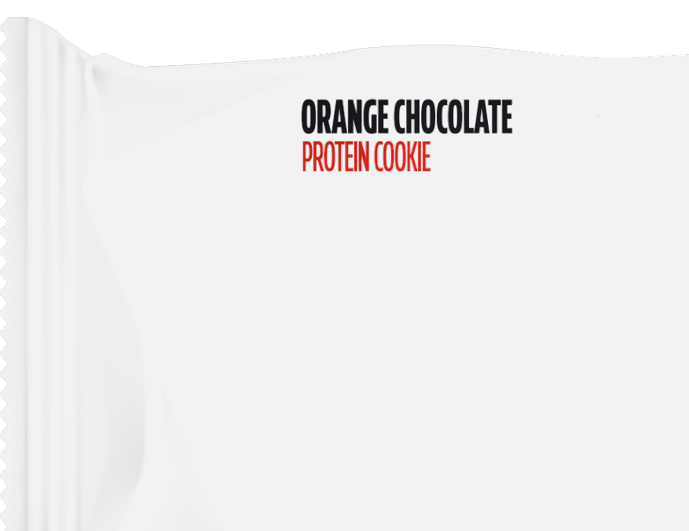
KEY FINDINGS: E_FLAVOUR · Can you read english? · 3 of 3
E_Flavour splits across the groups
No favors E05 Orange Chocolate Top Left Dark Text Panel; Yes favor Vanilla Chocolate Top Left Dark Text Panel.
E_FLAVOUR
E01 Tripple
Chocolate Chip Top…
+8
E01 Tripple
Chocolate Chip Top…
E06 Orange
Chocolate Top Left…
+11
+10*
+4*
E06 Orange Chocolate
Top Left White Text…
-4
+11
E07 Banana Chocolate
Top Centre Dark Text…
-3
+9
E04 Orange Chocolate
Top Centre Dark Text…
+8
+8
E07 Banana
Chocolate Top…
E04 Orange
Chocolate Top…
-10
0
10
20
+3*
+8*
No (basesize = 1)
Yes (basesize = 149)
No favors E05 Orange Chocolate Top Left Dark Text Panel; Yes favor Vanilla Chocolate Top Left Dark Text Panel. The widest segment gap is E08 Banana Chocolate Top Left Dark Text Panel: -40 no / +23 yes.
No basesize = 1; Yes basesize = 149. Top-2 scores rounded to whole points. *Average of the groups in the legend.
62

Slide 63
KEY FINDINGS: E_FLAVOUR · Which of these countries do you live in? · 1 of 3
E_Flavour splits across the groups
Bulgaria favors E02 Tripple Chocolate Chip Top Left Dark Text Panel; Greece favors E02 Tripple Chocolate Chip Top Left Dark Text Panel; Saudi Arabia favors Vanilla Chocolate Top Left Dark Text Panel.
E_FLAVOUR
E02 Tripple
Chocolate Chip Top…
+20
+26
E02 Tripple
Chocolate Chip Top…
Vanilla Chocolate
Top Left Dark Text…
+21
+22*
+23*
Vanilla Chocolate
Top Left Dark Text…
+20
+23
+26
E08 Banana Chocolate
Top Left Dark Text…
+19
+25
+25
E05 Orange Chocolate
Top Left Dark Text…
+17
+21
E08 Banana
Chocolate Top Left…
E05 Orange
Chocolate Top Left…
+15
0
10
20
30
40
+23*
+18*
Bulgaria (basesize = 50)
Greece (basesize = 49)
Saudi Arabia (basesize = 51)
Bulgaria favors E02 Tripple Chocolate Chip Top Left Dark Text Panel; Greece favors E02 Tripple Chocolate Chip Top Left Dark Text Panel; Saudi Arabia favors Vanilla Chocolate Top Left Dark Text Panel. The widest segment gap is Vanilla Chocolate Top Centre Dark Text D2D3 Panel: +7 bulgaria / +17 greece / +11 saudi arabia.
Bulgaria basesize = 50; Greece basesize = 49; Saudi Arabia basesize = 51. Top-2 scores rounded to whole points. *Average of the groups in the legend.
63

Slide 64
KEY FINDINGS: E_FLAVOUR · Which of these countries do you live in? · 2 of 3
E_Flavour splits across the groups
Bulgaria favors E02 Tripple Chocolate Chip Top Left Dark Text Panel; Greece favors E02 Tripple Chocolate Chip Top Left Dark Text Panel; Saudi Arabia favors Vanilla Chocolate Top Left Dark Text Panel.
E_FLAVOUR
Vanilla Chocolate
Top Centre Dark Text…
+7
+17
Vanilla Chocolate
Top Centre Dark…
E01 Tripple
Chocolate Chip Top…
+11
+12*
+11*
E01 Tripple
Chocolate Chip Top…
+8
+10
+16
E03 Tripple
Chocolate Chip Top…
+7
+15
+12
E06 Orange Chocolate
Top Left White Text…
+12
+8
E03 Tripple
Chocolate Chip Top…
E06 Orange
Chocolate Top Left…
+14
0
5
10
15
20
+11*
+11*
Bulgaria (basesize = 50)
Greece (basesize = 49)
Saudi Arabia (basesize = 51)
Bulgaria favors E02 Tripple Chocolate Chip Top Left Dark Text Panel; Greece favors E02 Tripple Chocolate Chip Top Left Dark Text Panel; Saudi Arabia favors Vanilla Chocolate Top Left Dark Text Panel. The widest segment gap is Vanilla Chocolate Top Centre Dark Text D2D3 Panel: +7 bulgaria / +17 greece / +11 saudi arabia.
Bulgaria basesize = 50; Greece basesize = 49; Saudi Arabia basesize = 51. Top-2 scores rounded to whole points. *Average of the groups in the legend.
64

Slide 65
KEY FINDINGS: E_FLAVOUR · Which of these countries do you live in? · 3 of 3
E_Flavour splits across the groups
Bulgaria favors E02 Tripple Chocolate Chip Top Left Dark Text Panel; Greece favors E02 Tripple Chocolate Chip Top Left Dark Text Panel; Saudi Arabia favors Vanilla Chocolate Top Left Dark Text Panel.
E_FLAVOUR
E09 Banana Chocolate
Top Left White Text…
+11
+10
E09 Banana
Chocolate Top Left…
Vanilla Chocolate
Top Left White Text…
+14
+12*
+11*
Vanilla Chocolate
Top Left White Text…
+13
+10
+11
E04 Orange Chocolate
Top Centre Dark Text…
+7
+6
+11
E07 Banana Chocolate
Top Centre Dark Text…
+9
+9
E04 Orange
Chocolate Top…
E07 Banana
Chocolate Top…
+10
0
5
10
15
20
+8*
+9*
Bulgaria (basesize = 50)
Greece (basesize = 49)
Saudi Arabia (basesize = 51)
Bulgaria favors E02 Tripple Chocolate Chip Top Left Dark Text Panel; Greece favors E02 Tripple Chocolate Chip Top Left Dark Text Panel; Saudi Arabia favors Vanilla Chocolate Top Left Dark Text Panel. The widest segment gap is Vanilla Chocolate Top Centre Dark Text D2D3 Panel: +7 bulgaria / +17 greece / +11 saudi arabia.
Bulgaria basesize = 50; Greece basesize = 49; Saudi Arabia basesize = 51. Top-2 scores rounded to whole points. *Average of the groups in the legend.
65

Slide 66
KEY FINDINGS: E_FLAVOUR · Do you currently consume protein-enriched food products · 1 of 3
E_Flavour splits across the groups
No, and I am not interested favors E01 Tripple Chocolate Chip Top Centre Dark Text D2D3 Panel; No, but I am interested in trying them favors E02 Tripple Chocolate Chip Top Left Dark Text Panel; Yes, occasionally favors Vanilla Chocolate Top Left Dark Text Panel; Yes, regularly favors Vanilla Chocolate Top Left Dark Text Panel.
E_FLAVOUR
Vanilla Chocolate
Top Left Dark Text…
-18
+18
+19
Vanilla Chocolate
Top Left Dark Text…
E05 Orange
Chocolate Top Left…
+31
+12*
+12*
E05 Orange Chocolate
Top Left Dark Text…
+1
+16
+3
+30
E08 Banana Chocolate
Top Left Dark Text…
0
+15
+18
+30
E02 Tripple
Chocolate Chip Top…
+10
+20
+17
+28
-50
0
50
E08 Banana
Chocolate Top Left…
E02 Tripple
Chocolate Chip Top…
No, and I am not interested (basesize = 5)
+16*
+19*
No, but I am interested in trying them (basesize = 15)
Yes, occasionally (basesize = 56)
Yes, regularly (basesize = 74)
No, and I am not interested favors E01 Tripple Chocolate Chip Top Centre Dark Text D2D3 Panel; No, but I am interested in trying them favors E02 Tripple Chocolate Chip Top Left Dark Text Panel; Yes, occasionally favors Vanilla Chocolate Top Left Dark Text Panel; Yes, regularly favors Vanilla Chocolate Top Left Dark Text Panel. The widest segment gap is Vanilla Chocolate Top Left Dark Text Panel: -18 no, and i am not interested / +18 no, but i am interested in trying them / +19 yes, occasionally / +31 yes, regularly.
Top-2 scores rounded to whole points. *Average of the groups in the legend.
66

Slide 67
KEY FINDINGS: E_FLAVOUR · Do you currently consume protein-enriched food products · 2 of 3
E_Flavour splits across the groups
No, and I am not interested favors E01 Tripple Chocolate Chip Top Centre Dark Text D2D3 Panel; No, but I am interested in trying them favors E02 Tripple Chocolate Chip Top Left Dark Text Panel; Yes, occasionally favors Vanilla Chocolate Top Left Dark Text Panel; Yes, regularly favors Vanilla Chocolate Top Left Dark Text Panel.
E_FLAVOUR
Vanilla Chocolate
Top Left White Text…
-15
+17
+8
Vanilla Chocolate
Top Left White Text…
E06 Orange
Chocolate Top Left…
+14
+6*
+8*
E06 Orange Chocolate
Top Left White Text…
+3
+4
+8
+16
E09 Banana Chocolate
Top Left White Text…
-7
+10
+9
+16
E03 Tripple
Chocolate Chip Top…
-10
+2
+11
+15
-20
-10
0
10
20
E09 Banana
Chocolate Top Left…
E03 Tripple
Chocolate Chip Top…
No, and I am not interested (basesize = 5)
+7*
+4*
No, but I am interested in trying them (basesize = 15)
Yes, occasionally (basesize = 56)
Yes, regularly (basesize = 74)
No, and I am not interested favors E01 Tripple Chocolate Chip Top Centre Dark Text D2D3 Panel; No, but I am interested in trying them favors E02 Tripple Chocolate Chip Top Left Dark Text Panel; Yes, occasionally favors Vanilla Chocolate Top Left Dark Text Panel; Yes, regularly favors Vanilla Chocolate Top Left Dark Text Panel. The widest segment gap is Vanilla Chocolate Top Left Dark Text Panel: -18 no, and i am not interested / +18 no, but i am interested in trying them / +19 yes, occasionally / +31 yes, regularly.
Top-2 scores rounded to whole points. *Average of the groups in the legend.
67

Slide 68
KEY FINDINGS: E_FLAVOUR · Do you currently consume protein-enriched food products · 3 of 3
E_Flavour splits across the groups
No, and I am not interested favors E01 Tripple Chocolate Chip Top Centre Dark Text D2D3 Panel; No, but I am interested in trying them favors E02 Tripple Chocolate Chip Top Left Dark Text Panel; Yes, occasionally favors Vanilla Chocolate Top Left Dark Text Panel; Yes, regularly favors Vanilla Chocolate Top Left Dark Text Panel.
E_FLAVOUR
Vanilla Chocolate
Top Centre Dark Text…
+5
+15
+12
Vanilla Chocolate
Top Centre Dark…
E01 Tripple
Chocolate Chip Top…
+12
+11*
+10*
E01 Tripple
Chocolate Chip Top…
+3
+10
+12
+13
E07 Banana Chocolate
Top Centre Dark Text…
+9
+12
+5
+12
E04 Orange Chocolate
Top Centre Dark Text…
+6
+5
+6
+11
0
5
10
15
20
E07 Banana
Chocolate Top…
E04 Orange
Chocolate Top…
No, and I am not interested (basesize = 5)
+10*
+7*
No, but I am interested in trying them (basesize = 15)
Yes, occasionally (basesize = 56)
Yes, regularly (basesize = 74)
No, and I am not interested favors E01 Tripple Chocolate Chip Top Centre Dark Text D2D3 Panel; No, but I am interested in trying them favors E02 Tripple Chocolate Chip Top Left Dark Text Panel; Yes, occasionally favors Vanilla Chocolate Top Left Dark Text Panel; Yes, regularly favors Vanilla Chocolate Top Left Dark Text Panel. The widest segment gap is Vanilla Chocolate Top Left Dark Text Panel: -18 no, and i am not interested / +18 no, but i am interested in trying them / +19 yes, occasionally / +31 yes, regularly.
Top-2 scores rounded to whole points. *Average of the groups in the legend.
68

Slide 69
KEY FINDINGS: E_FLAVOUR · What would be your ideal way to consume protein-enriched products? · 1 of 3
E_Flavour splits across the groups
Other favors E07 Banana Chocolate Top Centre Dark Text D2D3 Panel; Protein bars favor E08 Banana Chocolate Top Left Dark Text Panel; Protein cookies favor Vanilla Chocolate Top Left Dark Text Panel; Protein powder favors E02 Tripple Chocolate Chip Top Left Dark Text Panel.
E_FLAVOUR
E08 Banana Chocolate
Top Left Dark Text…
+10
+28
+23
E08 Banana
Chocolate Top Left…
Vanilla Chocolate
Top Left Dark Text…
+13
+18*
+17*
Vanilla Chocolate
Top Left Dark Text…
+1
+22
+16
+28
E02 Tripple
Chocolate Chip Top…
+11
+26
+22
+22
E05 Orange Chocolate
Top Left Dark Text…
+3
+24
+15
+22
E02 Tripple
Chocolate Chip Top…
E05 Orange
Chocolate Top Left…
0
10
20
30
40
+20*
+16*
Other (basesize = 10)
Protein bars (basesize = 52)
Protein cookies (basesize = 80)
Protein powder (basesize = 8)
Other favors E07 Banana Chocolate Top Centre Dark Text D2D3 Panel; Protein bars favor E08 Banana Chocolate Top Left Dark Text Panel; Protein cookies favor Vanilla Chocolate Top Left Dark Text Panel; Protein powder favors E02 Tripple Chocolate Chip Top Left Dark Text Panel. The widest segment gap is Vanilla Chocolate Top Left Dark Text Panel: +1 other / +22 protein bars / +28 protein cookies / +16 protein powder.
Top-2 scores rounded to whole points. *Average of the groups in the legend.
69

Slide 70
KEY FINDINGS: E_FLAVOUR · What would be your ideal way to consume protein-enriched products? · 2 of 3
E_Flavour splits across the groups
Other favors E07 Banana Chocolate Top Centre Dark Text D2D3 Panel; Protein bars favor E08 Banana Chocolate Top Left Dark Text Panel; Protein cookies favor Vanilla Chocolate Top Left Dark Text Panel; Protein powder favors E02 Tripple Chocolate Chip Top Left Dark Text Panel.
E_FLAVOUR
E06 Orange Chocolate
Top Left White Text…
+8
+16
+9
E06 Orange
Chocolate Top Left…
E09 Banana
Chocolate Top Left…
+7
+10*
+10*
E09 Banana Chocolate
Top Left White Text…
+6
+16
+6
+10
E03 Tripple
Chocolate Chip Top…
-6
+15
+6
+12
Vanilla Chocolate
Top Left White Text…
-4
+13
+11
+15
E03 Tripple
Chocolate Chip Top…
Vanilla Chocolate
Top Left White Text…
-10
0
10
20
+7*
+9*
Other (basesize = 10)
Protein bars (basesize = 52)
Protein cookies (basesize = 80)
Protein powder (basesize = 8)
Other favors E07 Banana Chocolate Top Centre Dark Text D2D3 Panel; Protein bars favor E08 Banana Chocolate Top Left Dark Text Panel; Protein cookies favor Vanilla Chocolate Top Left Dark Text Panel; Protein powder favors E02 Tripple Chocolate Chip Top Left Dark Text Panel. The widest segment gap is Vanilla Chocolate Top Left Dark Text Panel: +1 other / +22 protein bars / +28 protein cookies / +16 protein powder.
Top-2 scores rounded to whole points. *Average of the groups in the legend.
70

Slide 71
KEY FINDINGS: E_FLAVOUR · What would be your ideal way to consume protein-enriched products? · 3 of 3
E_Flavour splits across the groups
Other favors E07 Banana Chocolate Top Centre Dark Text D2D3 Panel; Protein bars favor E08 Banana Chocolate Top Left Dark Text Panel; Protein cookies favor Vanilla Chocolate Top Left Dark Text Panel; Protein powder favors E02 Tripple Chocolate Chip Top Left Dark Text Panel.
E_FLAVOUR
E07 Banana Chocolate
Top Centre Dark Text…
+11
+12
+7
E07 Banana
Chocolate Top…
E01 Tripple
Chocolate Chip Top…
+14
+11*
+9*
E01 Tripple
Chocolate Chip Top…
+10
+11
+3
+13
Vanilla Chocolate
Top Centre Dark Text…
+4
+12
+7
+13
E04 Orange Chocolate
Top Centre Dark Text…
+10
+7
+10
+4
Vanilla Chocolate
Top Centre Dark…
E04 Orange
Chocolate Top…
0
5
10
15
20
+9*
+8*
Other (basesize = 10)
Protein bars (basesize = 52)
Protein cookies (basesize = 80)
Protein powder (basesize = 8)
Other favors E07 Banana Chocolate Top Centre Dark Text D2D3 Panel; Protein bars favor E08 Banana Chocolate Top Left Dark Text Panel; Protein cookies favor Vanilla Chocolate Top Left Dark Text Panel; Protein powder favors E02 Tripple Chocolate Chip Top Left Dark Text Panel. The widest segment gap is Vanilla Chocolate Top Left Dark Text Panel: +1 other / +22 protein bars / +28 protein cookies / +16 protein powder.
Top-2 scores rounded to whole points. *Average of the groups in the legend.
71

Slide 72
KEY FINDINGS: E_FLAVOUR · How familiar are you with the Fitspo brand? · 1 of 3
E_Flavour splits across the groups
Heard of it, but know little about it favors Vanilla Chocolate Top Left Dark Text Panel; Not familiar at all favors E08 Banana Chocolate Top Left Dark Text Panel; Somewhat familiar favors E08 Banana Chocolate Top Left Dark Text Panel; Very familiar favors E02 Tripple Chocolate Chip Top Left Dark Text Panel.
E_FLAVOUR
E08 Banana Chocolate
Top Left Dark Text…
+1
+18
+31
E08 Banana
Chocolate Top Left…
Vanilla Chocolate
Top Left Dark Text…
+27
+19*
+20*
Vanilla Chocolate
Top Left Dark Text…
+11
+15
+27
+29
E02 Tripple
Chocolate Chip Top…
+10
+13
+28
+27
E05 Orange Chocolate
Top Left Dark Text…
+4
+9
+21
+24
E02 Tripple
Chocolate Chip Top…
E05 Orange
Chocolate Top Left…
0
10
20
30
40
+20*
+14*
Heard of it, but know little about it (basesize = 22)
Not familiar at all (basesize = 25)
Somewhat familiar (basesize = 49)
Very familiar (basesize = 54)
Heard of it, but know little about it favors Vanilla Chocolate Top Left Dark Text Panel; Not familiar at all favors E08 Banana Chocolate Top Left Dark Text Panel; Somewhat familiar favors E08 Banana Chocolate Top Left Dark Text Panel; Very familiar favors E02 Tripple Chocolate Chip Top Left Dark Text Panel. The widest segment gap is E08 Banana Chocolate Top Left Dark Text Panel: +1 heard of it, but know little about it / +18 not familiar at all / +31 somewhat familiar / +27 very familiar.
Top-2 scores rounded to whole points. *Average of the groups in the legend.
72

Slide 73
KEY FINDINGS: E_FLAVOUR · How familiar are you with the Fitspo brand? · 2 of 3
E_Flavour splits across the groups
Heard of it, but know little about it favors Vanilla Chocolate Top Left Dark Text Panel; Not familiar at all favors E08 Banana Chocolate Top Left Dark Text Panel; Somewhat familiar favors E08 Banana Chocolate Top Left Dark Text Panel; Very familiar favors E02 Tripple Chocolate Chip Top Left Dark Text Panel.
E_FLAVOUR
E06 Orange Chocolate
Top Left White Text…
-4
+3
+20
E06 Orange
Chocolate Top Left…
Vanilla Chocolate
Top Centre Dark…
+14
+8*
+11*
Vanilla Chocolate
Top Centre Dark Text…
+2
+17
+11
+14
E09 Banana Chocolate
Top Left White Text…
+8
+7
+11
+16
Vanilla Chocolate
Top Left White Text…
+7
+10
+9
+16
E09 Banana
Chocolate Top Left…
Vanilla Chocolate
Top Left White Text…
-10
0
10
20
+10*
+10*
Heard of it, but know little about it (basesize = 22)
Not familiar at all (basesize = 25)
Somewhat familiar (basesize = 49)
Very familiar (basesize = 54)
Heard of it, but know little about it favors Vanilla Chocolate Top Left Dark Text Panel; Not familiar at all favors E08 Banana Chocolate Top Left Dark Text Panel; Somewhat familiar favors E08 Banana Chocolate Top Left Dark Text Panel; Very familiar favors E02 Tripple Chocolate Chip Top Left Dark Text Panel. The widest segment gap is E08 Banana Chocolate Top Left Dark Text Panel: +1 heard of it, but know little about it / +18 not familiar at all / +31 somewhat familiar / +27 very familiar.
Top-2 scores rounded to whole points. *Average of the groups in the legend.
73

Slide 74
KEY FINDINGS: E_FLAVOUR · How familiar are you with the Fitspo brand? · 3 of 3
E_Flavour splits across the groups
Heard of it, but know little about it favors Vanilla Chocolate Top Left Dark Text Panel; Not familiar at all favors E08 Banana Chocolate Top Left Dark Text Panel; Somewhat familiar favors E08 Banana Chocolate Top Left Dark Text Panel; Very familiar favors E02 Tripple Chocolate Chip Top Left Dark Text Panel.
E_FLAVOUR
E03 Tripple
Chocolate Chip Top…
+7
+8
+12
E03 Tripple
Chocolate Chip Top…
E01 Tripple
Chocolate Chip Top…
+15
+10*
+10*
E01 Tripple
Chocolate Chip Top…
+6
+8
+13
+14
E07 Banana Chocolate
Top Centre Dark Text…
+4
+4
+12
+11
E04 Orange Chocolate
Top Centre Dark Text…
-1
+7
+10
+10
E07 Banana
Chocolate Top…
E04 Orange
Chocolate Top…
-10
0
10
20
+8*
+6*
Heard of it, but know little about it (basesize = 22)
Not familiar at all (basesize = 25)
Somewhat familiar (basesize = 49)
Very familiar (basesize = 54)
Heard of it, but know little about it favors Vanilla Chocolate Top Left Dark Text Panel; Not familiar at all favors E08 Banana Chocolate Top Left Dark Text Panel; Somewhat familiar favors E08 Banana Chocolate Top Left Dark Text Panel; Very familiar favors E02 Tripple Chocolate Chip Top Left Dark Text Panel. The widest segment gap is E08 Banana Chocolate Top Left Dark Text Panel: +1 heard of it, but know little about it / +18 not familiar at all / +31 somewhat familiar / +27 very familiar.
Top-2 scores rounded to whole points. *Average of the groups in the legend.
74

Slide 75
KEY FINDINGS: E_FLAVOUR · How often do you purchase Fitspo products? · 1 of 3
E_Flavour splits across the groups
Have never purchased Fitspo products favor E02 Tripple Chocolate Chip Top Left Dark Text Panel; Have purchased in the past, but not currently favors E08 Banana Chocolate Top Left Dark Text Panel; Occasionally favors E08 Banana Chocolate Top Left Dark Text Panel; Regularly favors Vanilla Chocolate Top Left Dark Text Panel.
E_FLAVOUR
E08 Banana Chocolate
Top Left Dark Text…
+12
+37
+25
E08 Banana
Chocolate Top Left…
E02 Tripple
Chocolate Chip Top…
+26
+25*
+24*
E02 Tripple
Chocolate Chip Top…
+16
+34
+23
+23
Vanilla Chocolate
Top Left Dark Text…
+12
+31
+24
+29
E05 Orange Chocolate
Top Left Dark Text…
+7
+24
+15
+27
0
10
20
30
40
Vanilla Chocolate
Top Left Dark Text…
E05 Orange
Chocolate Top Left…
Have never purchased Fitspo products (basesize = 37)
+24*
+18*
Have purchased in the past, but not currently (basesize = 12)
Occasionally (basesize = 56)
Regularly (basesize = 45)
Have never purchased Fitspo products favor E02 Tripple Chocolate Chip Top Left Dark Text Panel; Have purchased in the past, but not currently favors E08 Banana Chocolate Top Left Dark Text Panel; Occasionally favors E08 Banana Chocolate Top Left Dark Text Panel; Regularly favors Vanilla Chocolate Top Left Dark Text Panel. The widest segment gap is E08 Banana Chocolate Top Left Dark Text Panel: +12 have never purchased fitspo products / +37 have purchased in the past, but not currently / +25 occasionally / +26 regularly.
Top-2 scores rounded to whole points. *Average of the groups in the legend.
75

Slide 76
KEY FINDINGS: E_FLAVOUR · How often do you purchase Fitspo products? · 2 of 3
E_Flavour splits across the groups
Have never purchased Fitspo products favor E02 Tripple Chocolate Chip Top Left Dark Text Panel; Have purchased in the past, but not currently favors E08 Banana Chocolate Top Left Dark Text Panel; Occasionally favors E08 Banana Chocolate Top Left Dark Text Panel; Regularly favors Vanilla Chocolate Top Left Dark Text Panel.
E_FLAVOUR
E06 Orange Chocolate
Top Left White Text…
+1
+20
+12
E06 Orange
Chocolate Top Left…
E03 Tripple
Chocolate Chip Top…
+16
+12*
+11*
E03 Tripple
Chocolate Chip Top…
+8
+10
+9
+16
E09 Banana Chocolate
Top Left White Text…
+9
+11
+11
+16
E01 Tripple
Chocolate Chip Top…
0
+9
+13
+15
0
5
10
15
20
E09 Banana
Chocolate Top Left…
E01 Tripple
Chocolate Chip Top…
Have never purchased Fitspo products (basesize = 37)
+12*
+9*
Have purchased in the past, but not currently (basesize = 12)
Occasionally (basesize = 56)
Regularly (basesize = 45)
Have never purchased Fitspo products favor E02 Tripple Chocolate Chip Top Left Dark Text Panel; Have purchased in the past, but not currently favors E08 Banana Chocolate Top Left Dark Text Panel; Occasionally favors E08 Banana Chocolate Top Left Dark Text Panel; Regularly favors Vanilla Chocolate Top Left Dark Text Panel. The widest segment gap is E08 Banana Chocolate Top Left Dark Text Panel: +12 have never purchased fitspo products / +37 have purchased in the past, but not currently / +25 occasionally / +26 regularly.
Top-2 scores rounded to whole points. *Average of the groups in the legend.
76

Slide 77
KEY FINDINGS: E_FLAVOUR · How often do you purchase Fitspo products? · 3 of 3
E_Flavour splits across the groups
Have never purchased Fitspo products favor E02 Tripple Chocolate Chip Top Left Dark Text Panel; Have purchased in the past, but not currently favors E08 Banana Chocolate Top Left Dark Text Panel; Occasionally favors E08 Banana Chocolate Top Left Dark Text Panel; Regularly favors Vanilla Chocolate Top Left Dark Text Panel.
E_FLAVOUR
E04 Orange Chocolate
Top Centre Dark Text…
+2
+10
+7
E04 Orange
Chocolate Top…
Vanilla Chocolate
Top Left White Text…
+14
+8*
+11*
Vanilla Chocolate
Top Left White Text…
+10
+12
+9
+14
E07 Banana Chocolate
Top Centre Dark Text…
+6
+6
+9
+13
Vanilla Chocolate
Top Centre Dark Text…
+10
+13
+11
+12
0
5
10
15
20
E07 Banana
Chocolate Top…
Vanilla Chocolate
Top Centre Dark…
Have never purchased Fitspo products (basesize = 37)
+8*
+12*
Have purchased in the past, but not currently (basesize = 12)
Occasionally (basesize = 56)
Regularly (basesize = 45)
Have never purchased Fitspo products favor E02 Tripple Chocolate Chip Top Left Dark Text Panel; Have purchased in the past, but not currently favors E08 Banana Chocolate Top Left Dark Text Panel; Occasionally favors E08 Banana Chocolate Top Left Dark Text Panel; Regularly favors Vanilla Chocolate Top Left Dark Text Panel. The widest segment gap is E08 Banana Chocolate Top Left Dark Text Panel: +12 have never purchased fitspo products / +37 have purchased in the past, but not currently / +25 occasionally / +26 regularly.
Top-2 scores rounded to whole points. *Average of the groups in the legend.
77

Slide 78



KEY FINDINGS: F_GLUTEN-FREE · Can you read english? · 1 of 2
F_Gluten-free splits across the groups
No favors F03 Gluten Green Top Right; Yes favor F02 Gluten Free Badge White Top Right D1 Foil.
F_GLUTEN-FREE
F02 Gluten Free Badge White Top Right
D1 Foil
-8*
F02 Gluten Free
Badge White Top…
-23
+7
F04 Gluten Free
Blank
-37
F04 Gluten Free Blank
+6
-16*
F01 Gluten Free
Badge Dark Bottom…
-19
+5
F01 Gluten Free Badge Dark Bottom
Right D2D3
-40
-20
0
20
-7*
No (basesize = 1)
Yes (basesize = 149)
No favors F03 Gluten Green Top Right; Yes favor F02 Gluten Free Badge White Top Right D1 Foil. The widest segment gap is F04 Gluten Free Blank: -37 no / +6 yes.
No basesize = 1; Yes basesize = 149. Top-2 scores rounded to whole points. *Average of the groups in the legend.
78

Slide 79


KEY FINDINGS: F_GLUTEN-FREE · Can you read english? · 2 of 2
F_Gluten-free splits across the groups
No favors F03 Gluten Green Top Right; Yes favor F02 Gluten Free Badge White Top Right D1 Foil.
F_GLUTEN-FREE
F04 Gluten Green
Bottom Right
-20
+5
F04 Gluten Green
Bottom Right
F03 Gluten Green
Top Right
F03 Gluten Green
Top Right
-2
-8*
+1*
+4
-20
-10
0
10
20
No (basesize = 1)
Yes (basesize = 149)
No favors F03 Gluten Green Top Right; Yes favor F02 Gluten Free Badge White Top Right D1 Foil. The widest segment gap is F04 Gluten Free Blank: -37 no / +6 yes.
No basesize = 1; Yes basesize = 149. Top-2 scores rounded to whole points. *Average of the groups in the legend.
79

Slide 80
KEY FINDINGS: F_GLUTEN-FREE · Which of these countries do you live in? · 1 of 2
F02 Gluten Free Badge White Top Right D1 Foil leads in every group
F02 Gluten Free Badge White Top Right D1 Foil leads every group; F01 Gluten Free Badge Dark Bottom Right D2D3 ranks last.
F_GLUTEN-FREE
F02 Gluten Free Badge White Top Right
D1 Foil
+7*
F02 Gluten Free
Badge White Top…
+7
+7
+6
F04 Gluten Green
Bottom Right
+7
F04 Gluten Green Bottom Right
+7
+1
+5*
F04 Gluten Free
Blank
+6
+7
+5
F04 Gluten Free Blank
0
5
10
+6*
Bulgaria (basesize = 50)
Greece (basesize = 49)
Saudi Arabia (basesize = 51)
Every group ranks F02 Gluten Free Badge White Top Right D1 Foil first. The widest segment gap is F04 Gluten Green Bottom Right: +7 bulgaria / +7 greece / +1 saudi arabia.
Bulgaria basesize = 50; Greece basesize = 49; Saudi Arabia basesize = 51. Top-2 scores rounded to whole points. *Average of the groups in the legend.
80

Slide 81
KEY FINDINGS: F_GLUTEN-FREE · Which of these countries do you live in? · 2 of 2
F02 Gluten Free Badge White Top Right D1 Foil leads in every group
F02 Gluten Free Badge White Top Right D1 Foil leads every group; F01 Gluten Free Badge Dark Bottom Right D2D3 ranks last.
F_GLUTEN-FREE
F01 Gluten Free
Badge Dark Bottom…
+6
+4
+5
F01 Gluten Free
Badge Dark Bottom…
F03 Gluten Green
Top Right
F03 Gluten Green
Top Right
+6
+5*
+4*
+5
+1
0
5
10
Bulgaria (basesize = 50)
Greece (basesize = 49)
Saudi Arabia (basesize = 51)
Every group ranks F02 Gluten Free Badge White Top Right D1 Foil first. The widest segment gap is F04 Gluten Green Bottom Right: +7 bulgaria / +7 greece / +1 saudi arabia.
Bulgaria basesize = 50; Greece basesize = 49; Saudi Arabia basesize = 51. Top-2 scores rounded to whole points. *Average of the groups in the legend.
81

Slide 82
KEY FINDINGS: F_GLUTEN-FREE · Do you currently consume protein-enriched food products · 1 of 2
F_Gluten-free splits across the groups
No, and I am not interested favors F04 Gluten Green Bottom Right; No, but I am interested in trying them favors F04 Gluten Green Bottom Right; Yes, occasionally favors F02 Gluten Free Badge White Top Right D1 Foil; Yes, regularly favors F02 Gluten Free Badge White Top Right D1 Foil.
F_GLUTEN-FREE
F04 Gluten Green Bottom Right
+8*
F04 Gluten Green
Bottom Right
+19
+2
+3
+6
F02 Gluten Free
Badge White Top…
+1
-3
F02 Gluten Free Badge White Top Right
D1 Foil
+4
+11
+3*
F03 Gluten Green
Top Right
+11
-3
+2
+6
-10
0
10
20
F03 Gluten Green Top Right
No, and I am not interested (basesize = 5)
No, but I am interested in trying them (basesize = 15)
Yes, occasionally (basesize = 56)
+4*
Yes, regularly (basesize = 74)
No, and I am not interested favors F04 Gluten Green Bottom Right; No, but I am interested in trying them favors F04 Gluten Green Bottom Right; Yes, occasionally favors F02 Gluten Free Badge White Top Right D1 Foil; Yes, regularly favors F02 Gluten Free Badge White Top Right D1 Foil. The widest segment gap is F04 Gluten Green Bottom Right: +19 no, and i am not interested / +2 no, but i am interested in trying them / +3 yes, occasionally / +6 yes, regularly.
Top-2 scores rounded to whole points. *Average of the groups in the legend.
82

Slide 83
KEY FINDINGS: F_GLUTEN-FREE · Do you currently consume protein-enriched food products · 2 of 2
F_Gluten-free splits across the groups
No, and I am not interested favors F04 Gluten Green Bottom Right; No, but I am interested in trying them favors F04 Gluten Green Bottom Right; Yes, occasionally favors F02 Gluten Free Badge White Top Right D1 Foil; Yes, regularly favors F02 Gluten Free Badge White Top Right D1 Foil.
F_GLUTEN-FREE
F01 Gluten Free
Badge Dark Bottom…
+5
-4
+3
+9
F04 Gluten Free
Blank
+9
F01 Gluten Free
Badge Dark Bottom…
F04 Gluten Free
Blank
-3
+4
+3*
+4*
+8
-10
-5
0
5
10
No, and I am not interested (basesize = 5)
No, but I am interested in trying them (basesize = 15)
Yes, occasionally (basesize = 56)
Yes, regularly (basesize = 74)
No, and I am not interested favors F04 Gluten Green Bottom Right; No, but I am interested in trying them favors F04 Gluten Green Bottom Right; Yes, occasionally favors F02 Gluten Free Badge White Top Right D1 Foil; Yes, regularly favors F02 Gluten Free Badge White Top Right D1 Foil. The widest segment gap is F04 Gluten Green Bottom Right: +19 no, and i am not interested / +2 no, but i am interested in trying them / +3 yes, occasionally / +6 yes, regularly.
Top-2 scores rounded to whole points. *Average of the groups in the legend.
83

Slide 84
KEY FINDINGS: F_GLUTEN-FREE · What would be your ideal way to consume protein-enriched products? · 1 of 2
F_Gluten-free splits across the groups
Other favors F03 Gluten Green Top Right; Protein bars favor F02 Gluten Free Badge White Top Right D1 Foil; Protein cookies favor F02 Gluten Free Badge White Top Right D1 Foil; Protein powder favors F03 Gluten Green Top Right.
F_GLUTEN-FREE
F02 Gluten Free Badge White Top Right
D1 Foil
+6*
F02 Gluten Free
Badge White Top…
+1
+11
+5
+6
F03 Gluten Green
Top Right
+6
F03 Gluten Green Top Right
+7
+1
+11
+6*
F01 Gluten Free
Badge Dark Bottom…
+4
+9
+3
+5
0
5
10
15
F01 Gluten Free Badge Dark Bottom
Right D2D3
Other (basesize = 10)
Protein bars (basesize = 52)
Protein cookies (basesize = 80)
+5*
Protein powder (basesize = 8)
Other favors F03 Gluten Green Top Right; Protein bars favor F02 Gluten Free Badge White Top Right D1 Foil; Protein cookies favor F02 Gluten Free Badge White Top Right D1 Foil; Protein powder favors F03 Gluten Green Top Right. The widest segment gap is F02 Gluten Free Badge White Top Right D1 Foil: +1 other / +11 protein bars / +5 protein cookies / +6 protein powder.
Top-2 scores rounded to whole points. *Average of the groups in the legend.
84

Slide 85
KEY FINDINGS: F_GLUTEN-FREE · What would be your ideal way to consume protein-enriched products? · 2 of 2
F_Gluten-free splits across the groups
Other favors F03 Gluten Green Top Right; Protein bars favor F02 Gluten Free Badge White Top Right D1 Foil; Protein cookies favor F02 Gluten Free Badge White Top Right D1 Foil; Protein powder favors F03 Gluten Green Top Right.
F_GLUTEN-FREE
F04 Gluten Free
Blank
+5
+7
+5
+9
F04 Gluten Green
Bottom Right
+6
F04 Gluten Free
Blank
F04 Gluten Green
Bottom Right
+6
+6*
+6*
+4
+6
0
5
10
Other (basesize = 10)
Protein bars (basesize = 52)
Protein cookies (basesize = 80)
Protein powder (basesize = 8)
Other favors F03 Gluten Green Top Right; Protein bars favor F02 Gluten Free Badge White Top Right D1 Foil; Protein cookies favor F02 Gluten Free Badge White Top Right D1 Foil; Protein powder favors F03 Gluten Green Top Right. The widest segment gap is F02 Gluten Free Badge White Top Right D1 Foil: +1 other / +11 protein bars / +5 protein cookies / +6 protein powder.
Top-2 scores rounded to whole points. *Average of the groups in the legend.
85

Slide 86
KEY FINDINGS: F_GLUTEN-FREE · How familiar are you with the Fitspo brand? · 1 of 2
F_Gluten-free splits across the groups
Heard of it, but know little about it favors F02 Gluten Free Badge White Top Right D1 Foil; Not familiar at all favors F01 Gluten Free Badge Dark Bottom Right D2D3; Somewhat familiar favors F04 Gluten Free Blank; Very familiar favors F01 Gluten Free Badge Dark Bottom Right D2D3.
F_GLUTEN-FREE
F01 Gluten Free Badge Dark Bottom
Right D2D3
+4*
F01 Gluten Free
Badge Dark Bottom…
0
+1
+2
+12
F02 Gluten Free
Badge White Top…
+2
F02 Gluten Free Badge White Top Right
D1 Foil
-1
+7
+12
+5*
F04 Gluten Free
Blank
-2
+1
+8
+9
-10
0
10
20
F04 Gluten Free Blank
Heard of it, but know little about it (basesize = 22)
Not familiar at all (basesize = 25)
+4*
Somewhat familiar (basesize = 49)
Very familiar (basesize = 54)
Heard of it, but know little about it favors F02 Gluten Free Badge White Top Right D1 Foil; Not familiar at all favors F01 Gluten Free Badge Dark Bottom Right D2D3; Somewhat familiar favors F04 Gluten Free Blank; Very familiar favors F01 Gluten Free Badge Dark Bottom Right D2D3. The widest segment gap is F02 Gluten Free Badge White Top Right D1 Foil: +2 heard of it, but know little about it / -1 not familiar at all / +7 somewhat familiar / +12 very familiar.
Top-2 scores rounded to whole points. *Average of the groups in the legend.
86

Slide 87
KEY FINDINGS: F_GLUTEN-FREE · How familiar are you with the Fitspo brand? · 2 of 2
F_Gluten-free splits across the groups
Heard of it, but know little about it favors F02 Gluten Free Badge White Top Right D1 Foil; Not familiar at all favors F01 Gluten Free Badge Dark Bottom Right D2D3; Somewhat familiar favors F04 Gluten Free Blank; Very familiar favors F01 Gluten Free Badge Dark Bottom Right D2D3.
F_GLUTEN-FREE
F03 Gluten Green
Top Right
+2
+1
+2
+8
F04 Gluten Green
Bottom Right
0
F03 Gluten Green
Top Right
F04 Gluten Green
Bottom Right
+1
+3*
+4*
+7
+7
0
5
10
Heard of it, but know little about it (basesize = 22)
Not familiar at all (basesize = 25)
Somewhat familiar (basesize = 49)
Very familiar (basesize = 54)
Heard of it, but know little about it favors F02 Gluten Free Badge White Top Right D1 Foil; Not familiar at all favors F01 Gluten Free Badge Dark Bottom Right D2D3; Somewhat familiar favors F04 Gluten Free Blank; Very familiar favors F01 Gluten Free Badge Dark Bottom Right D2D3. The widest segment gap is F02 Gluten Free Badge White Top Right D1 Foil: +2 heard of it, but know little about it / -1 not familiar at all / +7 somewhat familiar / +12 very familiar.
Top-2 scores rounded to whole points. *Average of the groups in the legend.
87

Slide 88
KEY FINDINGS: F_GLUTEN-FREE · How often do you purchase Fitspo products? · 1 of 2
F_Gluten-free splits across the groups
Have never purchased Fitspo products favor F01 Gluten Free Badge Dark Bottom Right D2D3; Have purchased in the past, but not currently favors F04 Gluten Green Bottom Right; Occasionally favors F02 Gluten Free Badge White Top Right D1 Foil; Regularly favors F01 Gluten Free Badge Dark Bottom Right D2D3.
F_GLUTEN-FREE
F01 Gluten Free Badge Dark Bottom
Right D2D3
+4*
F01 Gluten Free
Badge Dark Bottom…
+2
-1
+5
+10
F02 Gluten Free
Badge White Top…
-1
+7
F02 Gluten Free Badge White Top Right
D1 Foil
+9
+9
+6*
F04 Gluten Free
Blank
+2
+4
+6
+9
-5
0
5
10
F04 Gluten Free Blank
Have never purchased Fitspo products (basesize = 37)
Have purchased in the past, but not currently (basesize = 12)
Occasionally (basesize = 56)
+5*
Regularly (basesize = 45)
Have never purchased Fitspo products favor F01 Gluten Free Badge Dark Bottom Right D2D3; Have purchased in the past, but not currently favors F04 Gluten Green Bottom Right; Occasionally favors F02 Gluten Free Badge White Top Right D1 Foil; Regularly favors F01 Gluten Free Badge Dark Bottom Right D2D3. The widest segment gap is F01 Gluten Free Badge Dark Bottom Right D2D3: +2 have never purchased fitspo products / -1 have purchased in the past, but not currently / +5 occasionally / +10 regularly.
Top-2 scores rounded to whole points. *Average of the groups in the legend.
88

Slide 89
KEY FINDINGS: F_GLUTEN-FREE · How often do you purchase Fitspo products? · 2 of 2
F_Gluten-free splits across the groups
Have never purchased Fitspo products favor F01 Gluten Free Badge Dark Bottom Right D2D3; Have purchased in the past, but not currently favors F04 Gluten Green Bottom Right; Occasionally favors F02 Gluten Free Badge White Top Right D1 Foil; Regularly favors F01 Gluten Free Badge Dark Bottom Right D2D3.
F_GLUTEN-FREE
F04 Gluten Green
Bottom Right
-1
+8
+8
+5
F03 Gluten Green
Top Right
+1
F04 Gluten Green
Bottom Right
F03 Gluten Green
Top Right
-4
+5
+5*
+2*
+7
-5
0
5
10
Have never purchased Fitspo products (basesize = 37)
Have purchased in the past, but not currently (basesize = 12)
Occasionally (basesize = 56)
Regularly (basesize = 45)
Have never purchased Fitspo products favor F01 Gluten Free Badge Dark Bottom Right D2D3; Have purchased in the past, but not currently favors F04 Gluten Green Bottom Right; Occasionally favors F02 Gluten Free Badge White Top Right D1 Foil; Regularly favors F01 Gluten Free Badge Dark Bottom Right D2D3. The widest segment gap is F01 Gluten Free Badge Dark Bottom Right D2D3: +2 have never purchased fitspo products / -1 have purchased in the past, but not currently / +5 occasionally / +10 regularly.
Top-2 scores rounded to whole points. *Average of the groups in the legend.
89

Slide 90
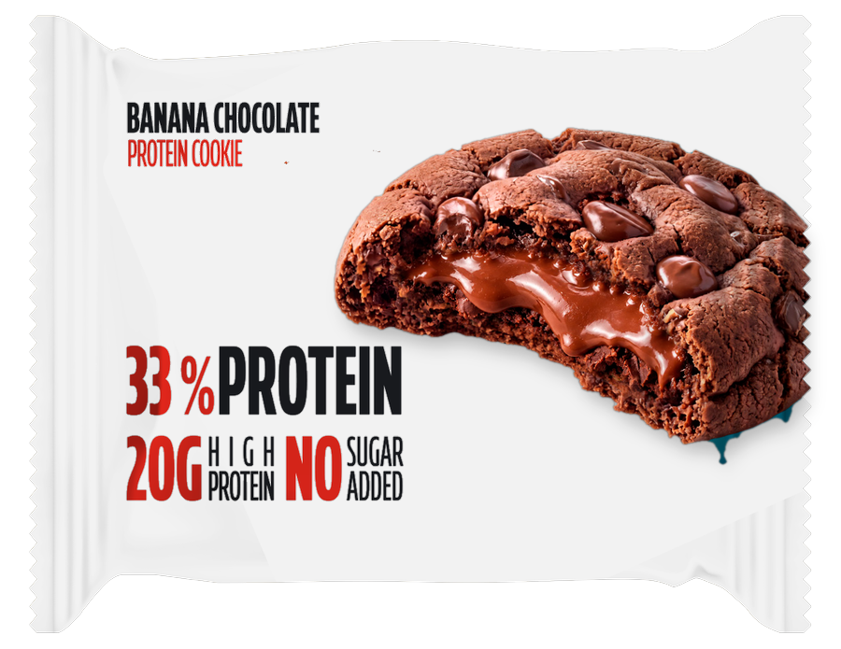
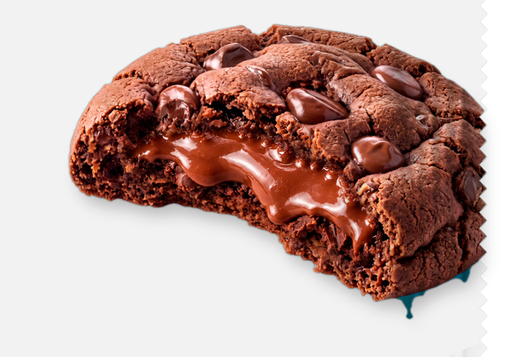



KEY FINDINGS: COMBINED PACK
Highest-lift layers, stacked into one pack
The strongest element in each silo. Where two elements cannot share a pack, the higher coefficient stays and the lower one is replaced or left off.
01
B_Cookie · B01 Cookie Chocolate Filling Right Upper D2D3
+26
02
C_Claim · C05 Claim 33 Protein 20g High Protein No Sugar Added Mid Left D1
+21
03
E_Flavour · E08 Banana Chocolate Top Left Dark Text Panel
+23
04
F_Gluten-free · F04 Gluten Free Blank
+6
Layer lift +76
n=150 respondents. Top-2 Box model (ratings 4–5): element lifts show movement above or below the model baseline.
90

Slide 91
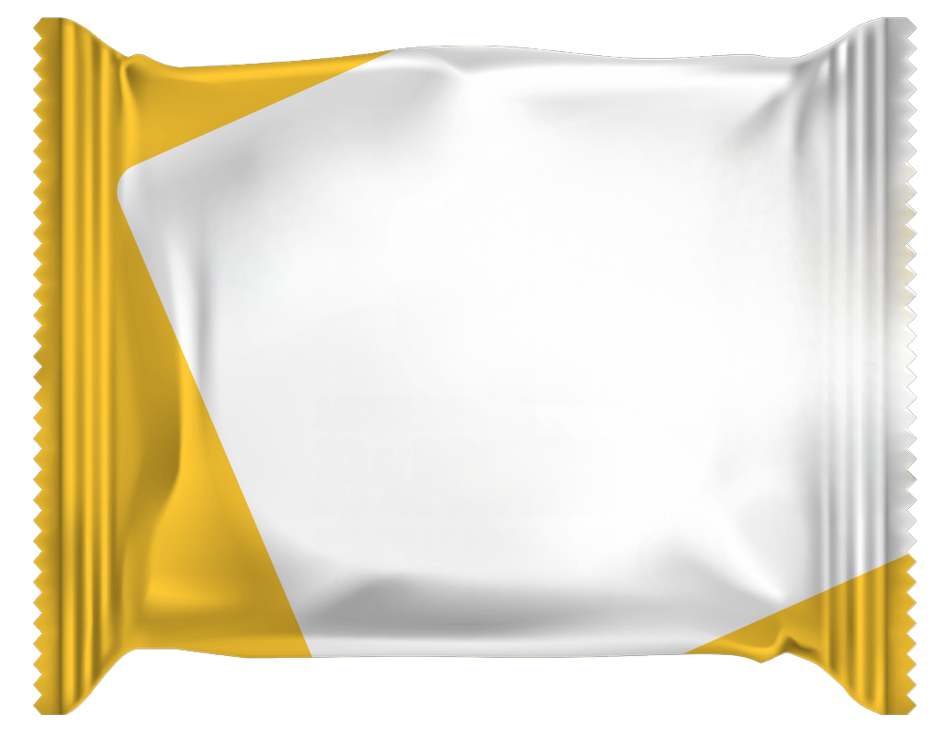
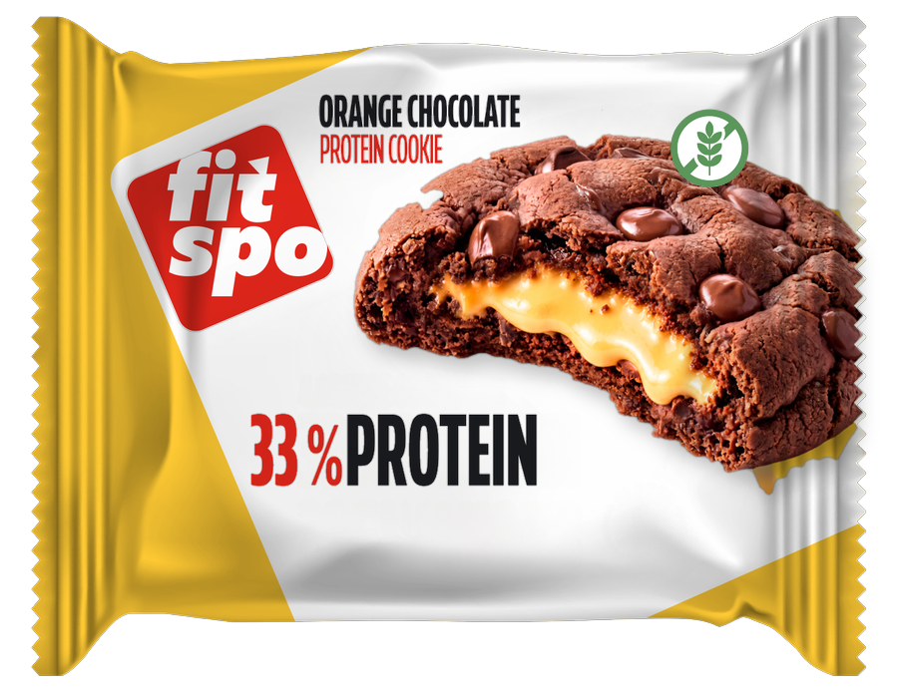
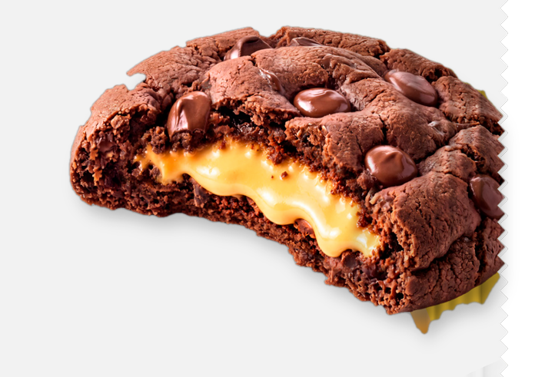


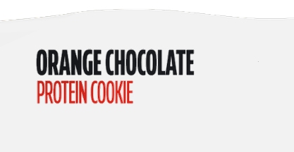

KEY FINDINGS: COMBINED PACK
Lowest-lift layers, stacked into one pack
The weakest element in each silo. Where two elements cannot share a pack, the lower coefficient stays and the higher one is replaced or left off.
01
A_Background · D3 Yellow Wrapper
+13
02
B_Cookie · B03 Cookie Banana Filling Right Upper D2D3
+21
03
C_Claim · C03 Claim 33 Protein Only Bottom Centre D2D3
+12
04
D_Logo · D01 Logo Small Top Left D2
+3
05
E_Flavour · E04 Orange Chocolate Top Centre Dark Text D2D3 Panel
+8
06
F_Gluten-free · F03 Gluten Green Top Right
+4
Layer lift +61
n=150 respondents. Top-2 Box model (ratings 4–5): element lifts show movement above or below the model baseline.
91

Slide 92
KEY FINDINGS: BUILD COMPARISON
The higher-lift build against the lower-lift build
HIGHER-LIFT BUILD
LOWER-LIFT BUILD
+76
+61
Lift only, no separate base
Lift only, no separate base
B_Cookie
B01 Cookie Chocolate Filling Right Upper D2D3
+26
A_Background
D3 Yellow Wrapper
+13
B_Cookie
B03 Cookie Banana Filling Right Upper D2D3
+21
C_Claim
C05 Claim 33 Protein 20g High Protein No Sugar Added Mid Left D1
+21
C_Claim
C03 Claim 33 Protein Only Bottom Centre D2D3
+12
E_Flavour
E08 Banana Chocolate Top Left Dark Text Panel
+23
D_Logo
D01 Logo Small Top Left D2
+3
E_Flavour
E04 Orange Chocolate Top Centre Dark Text D2D3 Panel
+8
F_Gluten-free
F04 Gluten Free Blank
+6
F_Gluten-free
F03 Gluten Green Top Right
+4
The higher-lift build leads by +15 points. This model has no intercept, so the totals are the element lifts. Pairing rules keep the higher coefficient when two elements cannot share a pack.
n=150 respondents. Top-2 Box model (ratings 4–5): element lifts show movement above or below the model baseline.
92

Slide 93
Appendix

Slide 94
APPENDIX · FULL ELEMENT LIFT SUMMARY
Every element, same model
Scores are Top-2 Box coefficients (ratings 4–5), rounded the same way as the charts. Green is lift above the baseline. Red is lift below it. A star means the coefficient cleared the study threshold.
No intercept
6
47
Base appeal
Silos in the tables
Elements scored
n=150 respondents. Top-2 Box model (ratings 4–5): element lifts show movement above or below the model baseline.
94

Slide 95
FULL ELEMENT LIFT SUMMARY
A_Background · 1 of 2
A_BACKGROUND PREFERENCES
+18
+18
+17
+17
+16
+16
+15
+14
+13
0
10
20
30
n=150 respondents. Top-2 Box model (ratings 4–5): element lifts show movement above or below the model baseline.
95

Slide 96
FULL ELEMENT LIFT SUMMARY
A_Background · 2 of 2
A_BACKGROUND PREFERENCES
+13
+13
+10
0
5
10
15
n=150 respondents. Top-2 Box model (ratings 4–5): element lifts show movement above or below the model baseline.
96

Slide 97
FULL ELEMENT LIFT SUMMARY
E_Flavour · 1 of 2
E_FLAVOUR PREFERENCES
+23
+23
+22
+18
+12
+12
+11
+11
+11
0
10
20
30
n=150 respondents. Top-2 Box model (ratings 4–5): element lifts show movement above or below the model baseline.
97

Slide 98
FULL ELEMENT LIFT SUMMARY
E_Flavour · 2 of 2
E_FLAVOUR PREFERENCES
+11
+9
+8
0
5
10
15
n=150 respondents. Top-2 Box model (ratings 4–5): element lifts show movement above or below the model baseline.
98

Slide 99
FULL ELEMENT LIFT SUMMARY
B_Cookie · C_Claim
B_COOKIE PREFERENCES
C_CLAIM PREFERENCES
+26
+23
+23
+21
+22
+17
+22
+21
+16
+20
+14
+17
+12
+16
0
10
20
30
40
0
10
20
30
n=150 respondents. Top-2 Box model (ratings 4–5): element lifts show movement above or below the model baseline.
99

Slide 100
FULL ELEMENT LIFT SUMMARY
D_Logo · F_Gluten-free
D_LOGO PREFERENCES
F_GLUTEN-FREE PREFERENCES
+5
+7
+6
+4
+5
+3
+5
+3
+4
0
2
4
6
0
5
10
n=150 respondents. Top-2 Box model (ratings 4–5): element lifts show movement above or below the model baseline.
100

Slide 101
Element Assets

Slide 102
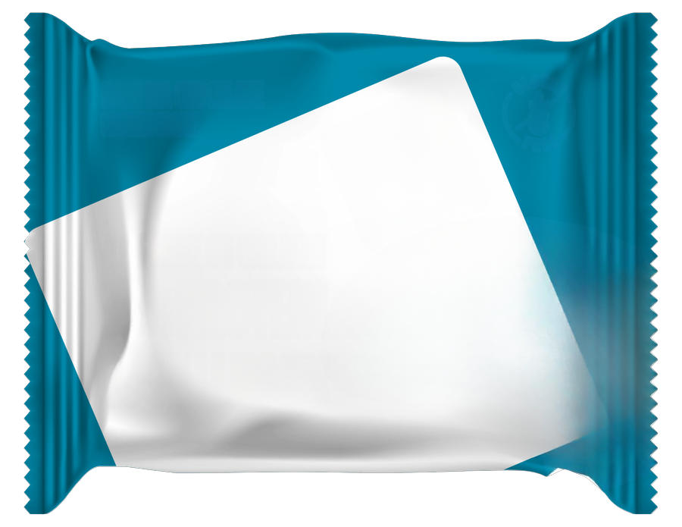
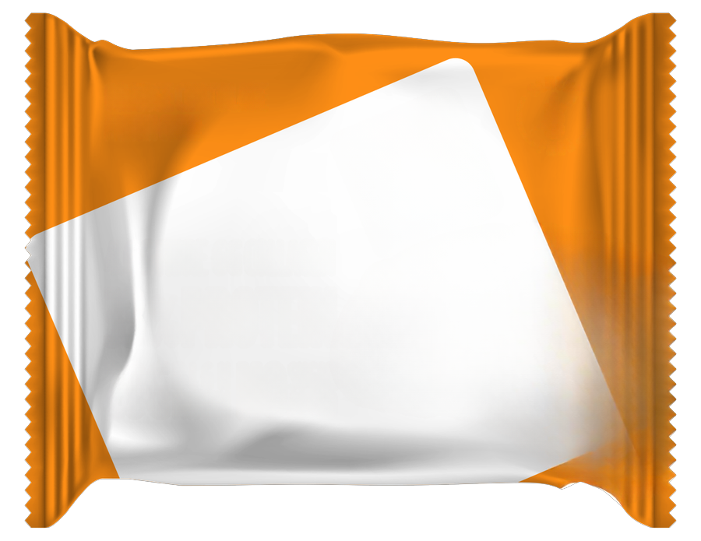

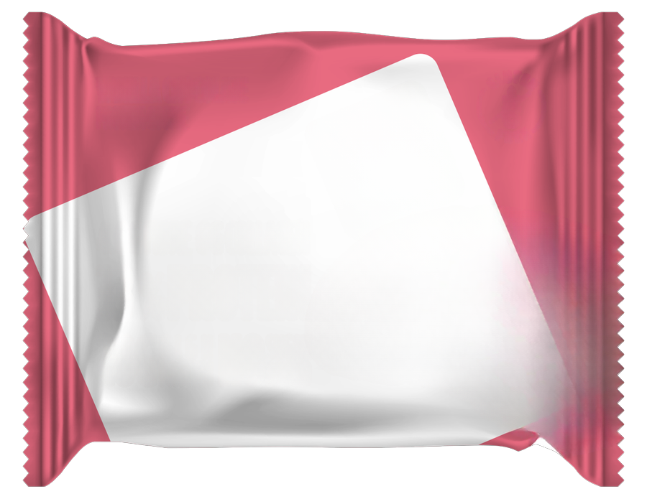
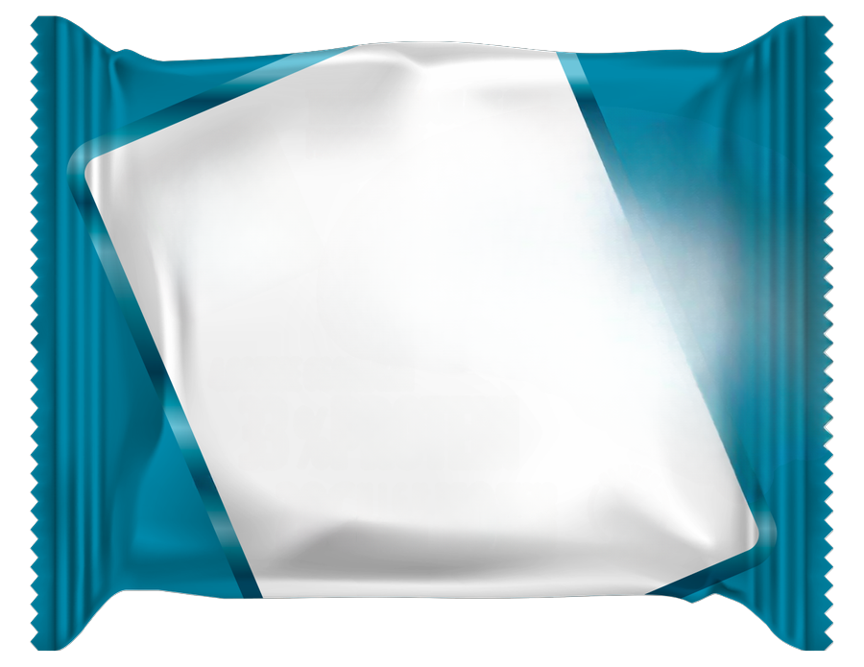
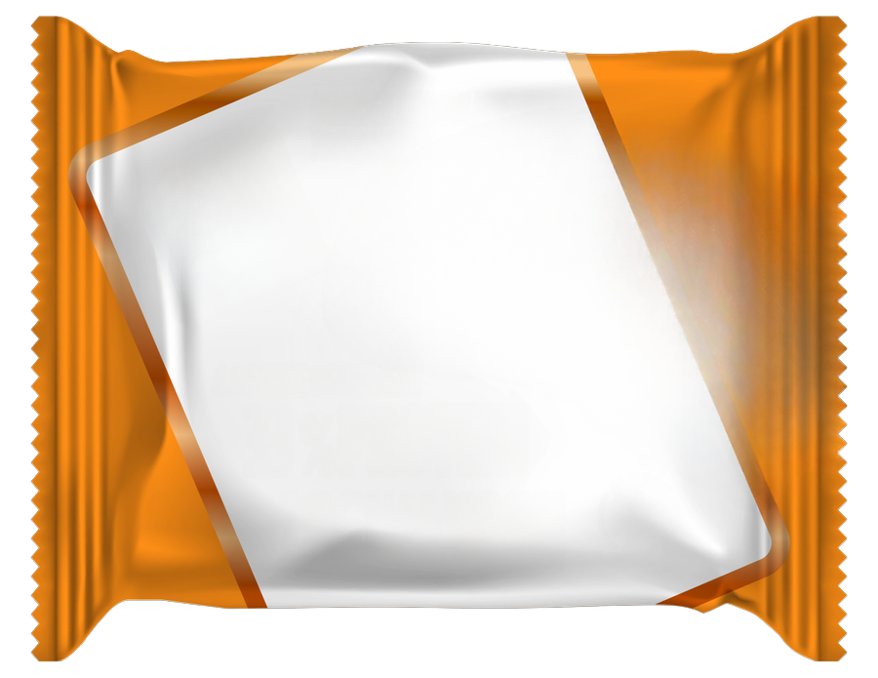

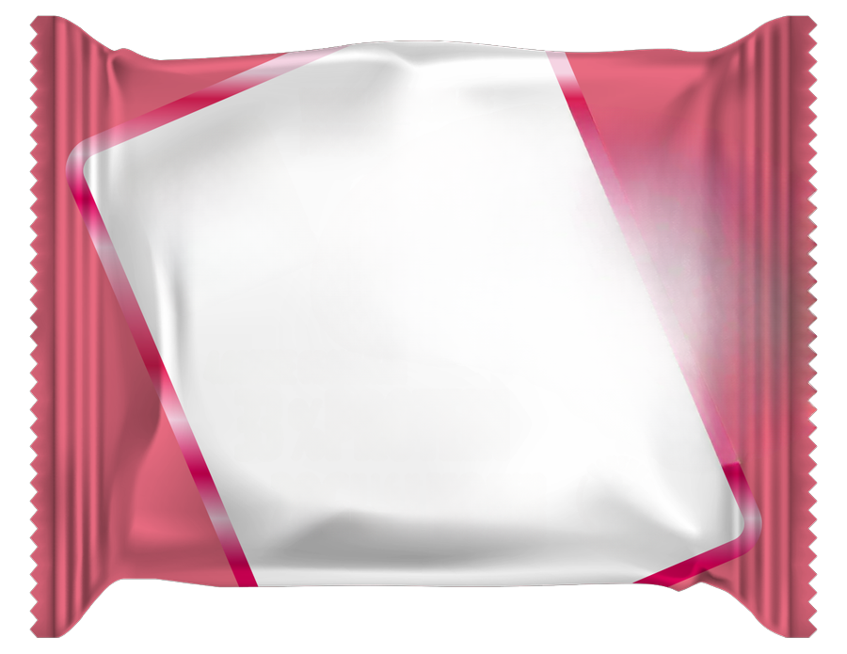
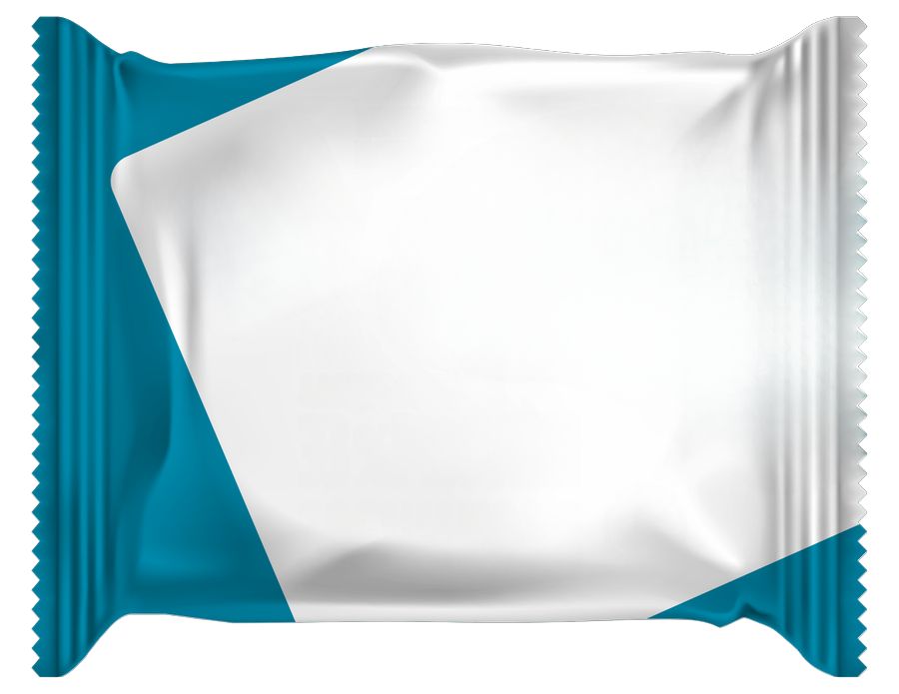
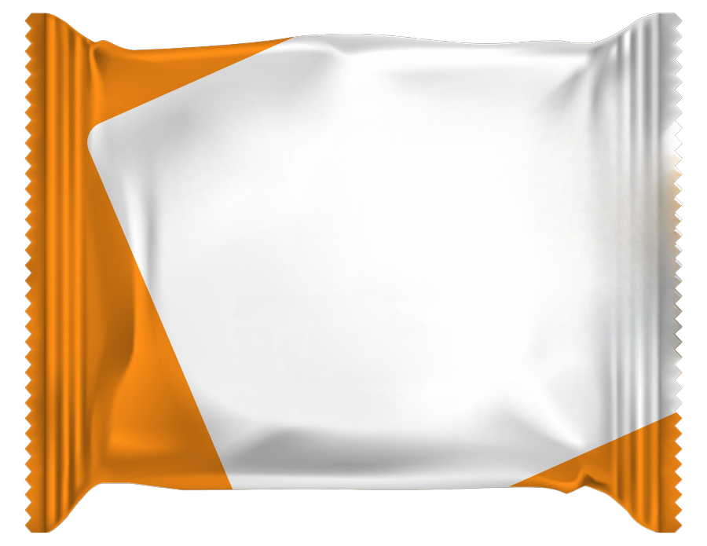
ELEMENT ASSETS
A_Background — element assets · 1 of 2
A · 12 variations
A01 D1 Blue Wrapper
A02 D1 Orange Wrapper
A03 D1 Yellow Wrapper
A04 D1 Pink Wrapper
A05 D2 Blue Wrapper
A06 D2 Orange Wrapper
A07 D2 Yellow Wrapper
A08 D2 Pink Wrapper
A09 D3 Blue Wrapper
D3 Orange Wrapper
n=150 respondents. Top-2 Box model (ratings 4–5): element lifts show movement above or below the model baseline.
102

Slide 103

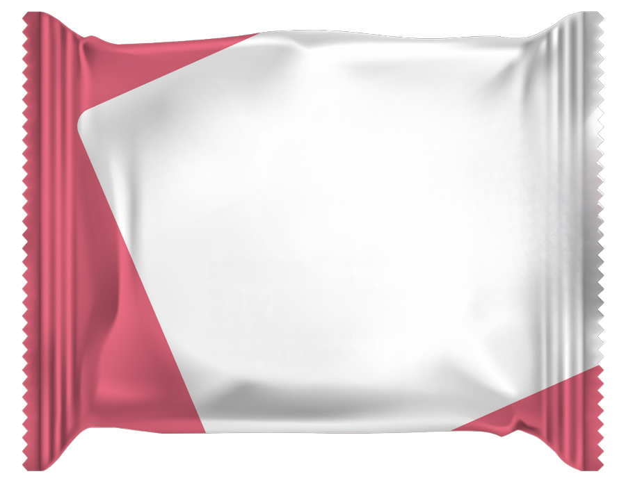
ELEMENT ASSETS
A_Background — element assets · 2 of 2
A · 12 variations
D3 Yellow Wrapper
D3 Pink Wrapper
n=150 respondents. Top-2 Box model (ratings 4–5): element lifts show movement above or below the model baseline.
103

Slide 104








ELEMENT ASSETS
B_Cookie — element assets
B · 8 variations
B01 Cookie Chocolate
Filling Right Upper D2D3
B02 Cookie Orange Filling
Right Upper D2D3
B03 Cookie Banana Filling
Right Upper D2D3
B04 Cookie Vanilla Filling
Right Upper D2D3
B05 Cookie Chocolate
Filling Right Lower D1
B06 Cookie Orange Filling Right
Lower D1
B07 Cookie Banana Filling Right
Lower D1
B08 Cookie Vanilla Filling Right
Lower D1
n=150 respondents. Top-2 Box model (ratings 4–5): element lifts show movement above or below the model baseline.
104

Slide 105
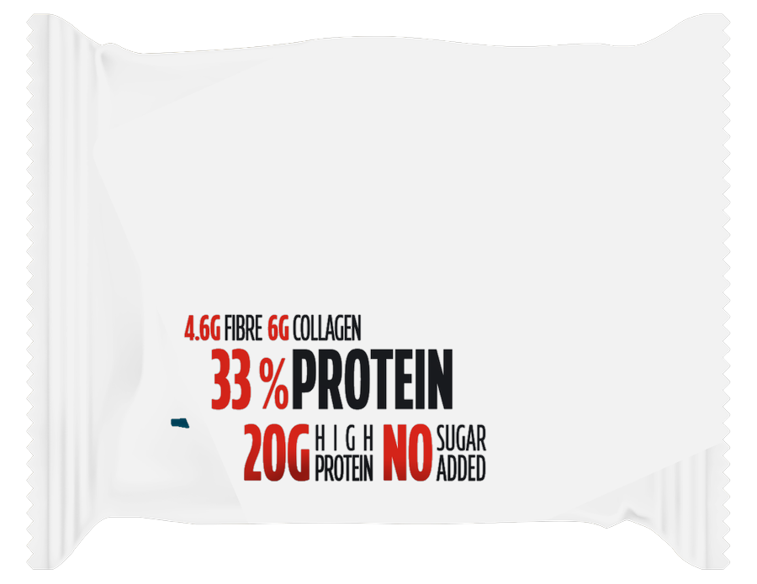
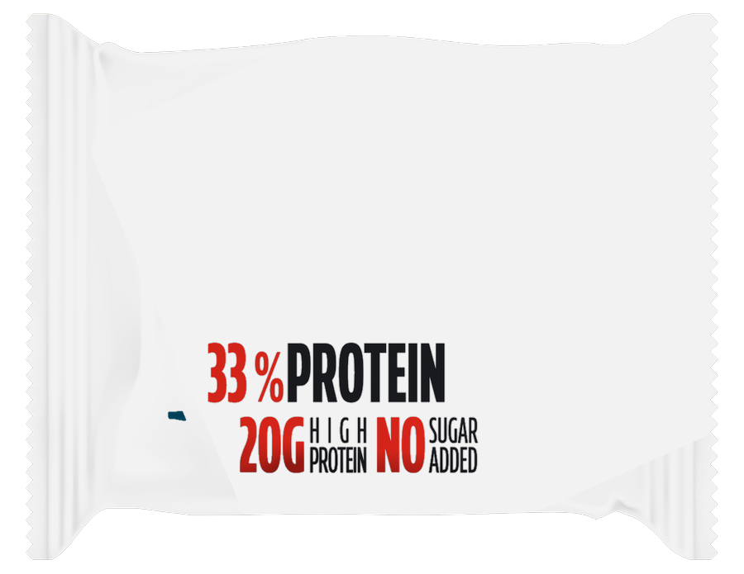
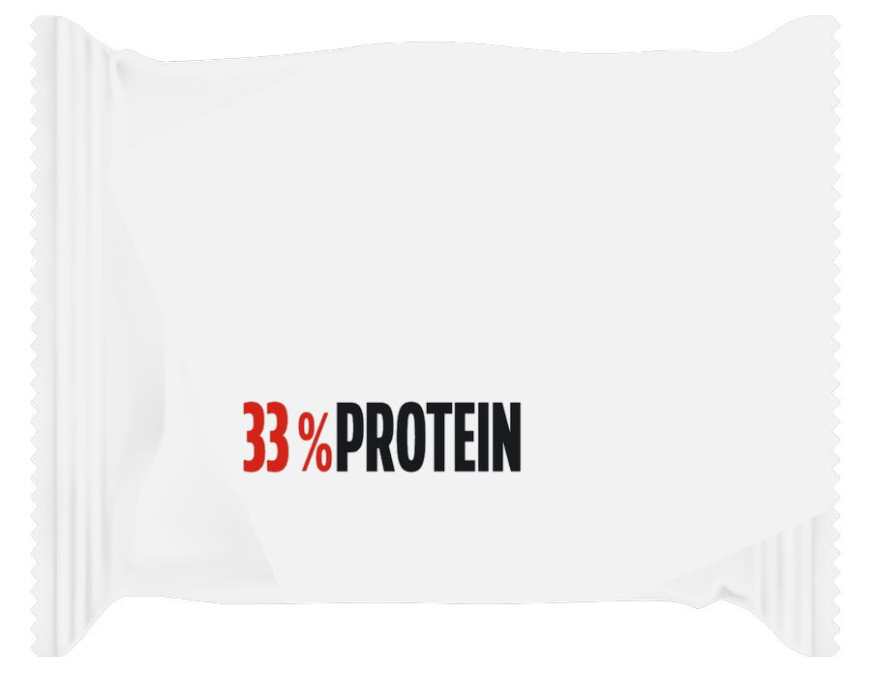
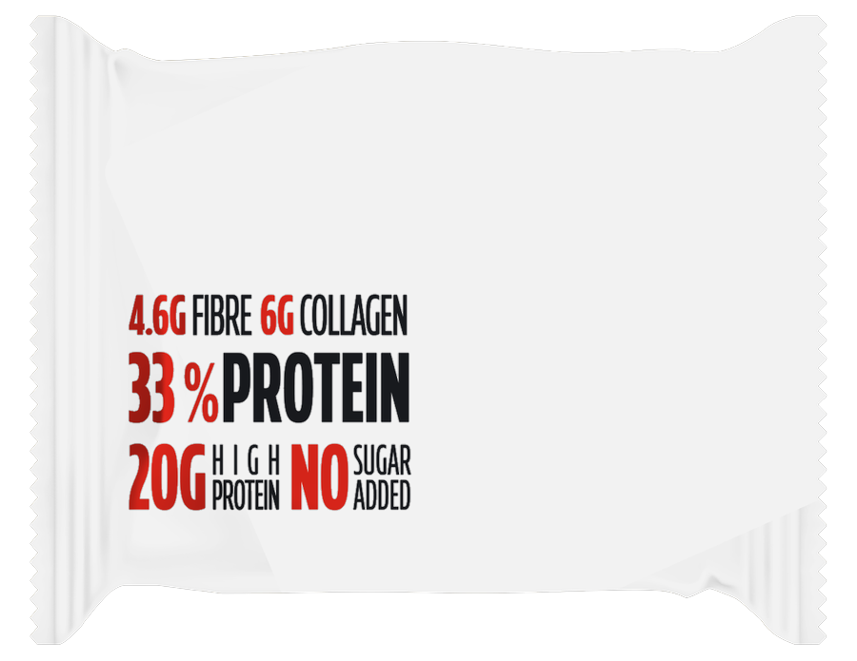
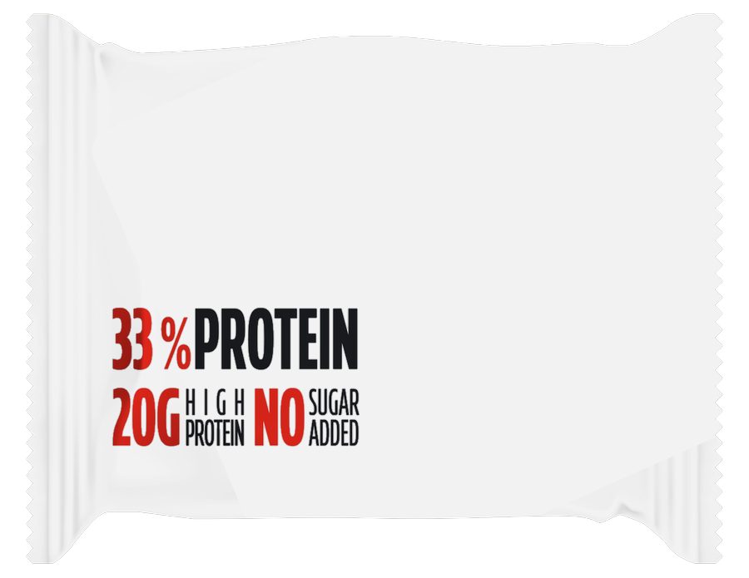
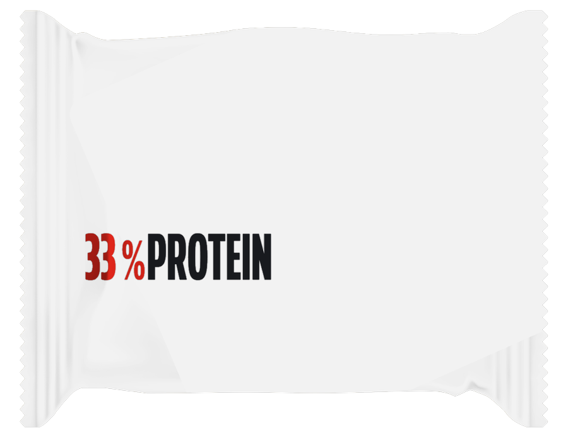
ELEMENT ASSETS
C_Claim — element assets
C · 6 variations
C01 Claim Full Block
Fibrecollagen 33 Protein…
C02 Claim 33 Protein 20g
High Protein No Sugar Added…
C03 Claim 33 Protein Only
Bottom Centre D2D3
C04 Claim Full Block
Fibrecollagen 33 Protein…
C05 Claim 33 Protein 20g
High Protein No Sugar Added…
C06 Claim 33 Protein Only Mid
Left D1
n=150 respondents. Top-2 Box model (ratings 4–5): element lifts show movement above or below the model baseline.
105

Slide 106




ELEMENT ASSETS
D_Logo — element assets
D · 4 variations
D01 Logo Small Top Left D2
D02 Logo Large Top Left D3
D03 Logo Small Upper Centre Right
D1
D04 Logo Large Upper Centre Right
D1 Position
n=150 respondents. Top-2 Box model (ratings 4–5): element lifts show movement above or below the model baseline.
106

Slide 107










ELEMENT ASSETS
E_Flavour — element assets · 1 of 2
E · 12 variations
E01 Tripple Chocolate Chip
Top Centre Dark Text D2D3…
E02 Tripple Chocolate Chip
Top Left Dark Text Panel
E03 Tripple Chocolate Chip
Top Left White Text D1 Foil
E04 Orange Chocolate Top
Centre Dark Text D2D3 Panel
E05 Orange Chocolate Top
Left Dark Text Panel
E06 Orange Chocolate Top
Left White Text D1 Foil
E07 Banana Chocolate Top
Centre Dark Text D2D3 Panel
E08 Banana Chocolate Top
Left Dark Text Panel
E09 Banana Chocolate Top
Left White Text D1 Foil
Vanilla Chocolate Top
Centre Dark Text D2D3 Panel
n=150 respondents. Top-2 Box model (ratings 4–5): element lifts show movement above or below the model baseline.
107

Slide 108


ELEMENT ASSETS
E_Flavour — element assets · 2 of 2
E · 12 variations
Vanilla Chocolate Top Left Dark
Text Panel
Vanilla Chocolate Top Left White
Text D1 Foil
n=150 respondents. Top-2 Box model (ratings 4–5): element lifts show movement above or below the model baseline.
108

Slide 109





ELEMENT ASSETS
F_Gluten-free — element assets
F · 5 variations
F01 Gluten Free Badge Dark
Bottom Right D2D3
F02 Gluten Free Badge White
Top Right D1 Foil
F03 Gluten Green Top Right
F04 Gluten Green Bottom
Right
F04 Gluten Free Blank
n=150 respondents. Top-2 Box model (ratings 4–5): element lifts show movement above or below the model baseline.
109

Slide 110
Thank you
We look forward to discussing the full report and next steps.
Consumer Product Packaging Study Appeal Report | October 2026
Prepared by: J Brown Fitterman | jbrown@mindgenomicsassociates.com
Mind Genomics Associates, Inc
Consumer Product Packaging Study

